Slide 1
Business Process Modelling Model and Notation = BPMN

Slide 2
BPMN
The primary goal of BPMN is to provide a notation that is readily understandable by all business users:
the business analysts that create the initial drafts of the process,
the technical developers responsible for implementing the technology that will perform those process
the business people who will manage and monitor those processes
Thus, BPMN creates a standardized bridge for the gap between the business process design and process implementation
We focus on it since it is the de facto standard notation to model BPs in particular within industrial contexts
2

Slide 3
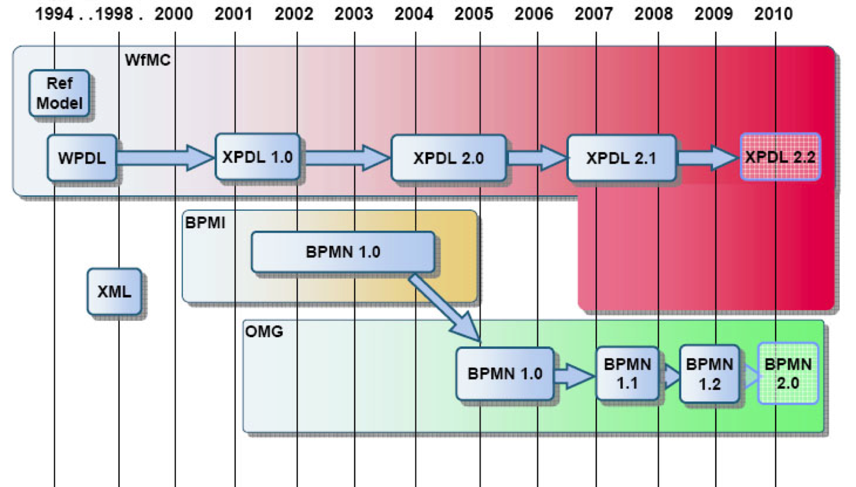
History
The vendors realized immediately there was a need of a graphical representation for the language oriented towards the needs of business users. Not a notation that directly represents the precise execution language under development.
In 2001 BPMI (Business Process Management Initiative) developed BPML as an XML process execution language.
In 2004 BPMN 1.0 was released to the public and in 2006 it was adopted as OMG standard.
In Feb.2008 BPMN 1.1 was released to the public, making the meaning of the notation more explicit.
BPMN 1.2 does not include any significant graphical changes; modifications were merely editorial.
3

Slide 4
BPMN 1.2 vs BPMN 2.0
BPMN 1.2 provides a mapping from a “valid” BPMN diagram to BPEL, such that an engine can execute the process
The 1.2 specification provides only contained verbal descriptions of the graphic notations elements and modeling rules, this leads to misleading and confusions in the translation process
BPMN 2.0 beta 2 was introduced in June 2010
It represents the biggest revision of BPMN since its inception
BPMN 2.0 received a formal definition in the form of a meta-model, that is a precise definition of the constructs and rules needed for creating specific models
4

Slide 5
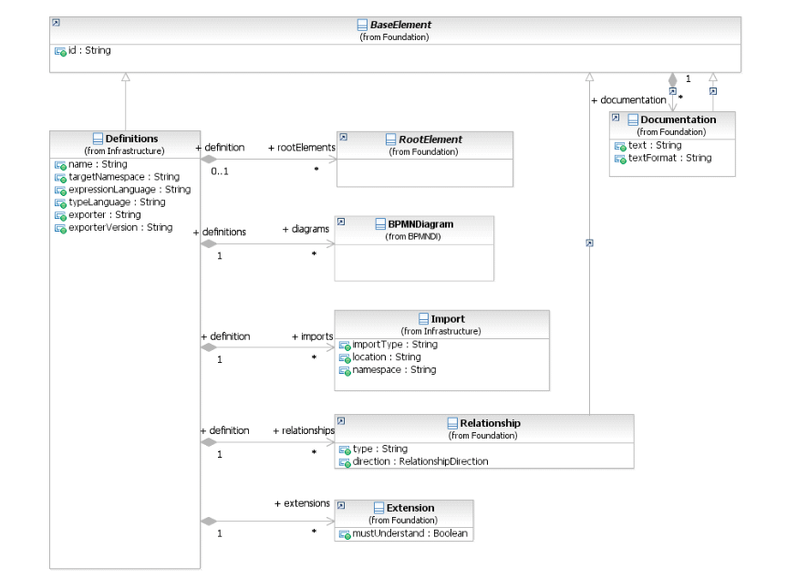
BPMN 2.0 Meta-model
Metamodelling provides a number of benefits:
It formalizes the definition of models and entities
It formalizes the relationship between elements
It enables interoperability
The new version’s specification document has got comprehensive UML class diagram that graphically show the features of the different BPMN constructs and their relationships
5

Slide 6
BPMN 1.2 vs BPMN 2.0
The metamodel also has got additional language constructs that cannot be represented in the graphic models.
Such constructs are required by process engines to capture the necessary additional information for process execution.
Moreover, the metamodel was the basis for the development on an exchange format for BPMN models
Up to now, it was almost impossible to transfer BPMN models from one tool into another.
Some tools have got import and export interfaces for the exchange of BPMN models by means of the XPDL format, but the use of XPDL for this purpose is not widely accepted yet.
Moreover, XPDL has not been implemented uniformly by all vendors, so that in practice there are quite often problems with model exchange
6

Slide 7
BPMN 2.0 (http://www.bpmn.org/)
7

Slide 8
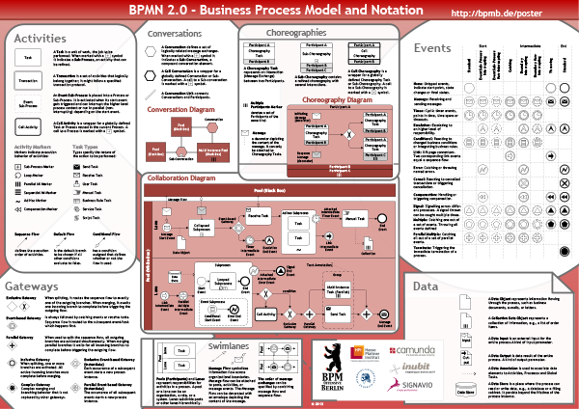
BPMN 2.0 manifesto
8

Slide 9
BPMN 2.0 model types
Processes, including Private (internal) Business Processes and Public Processes
Collaborations, which can include Processes
Choreographies
Enterprise and Business Process Modelling
9

Slide 10
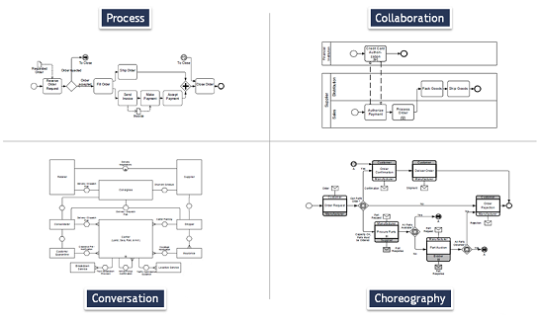
BPMN 2.0 model types
Enterprise and Business Process Modelling
10

Slide 11
Process Diagram
Private Business Processes are those internal to a specific organization.
An executable Process is a Process that has been modeled for the purpose of being executed according to the semantics
A non-executable Process is a private Process that has been modeled for the purpose of documenting Process behavior at a modeler-defined level of detail. Thus, information needed for execution, such as formal condition Expressions are typically not included in a non-executable Process.
11

Slide 12
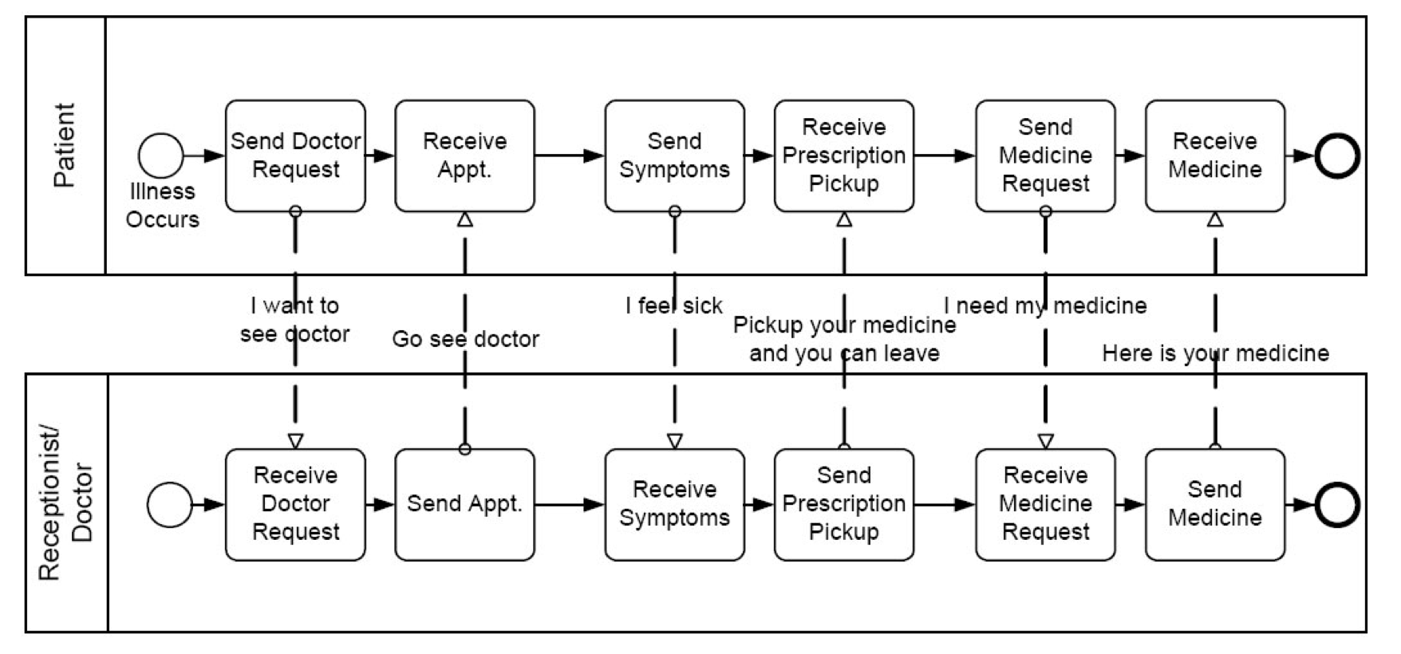
Collaboration Diagram
A Collaboration depicts the interactions between two or more business entities
12

Slide 13
Choreography Diagram
A self-contained Choreography is a definition of the expected behavior, basically a procedural contract, between interacting Participants
While a normal Process exists within a Pool, a Choreography exists between Pools (or Participants)
13

Slide 14
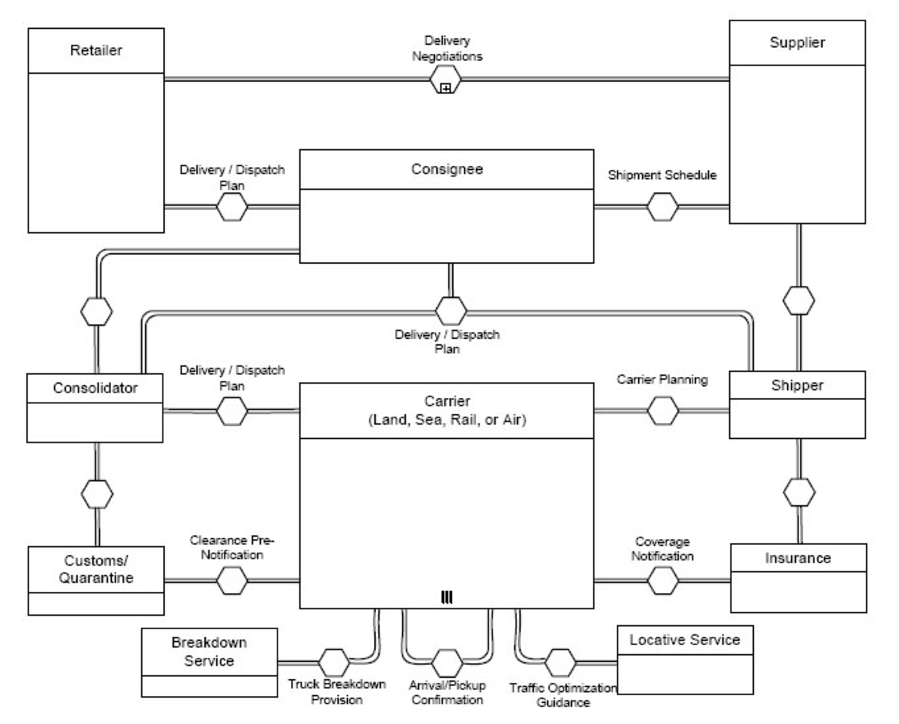
Conversation Diagram
The Conversation diagram is a particular usage of and an informal description of a Collaboration diagram
A Conversation is the logical relation of Message exchanges
14

Slide 15
Let’s focus on Processes and Collaboration Diagrams
15

Slide 16
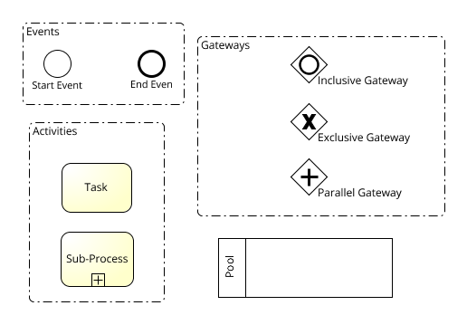
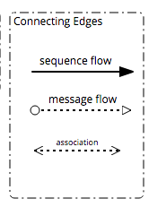
Basic Elements
Used for simple business process modelling, understood by majority of business process related stakeholders
16

Slide 17
Token Generation
Token like a virtual marble, which is generated when a process is called
Token never crosses the message flow to reach the flow of another pool
When a process begins, he start event generates a token
The token migrates to the first activity along with the sequence flow
When a token touch an activity, it is executed
After activity execution, the token goes to the next flow

Slide 18
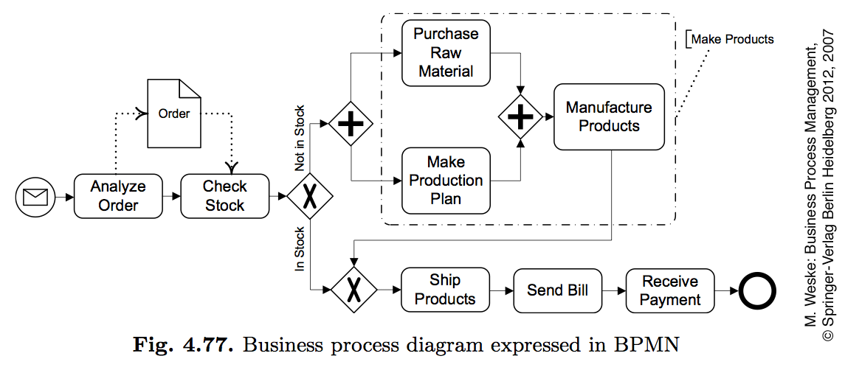
Simple BP model in BPMN
Order
received
Order
processed
18

Slide 19
Resources
BPMN provides two constructs to model resource aspects:
Pools are generally used to model resource classes
Lanes are used to partition a pool into sub-classes or single resources. Lanes can be nested within each other in multiple levels.
There are no constraints as to what specific resource type a pool or a lane should model
We would typically use:
A pool to model a business party like a whole organization
A lane to model a department, unit, team or software system/equipment within that organization
A message flow represents the flow of information between two separate resource classes (pools)
19

Slide 20
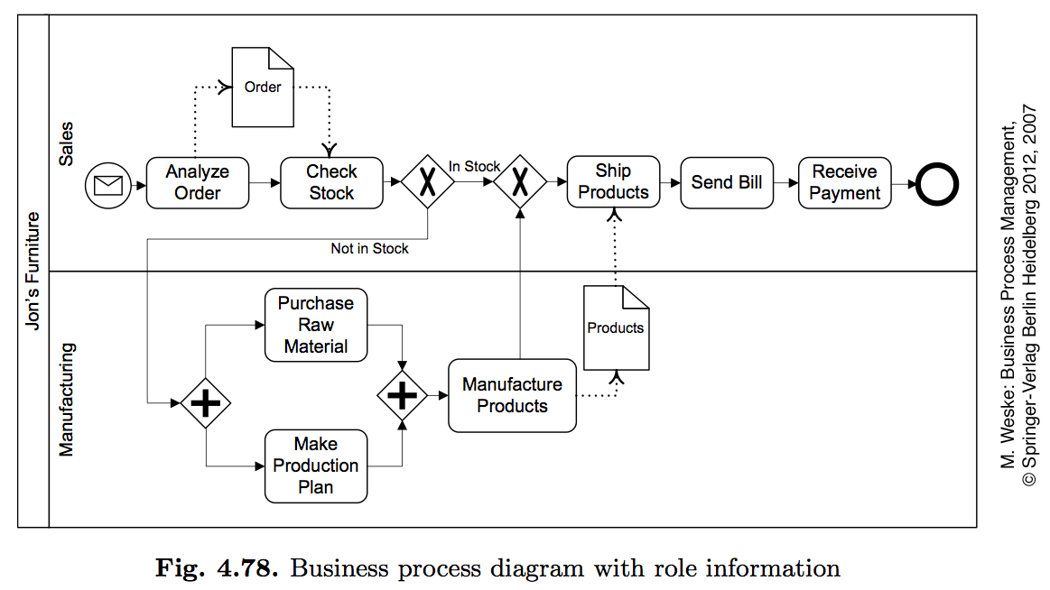
Simple BP model with resources information
20

Slide 21
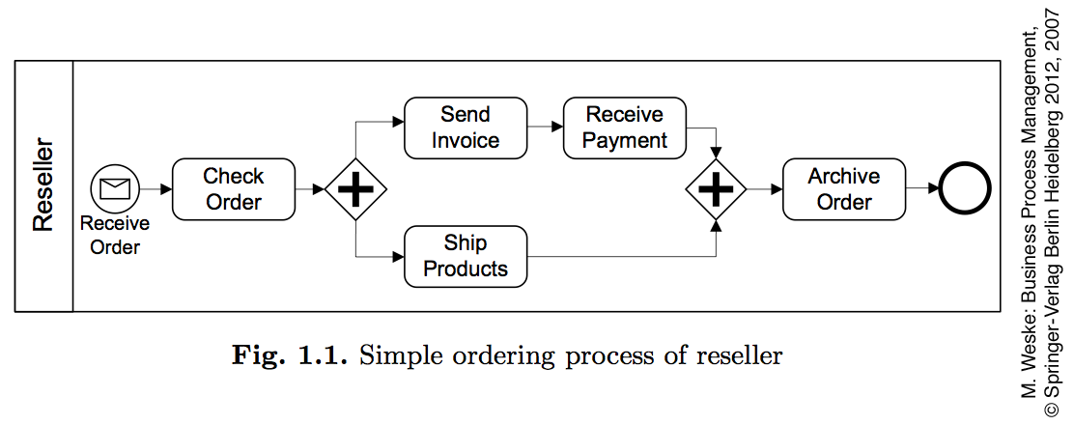
From textual to graphical notation: Reseller
21

Slide 22
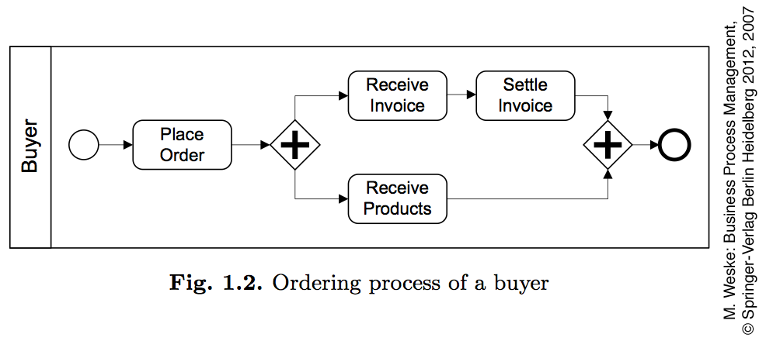
From textual to graphical notation: Buyer
22

Slide 23
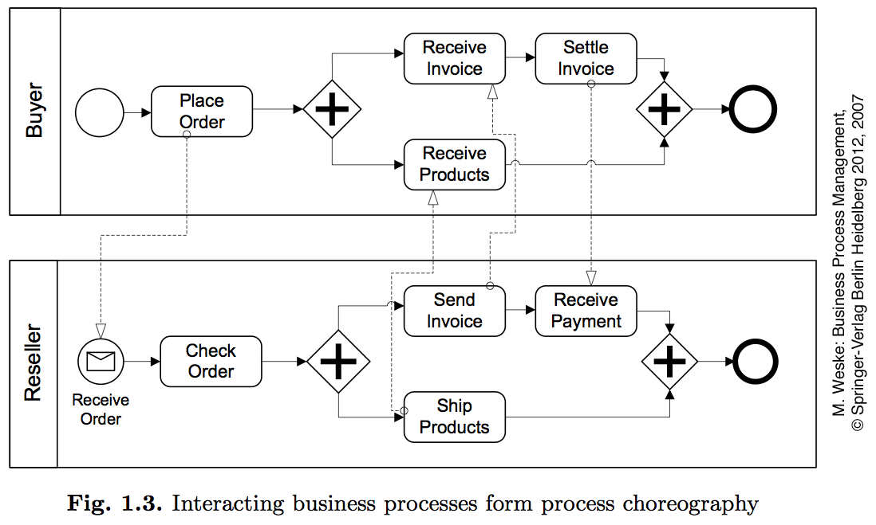
Buyer – Re-seller: Collaboration
23

Slide 24
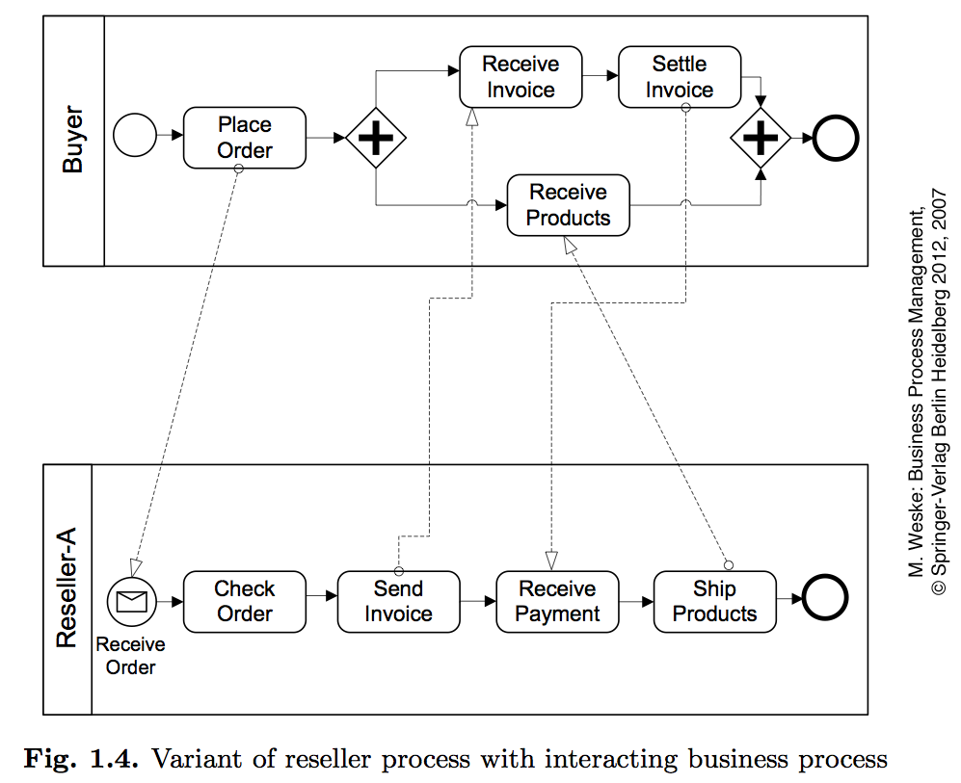
Protecting Reseller from Fraudulent Buyers
24

Slide 25
Black box or white box?
Modeling a pool as a white box or as a black box is a matter of relevance
When working on a collaboration diagram, an organization may decide whether or not to expose their internal behavior depending on the requirements of the project at hand
25

Slide 26
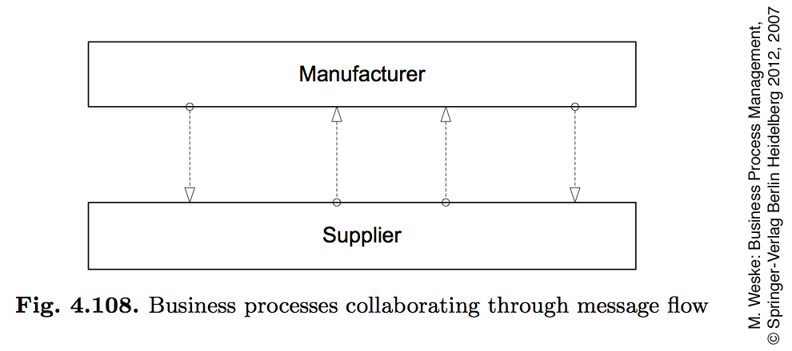
Business Process collaboration – message flow
26

Slide 27
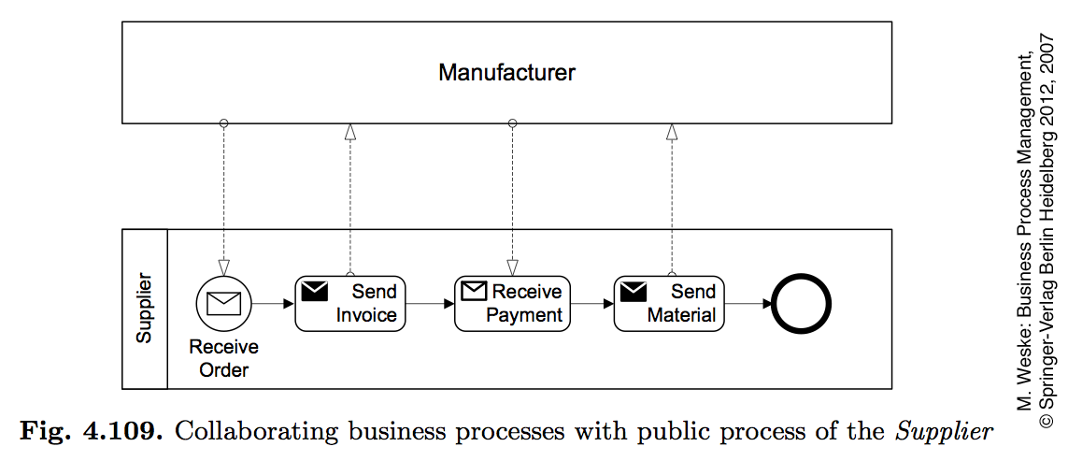
BP collaboration with one public process
27

Slide 28
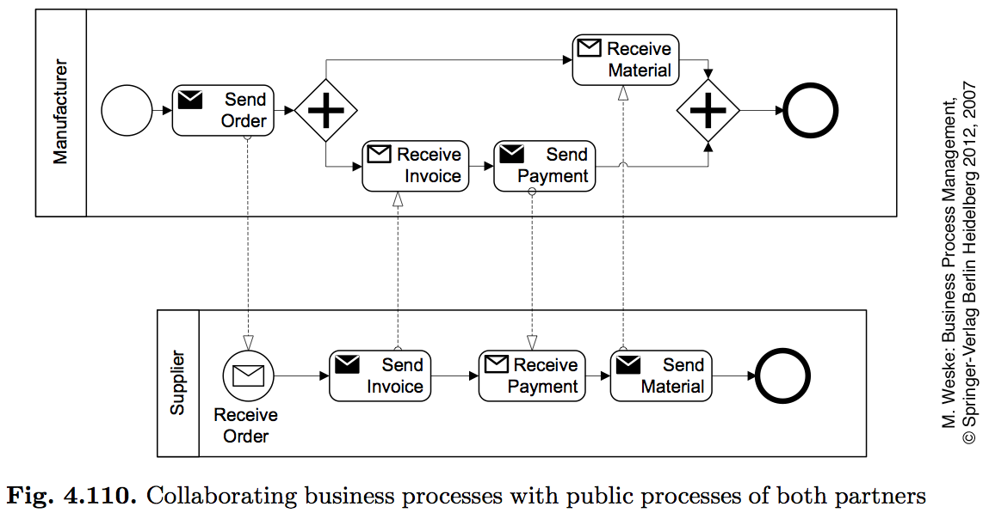
BP collaborating with two public process
28

Slide 29
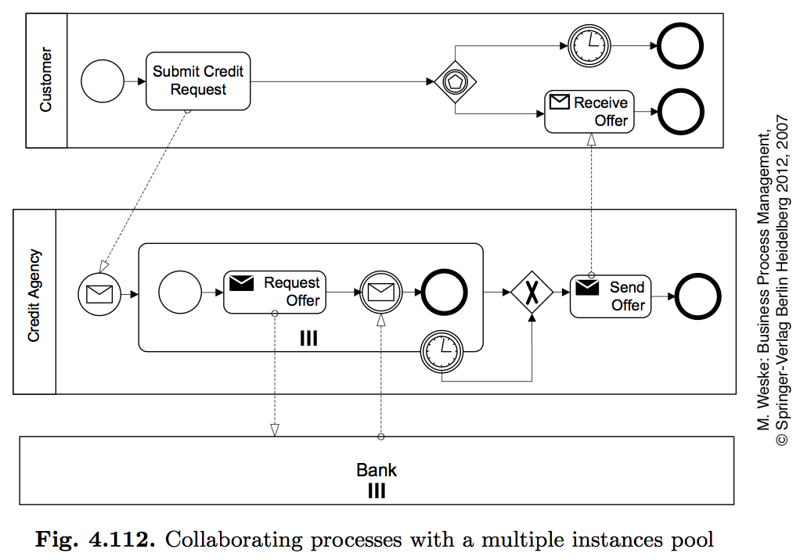
Multiple instance pool
29

Slide 30
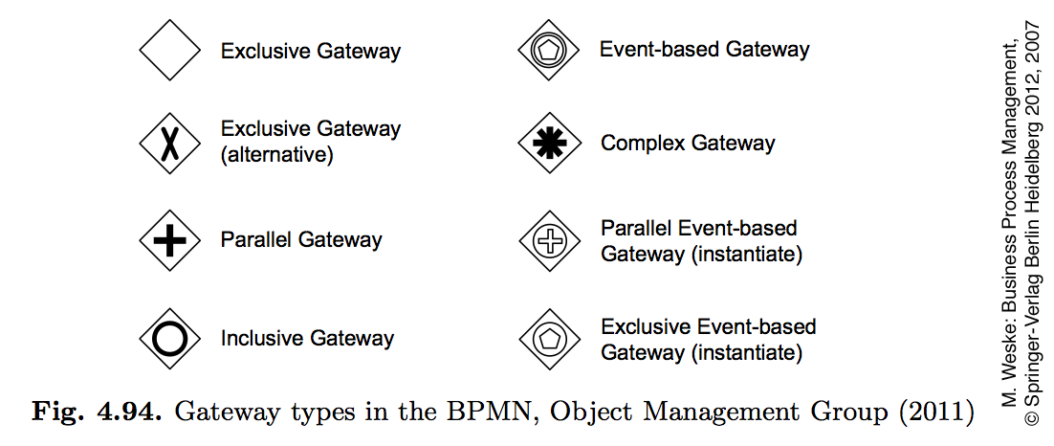
Types of gateways
30

Slide 31
Exclusive Gateways
Indicates locations within a business process where the sequence flow can take two or more alternative paths.
Only one of the paths can be taken.
Depicted by a diamond shape that may contain a marker that is shaped like an “X”.
We use a XOR-join to merge two or more alternative branches that may have previously been forked with a XOR-split.
31

Slide 32
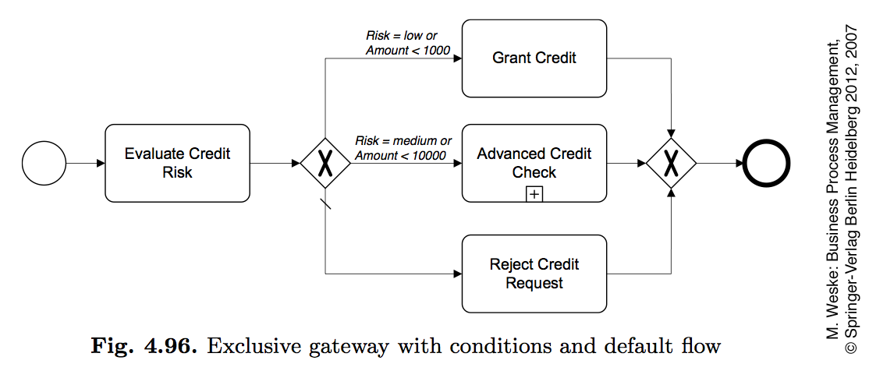
Exclusive gateway with default flow
Exclusive gateways are locations within a process where there are two or more alternative paths.
The criteria for the decision, which the exclusive gateway represents, exist as conditions on each of the outgoing sequence flow.
When a token arrives at an exclusive gateway, there is an immediate evaluation of the conditions that are on the gateway’s outgoing sequence flow. One of those conditions must always evaluate to true.
32

Slide 33
Exclusive gateway with default flow
One way for the modeler to ensure that the process does not get stuck at an exclusive gateway is to use a default condition for one of the outgoing sequence flow.
The default condition can complement a set of standard conditions to provide an automatic escape mechanism in case all the standard conditions evaluate to false.
The default is chosen if all the other sequence flow conditions turn out to be false.
The default condition has the meening of “otherwise” and it can be unlabeled
33

Slide 34
Exclusive gateway with default flow
When a token arrives at the exclusive gateway, there is no evaluation of conditions (on the incoming sequence flow), and immediately moves down the outgoing sequence flow.
The token is passed-through. There is not delay incoming condition evalution or syncronization
34

Slide 35
Exercise
As soon as an invoice is received from a customer, it needs to be checked for mismatches.
The check may result in either of these three options:
there are no mismatches, in which case the invoice is posted;
there are mismatches but these can be corrected, in which case the invoice is re-sent to the customer; and
there are mismatches but these cannot be corrected, in which case the invoice is blocked
Once one of these three activities is performed the invoice is parked and the process completes.
35

Slide 36
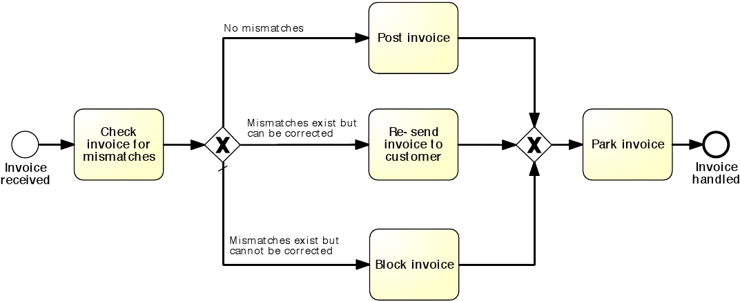
Solution
36

Slide 37
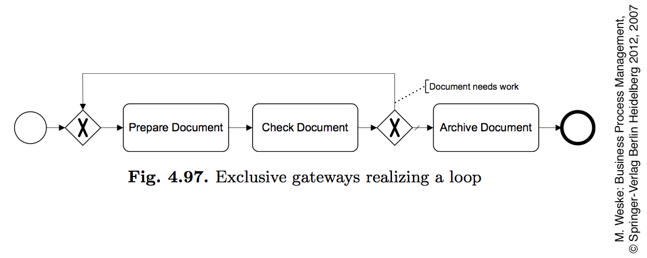
Exclusive gateways realizing a loop
37

Slide 38
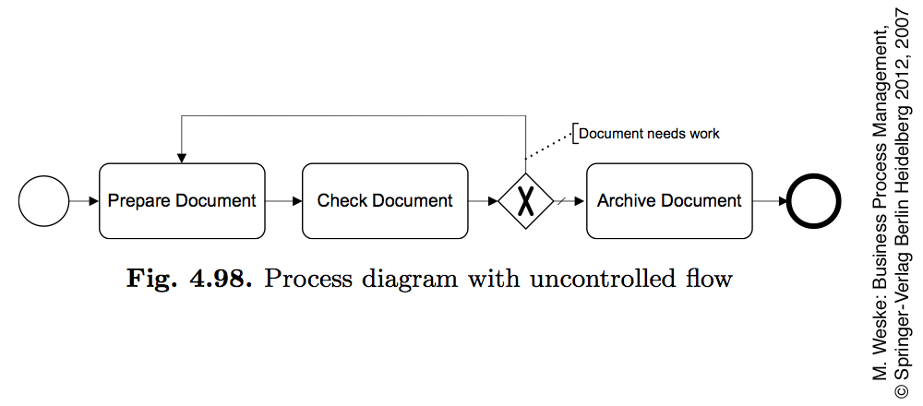
BP with uncontrolled flow
38

Slide 39
Parallel Gateways
Provide a mechanism to synchronize parallel flows (AND-join) and to create parallel flows (AND-split), with activities that can be executed concurrently
Depicted by a diamond shape that must contain a marker that is shaped like a plus sign
39

Slide 40
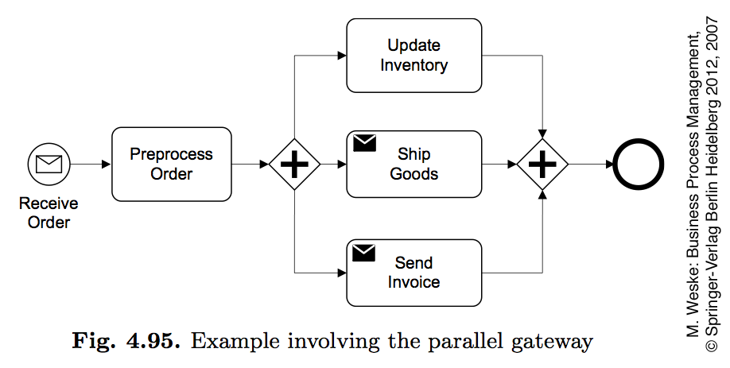
Parallel gateway (Splitting Behaviour)
When a token arrives at a parallel gateway, there is no evaluation of any conditions on the outgoing sequence flow.
The parallel gateway will create parallel paths.
This means that the gateway will create a number of tokens that are equal to the number of outgoing sequence flow. One token moves down each of those outgoing sequence flow.
40

Slide 41
Parallel gateway (Merging Behaviour)
To synchronize the flow, the parallel gateway will wait for a token to arrive from each incoming sequence flow.
When the first token arrives, there is no evaluation of a condition for the incoming sequence flow, but the token is “held” at the gateway and does not continue.
When all the tokens are arrived, then they are merged and one token moves down the outgoing sequence flow.
41

Slide 42
Exercise
Once the boarding pass has been received, passengers proceed to the security check. Here they need to pass the personal security screening and the luggage screening. Afterwards, they can proceed to the departure level.
42

Slide 43
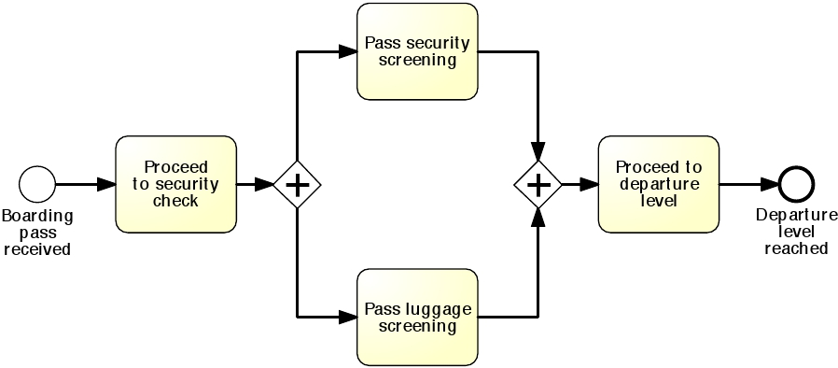
Exercise
43

Slide 44
Gateways Combination
2
1
5
6
3
4
9
7
8
44

Slide 45
Inclusive Gateways
Sometimes we may need to take one or more branches after a decision activity.
To model situations where a decision may lead to one or more options being taken at the same time, we need to use an inclusive (OR) split gateway.
An OR-split is similar to the XOR-split, but the conditions on its outgoing branches do not need to be mutually exclusive, i.e. more than one of them can be true at the same time.
When we encounter an OR-split, we thus take one or more branches depending on which conditions are true.
45

Slide 46
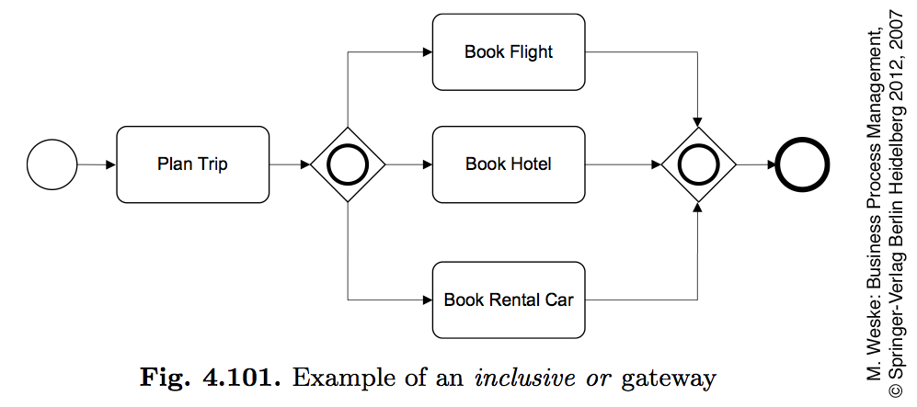
Inclusive or gateway (Splitting Behaviour)
- Inclusive gateways support decisions where more than one outcome is possible at the decision point.
- Inclusive gateway with multiple outgoing sequence flows creates one or more paths based on the conditions on those sequence flow.
- In terms of token semantics, this means that the OR-split takes the input token and generates a number of tokens equivalent to the number of output conditions that are true.
- Every condition that evaluates to true will result in a token moving down that sequence flow.
- At least one of those conditions must evaluate to true.
46

Slide 47
Inclusive or gateway (Merging Behaviour)
- When the first token arrives at the gateway, the gateway will “look” upstream for each of the other incoming sequence flow to see if there is a token that might arrive at a later time.
- Thus, the gateway will hold the first token that arrived in the upper path until the other token from the lower path arrives.
- When all the expected tokens have arrived at the gateway, the process flow is synchronized (the incoming tokens are merged) and then a token moves down the gateway’s outgoing sequence flow.
47

Slide 48
From BPMN 2.0 Specification to Process Execution
The Inclusive Gateway is activated if:
At least one incoming Sequence Flow has at least one token and
For every directed path formed by Sequence Flow that:
starts with a Sequence Flow f of the diagram that has a token,
ends with an incoming Sequence Flow of the inclusive gateway that has no token,
does not visit the Inclusive Gateway.
There is also a directed path formed by Sequence Flow that:
starts with f,
ends with an incoming Sequence Flow of the inclusive gateway that has a token,
does not visit the Inclusive Gateway.
Enterprise and Business Process Modelling
48

Slide 49
EXAMPLE
f
f
incoming Sequence Flow has at least one token
Enterprise and Business Process Modelling
49

Slide 50
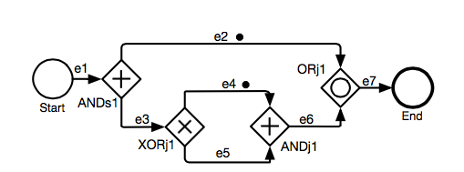
An Example of Deadlock Upstream an OR-Join
incoming Sequence Flow has at least one token
The OR-Join
is blocked
DEADLOCK!
Enterprise and Business Process Modelling
50

Slide 51
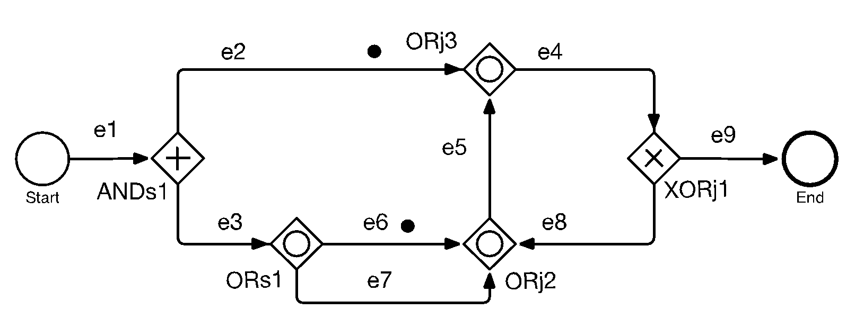
An Example of Vicious Circle
The OR-Join
is blocked
Enterprise and Business Process Modelling
51

Slide 52
Exercise
A company has two warehouses that store different products, one in Amsterdam and another one in Hamburg.
When an order is received, it is distributed across these warehouses: if some of the relevant products are maintained in Amsterdam, a sub-order is sent there; likewise, if some relevant products are maintained in Hamburg, a sub-order is sent there.
Afterwards, the order is registered and the process completes.
52

Slide 53
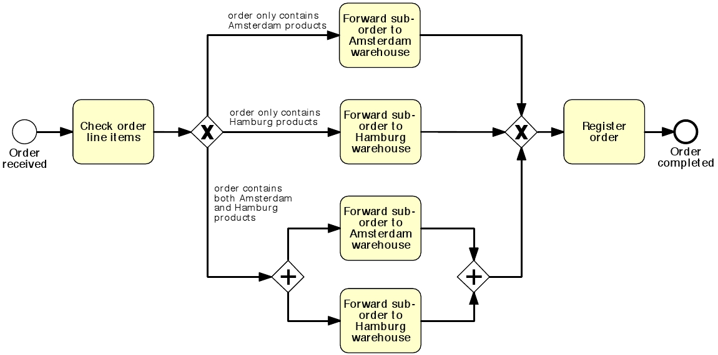
A first solution
53

Slide 54
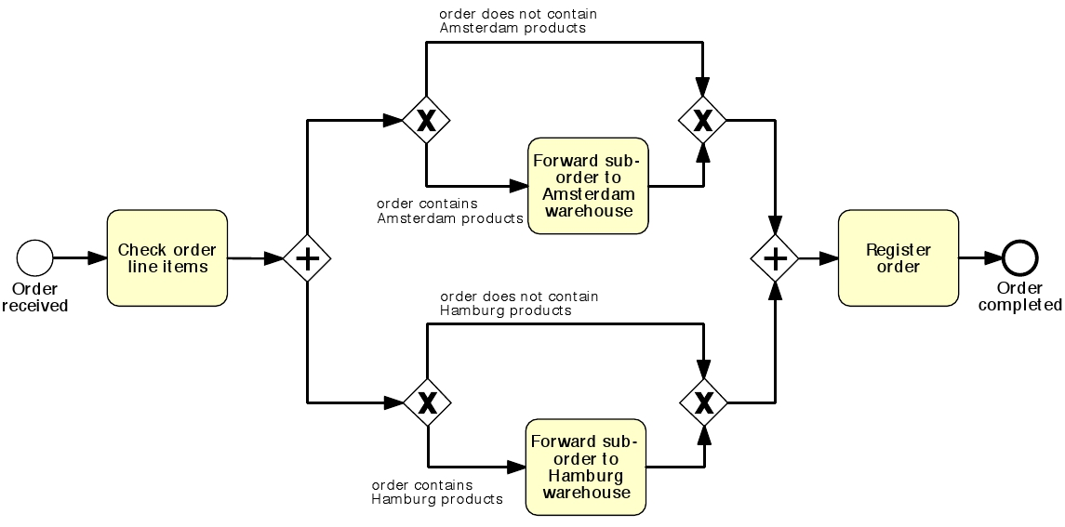
A second solution
54

Slide 55
A third solution with OR gateways
55

Slide 56
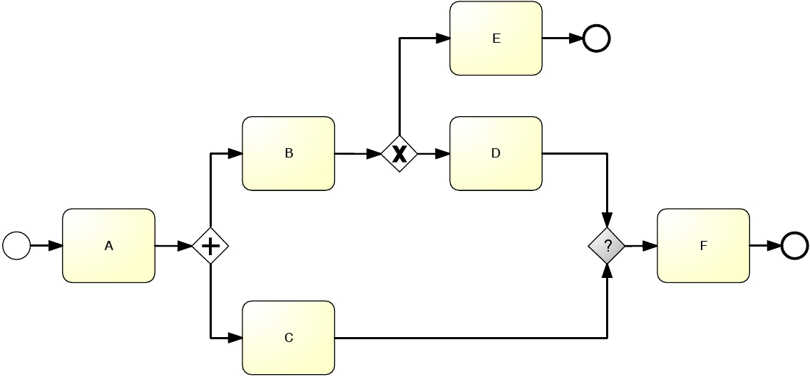
What kind of join should we use?
56

Slide 57
Solution
Since the OR-join semantics is not simple, the presence of this element in a model may confuse the reader.
Thus, we suggest to use it only when it is strictly required.
Clearly, it is easy to see that an OR-join must be used whenever we need to synchronize control from a preceding OR-split. Similarly, we should use an AND-join to synchronize control from a preceding AND-split and an XOR-join to merge a set of branches that are mutually exclusive.
57

Slide 58
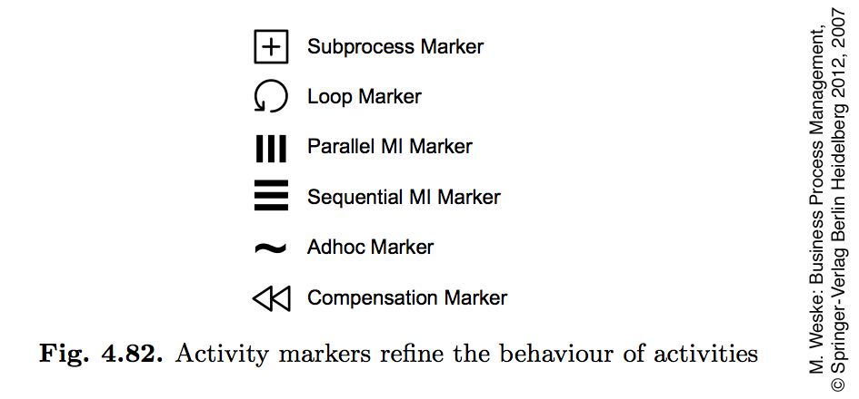
Activity in BPMN
Activity Markers
Task Types
58

Slide 59
Task types
A send task is a task that send a message. Once the message is sent, the task is completes
A receive task is a task that waits to receive a message. Once the message arrives, the task completes
User tasks represent traditional workflow tasks that involve user interaction
Manual activities are performed without the support of software systems.
A Business Rule task is used to synchronously execute one or more rules.
A service task is a task that is implemented by a piece of software, either using a Web services interface or an application programming interface to a software system.
A script task is a task that uses some scripting language expression in order to be performed. Script tasks are used to represent simple functionality, for which no dedicated software system is required.
59

Slide 60
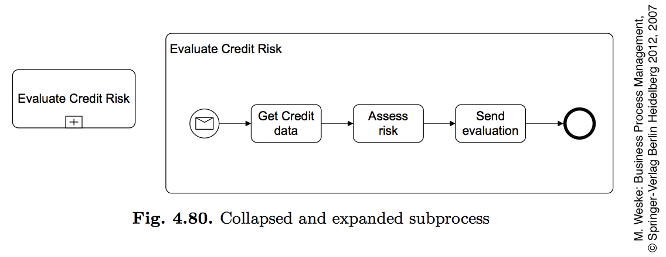
Collapsed and expanded sub-process
A Task is an atomic activity within a process flow
A Sub-Process is a compound activity that represents a collection of other task and sub-processes
60

Slide 61
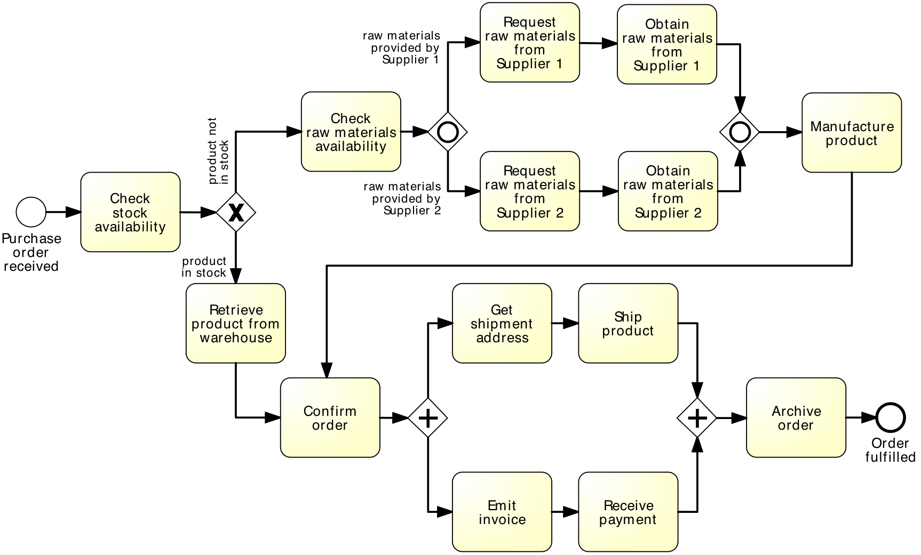
Anything wrong with this model?

Slide 62
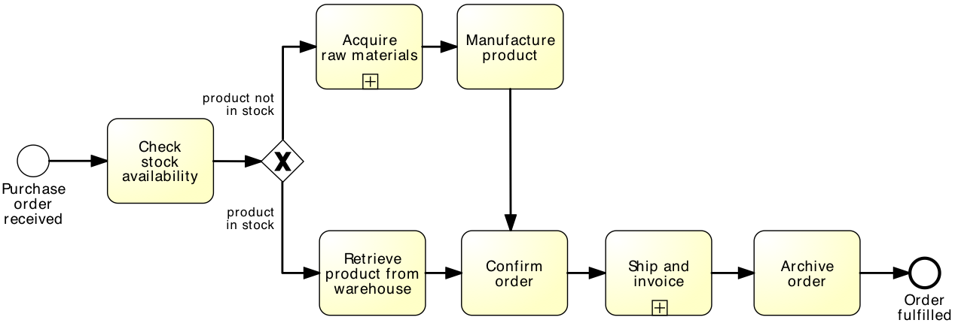
Is this better?

Slide 63
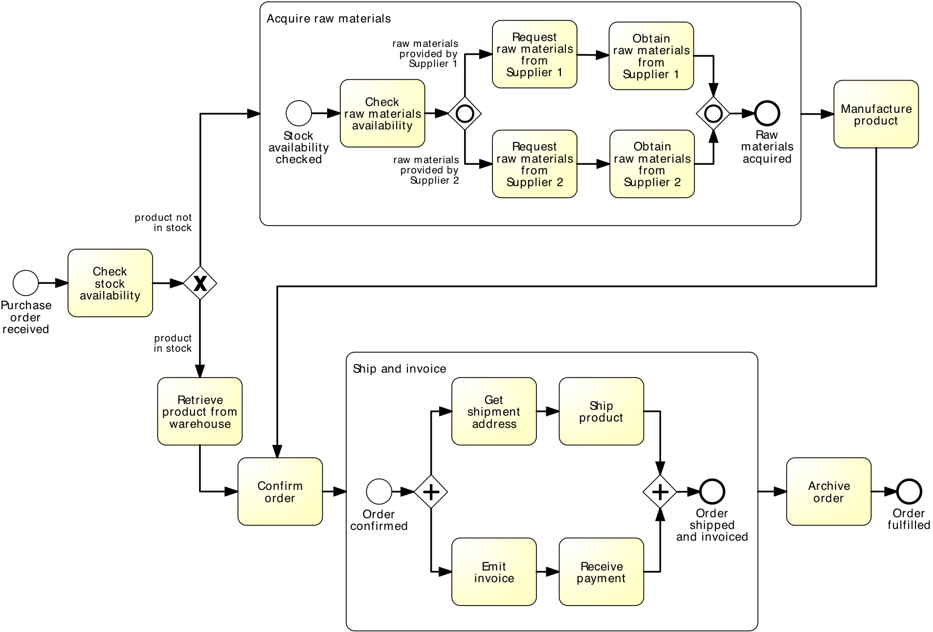
Expanded…

Slide 64
Use of Sub-processes
Break down large models into smaller ones, making them easier to understand and maintain
Share common fragments across multiple processes
Identify parts of a process that should be repeated

Slide 65
Process hierarchies
Process hierarchies: we can nest sub-processes in multiple levels, so as to decompose a process model hierarchically
65

Slide 66
Call Activity
Activity defined in a process that is external to the current process definition
Call Activity is a point in the process where a global processor
It allows you to create a reusable process definition that can be reused in multiple other process definitions

Slide 67
Call Activity: reusability and maintenance
Our default choice should be to define sub-processes as global process models so as to maximize their reusability within our process model collection
Supporting processes such as payment, invoicing, HR, printing, are good candidates for being defined as global process models, since they are typically shared by various business processes within an organization
Besides reusability, another advantage of using global process models is that any change made to these models will be automatically propagated to all process models that invoke them
67

Slide 68
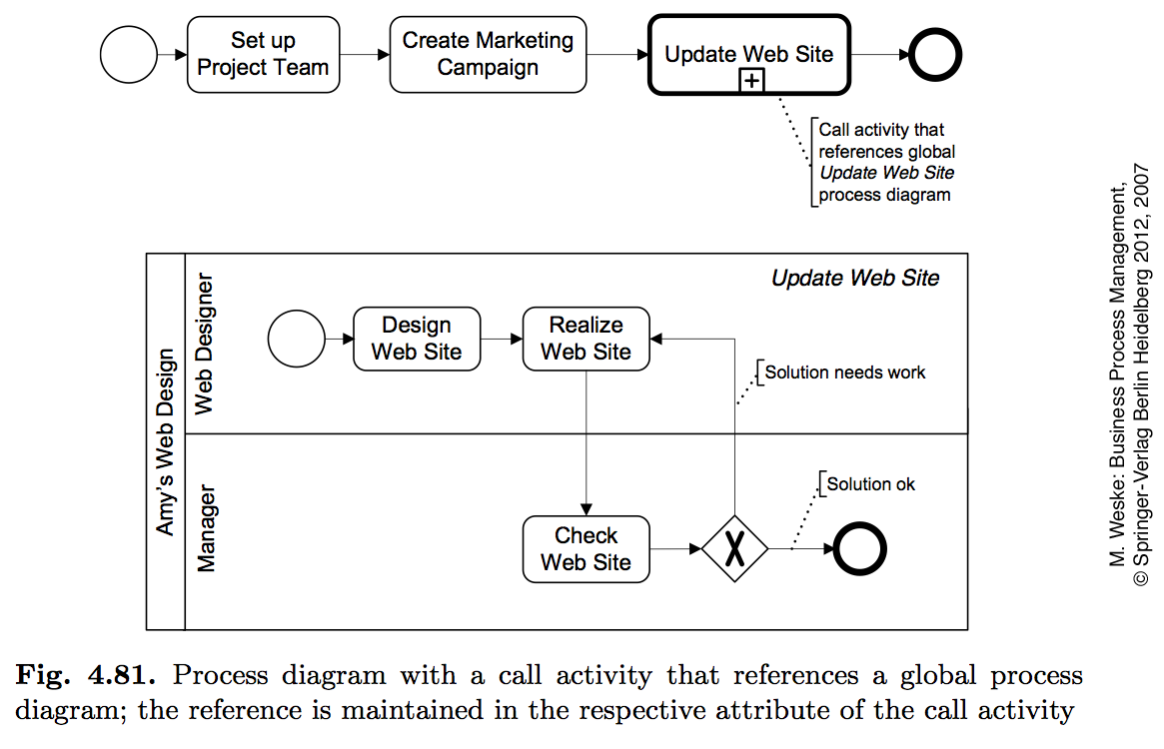
Share common fragments across multiple processes: Call Activity
The call activity refers to a process model that can be invoked by more than one process
In the same process model collection
68

Slide 69
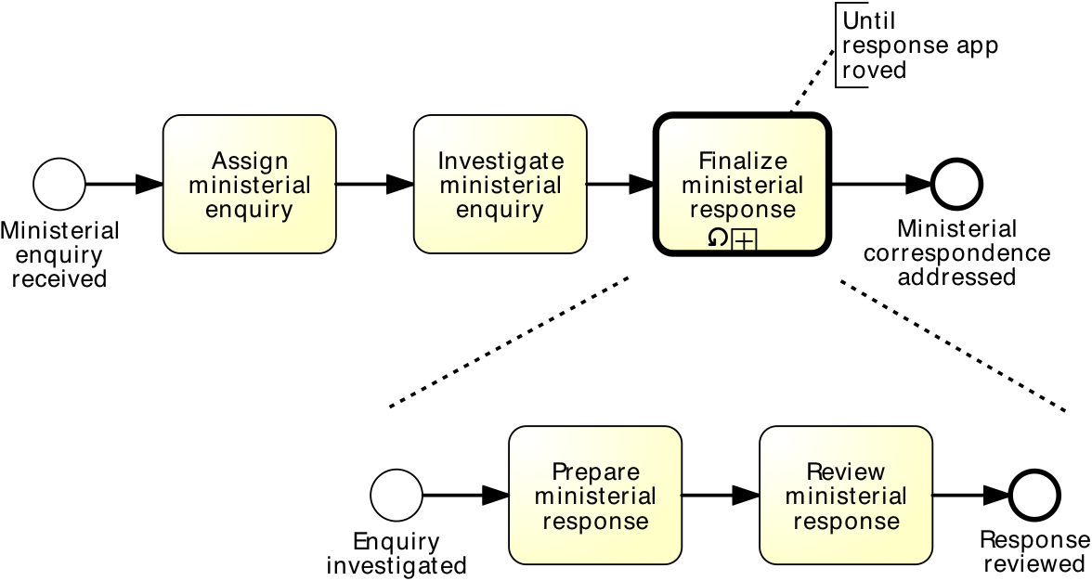
Identify parts of a process that should be repeated
equivalent to:

Slide 70
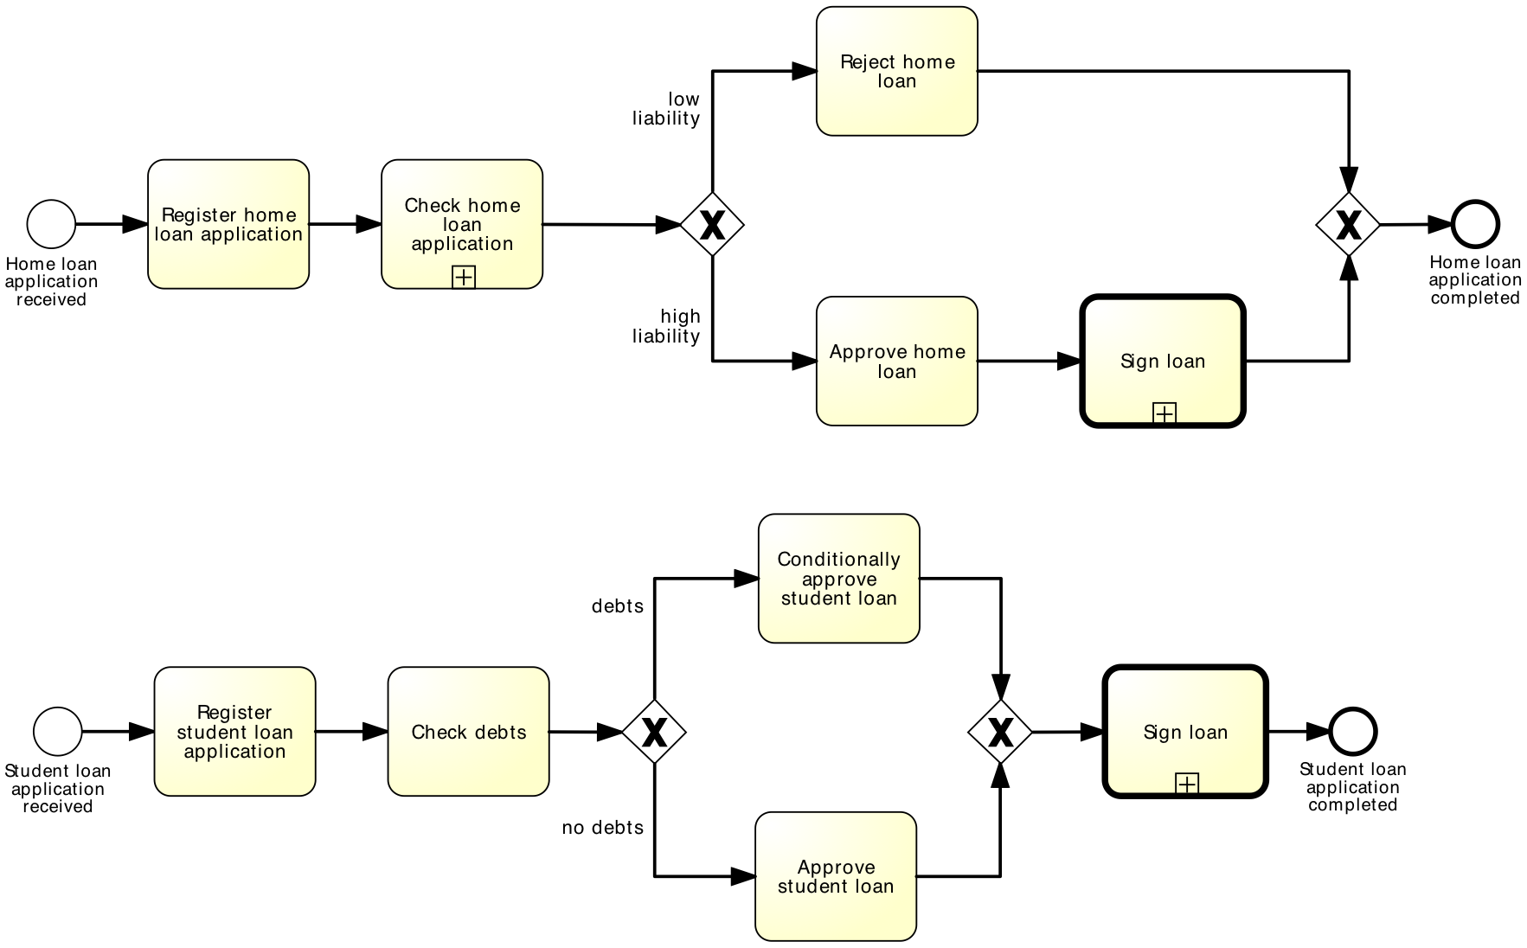
Share common fragments across multiple processes: example

Slide 71
More On the Loop
71

Slide 72
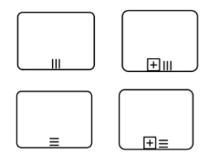
Multi-Instance Activity
Multi-instance activity can run with other identical activities simultaneously
Multi-instance marker will cause the activity to be executed multiple times at run-time
The instance may executed in parallel or sequential

Slide 73
Multi Instance Vs. Loop Activity
Use Loop when:
Loops for as long as the underlying looping condition is true
Condition must be evaluated for every loop iteration (in beginning or end of iteration)
→ While (condition)
Use multi-instance when:
Activity is performed may times with different data sets
For example: when a company’s manager receives reports from his employees he or she will need to evaluate them many times, each time with different data
→ Foreach (x in array of instants)

Slide 74
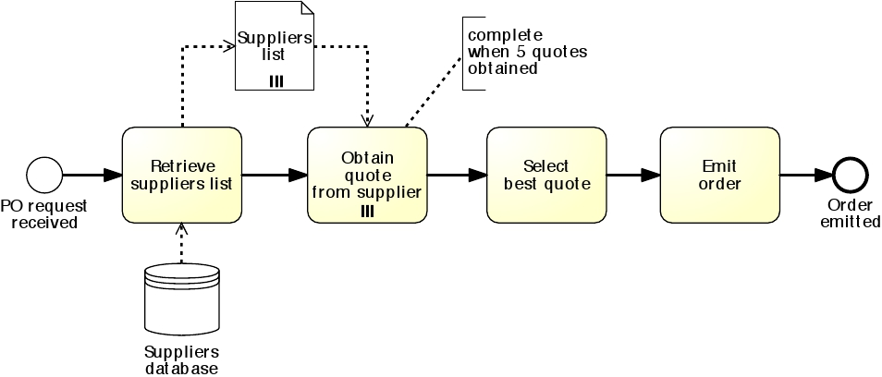
Use of Multiple-Instance Activity (in parallel)
Use of Multiple-Instance Activity
(in sequence)
74

Slide 75
Exercise - Model the following process fragment
After a car accident, a statement is sought from two witnesses out of the five that were present, in order to lodge the insurance claim.
As soon as the first two statements are received, the claim can be lodged with the insurance company without waiting for the other statements.
75

Slide 76
Solution
76

Slide 77
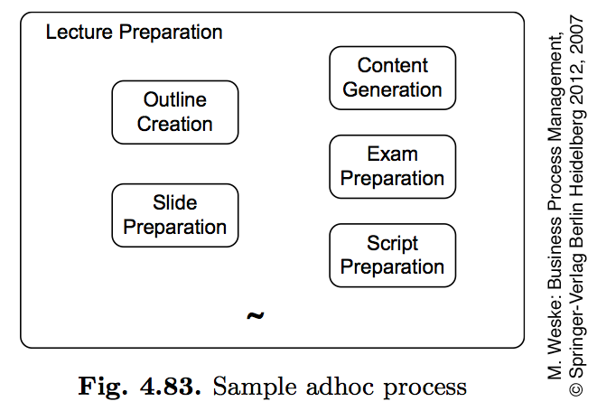
Uncontrolled Repetition: Sample ad-hoc process
Sometimes we may need to model that one or more activities can be repeated a number of times, without a specific order, until a condition is met.
These activities are uncontrolled, in the sense that they may be repeated multiple times with no specific order, or not occur at all, until a condition is met—in our case the order being fulfilled.
A partial order may be established among the activities of an ad-hoc sub-process via the sequence flow. However, we cannot represent start and end events in an ad- hoc sub-process.
77

Slide 78
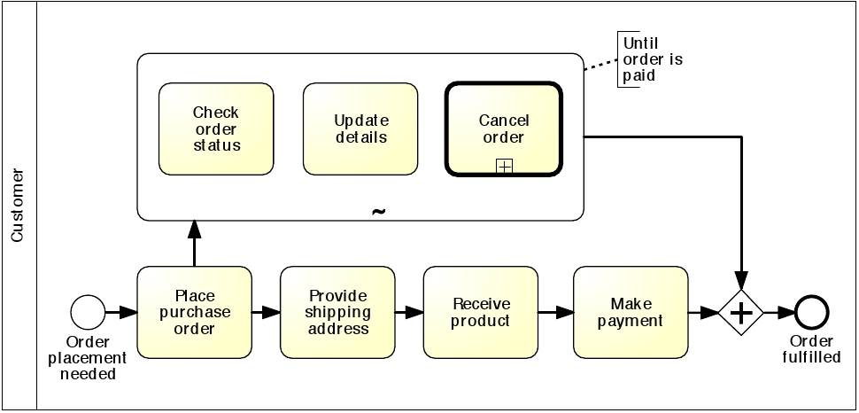
Using an ad-hoc sub-process to model uncontrolled repetition: example
78

Slide 79
Exercise - Model the following process snippet
Un tipico processo di reclutamento dell'esercito inizia selezionando un elenco di tutte le candidature dei candidati. Quelli selezionati vengono quindi chiamati per sostenere i seguenti test:
droga e alcool, occhi, visione dei colori, udito, sangue, urine, peso, impronte digitali ed esame medico. La visione dei colori può essere eseguita solo dopo l'esame degli occhi, mentre l'esame medico può essere effettuato solo dopo aver esaminato la visione dei colori, l'udito, il sangue, l'urina e il peso. Inoltre, potrebbe essere necessario che alcuni candidati ripetano più volte alcuni di questi test per ottenere una valutazione corretta, ad es. potrebbe essere necessario ripetere l'esame del sangue se il candidato ha assunto troppo zucchero nelle precedenti 24 ore. Ai candidati che superano tutti i test viene chiesto di sostenere un esame mentale e un esame fisico, seguito da un colloquio. Solo quelli che superano questi due esami e si comportano bene nell'intervista possono essere reclutati nell'esercito.
79
Notes:
Un tipico processo di reclutamento dell'esercito inizia selezionando un elenco di tutte le candidature dei candidati. Quelli selezionati vengono quindi chiamati per sostenere i seguenti test:
droga e alcool, occhi, visione dei colori, udito, sangue, urine, peso, impronte digitali ed esame medico. La visione dei colori può essere eseguita solo dopo l'esame degli occhi, mentre l'esame medico può essere effettuato solo dopo aver esaminato la visione dei colori, l'udito, il sangue, l'urina e il peso. Inoltre, potrebbe essere necessario che alcuni candidati ripetano più volte alcuni di questi test per ottenere una valutazione corretta, ad es. potrebbe essere necessario ripetere l'esame del sangue se il candidato ha assunto troppo zucchero nelle precedenti 24 ore. Ai candidati che superano tutti i test viene chiesto di sostenere un esame mentale e un esame fisico, seguito da un colloquio. Solo quelli che superano questi due esami e si comportano bene nell'intervista possono essere reclutati nell'esercito.

Slide 80
A Possible Solution
80

Slide 81
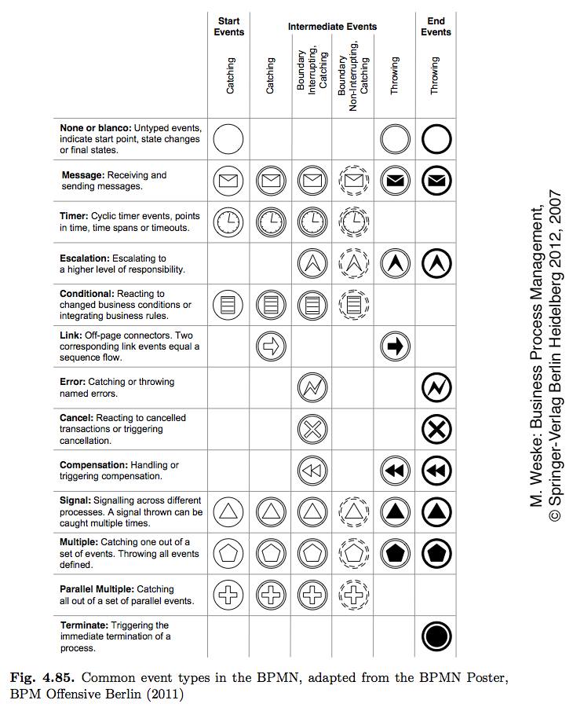
Handling BPMN Events
While it comes natural to give a name (also called label) to each activity, we should not forget to give labels to events as well.
For example, giving a name to each start event allows us to communicate what triggers an instance of the process, meaning, when should a new instance of the process be started.
Similarly, giving a label to each end event allows us to communicate what conditions hold when an instance of the process completes, i.e. what the outcome of the process is.
81

Slide 82
More on Events
82

Slide 83
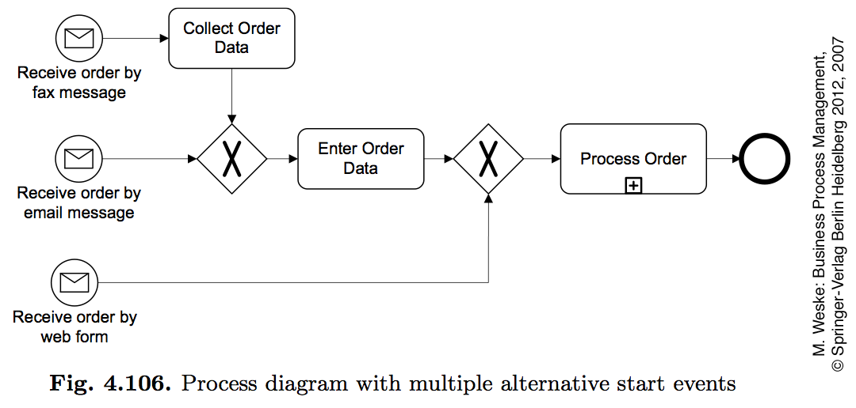
BPMN Events
83

Slide 84
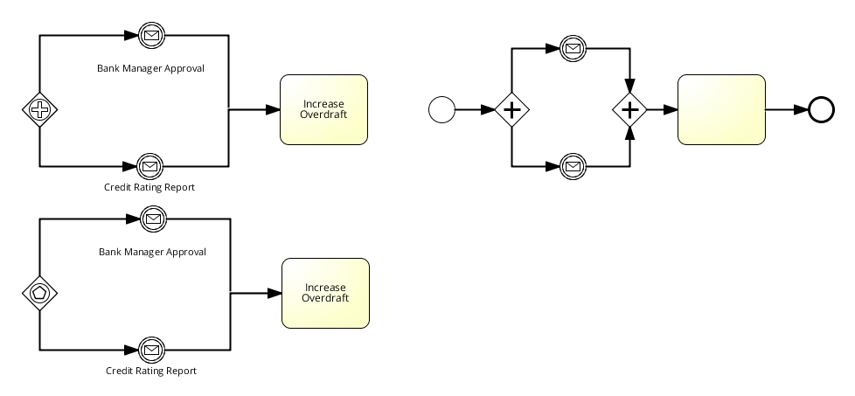
Start Event Gateways
84

Slide 85
Message Events
85

Slide 86
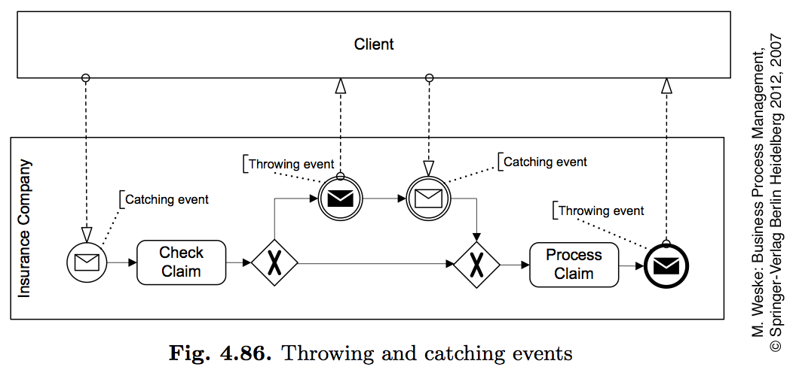
Message Events: Throwing and Catching Events
86

Slide 87
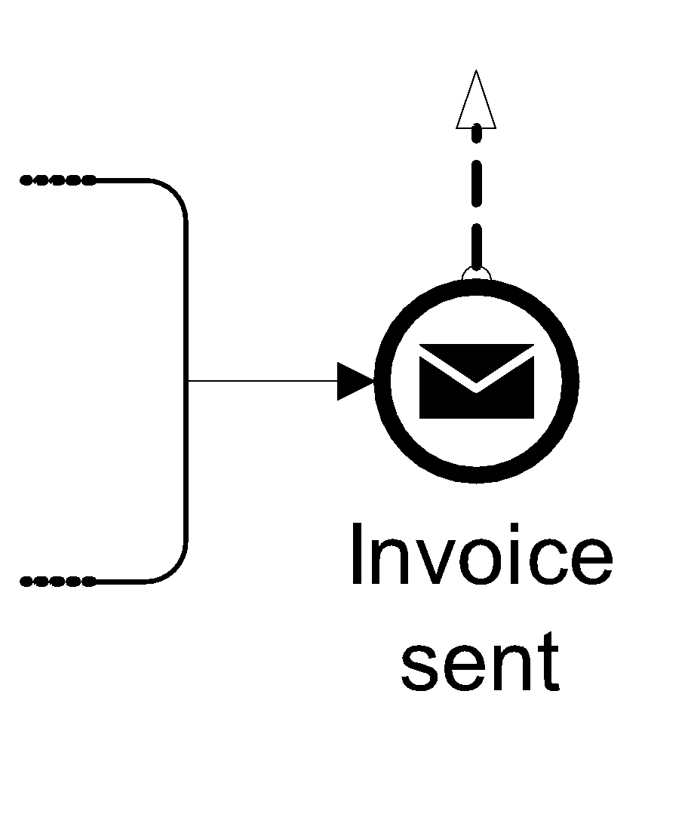
Comparison with sending/receiving tasks
=
Is this really the same?
=
=
=

Slide 88
When to use what?
Use message events only when the corresponding activity would simply send or receive a message and do nothing else
88

Slide 89
BPMN Events
89

Slide 90
Temporal Event and Example
90

Slide 91
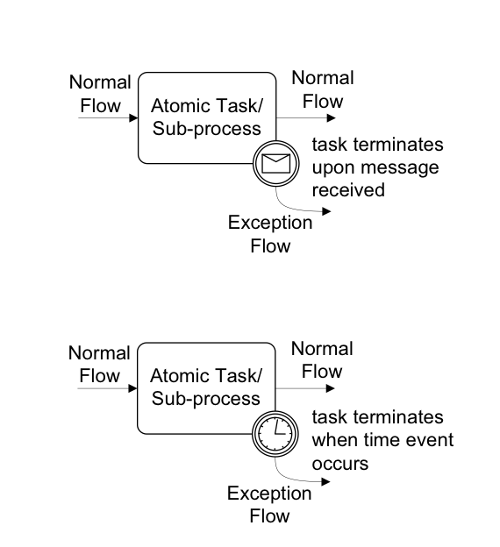
Modelling Exceptional Behaviours
(esternal)
(time dependent)
Both of them can be interrupting or not interrupting
??? (internal) ???
91

Slide 92
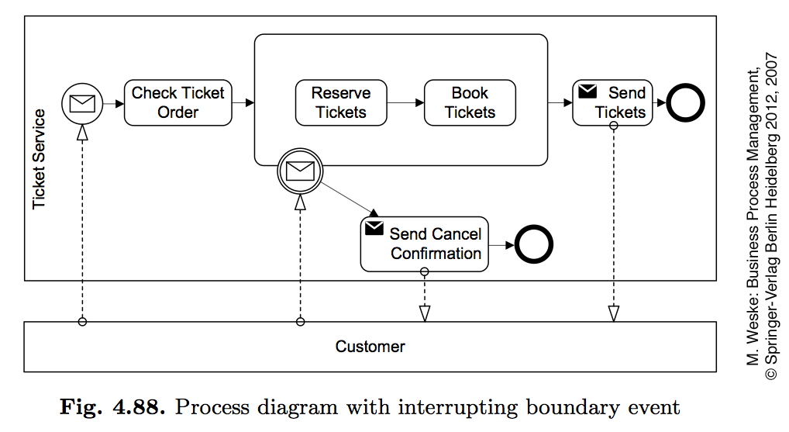
BP with interrupting boundary event
92

Slide 93
BP with non-interrupting boundary event
93

Slide 94
Interrupting and non interrupting boundary time
94

Slide 95
Process Abortion
The simplest way of handling an exception is to abort the running process and signal an improper process termination.
Observe that if a terminate event is triggered from within a sub-process, it will not cause the abortion of the parent process but only that of the sub-process, i.e. the terminate event is only propagated downwards in a process hierarchy.
T
95

Slide 96
Exception (internal)
Instead of aborting the whole process, we can handle an exception by interrupting the specific activity that has caused the exception
An end error event is used to interrupt the enclosing sub-process and throw an exception
This exception is then caught by an intermediate catching error event which is attached to the boundary of the same sub-process
In turn, this boundary event triggers the recovery procedure through an outgoing branch which is called exception flow
96

Slide 97
Racing Events
A typical scenario encountered when modeling processes with events is the one where two external events race against one another
The first of the two events that occurs determines the continuation of the process.
97

Slide 98
Racing Event: Event Based Gateway
Event-based gateways can be used to avoid behavioral anomalies in the communication between pools.
An example of deadlocking collaboration between two pools
98

Slide 99
Solution
99

Slide 100
Exercise: Fix
the
collaboration
diagram
100

Slide 101
Solution
101

Slide 102
Events Combination
102

Slide 103
Transaction
Specialized type of sub-process that will have a special behaviour that is controlled through a transaction protocol (such as WS-Transaction)
Logical unit of work which allows grouping of a set of individual activities, so that they either succeed or fail collectivelly
Like atomic transaction type (all success or nothing)
Transaction Real World Example: on-line Payment Transactions

Slide 104
Activity Compensation
As soon as the message is received the compensation is activated.
104

Slide 105
Transaction and compensation
MORE IN GENERAL
(An event trigger the compensation)
105

Slide 106
Recommendations
Before adding exceptions it is important to understand the sunny-day scenario well
Start by modeling the sunny day scenario.
Then think of all possible situations that can go wrong.
For each of these exceptions, identify what type of exception handling mechanism needs to be used
First, determine the cause of the exception: internal or external
Next, decide if aborting the process is enough, or if a recovery procedure needs to be triggered
Finally, evaluate whether the interrupted activity needs to be compensated as part of the recovery procedure.
106

Slide 107
Exercise - Model the following routine for logging into an Internet bank account
The routine for logging into an Internet bank account starts once the credentials entered from the user have been retrieved. First, the username is validated. If the username is not valid, the routine is interrupted and the invalid username is logged.
If the username is valid, the number of password trials is set to zero. Then the password is validated. If this is not valid, the counter for the number of trials is incremented and if lower than three, the user is asked to enter the password again, this time together with a CAPTCHA test to increase the security level. If the number of failed attempts reaches three times, the routine is interrupted and the account is frozen. Moreover, the username and password validation may be interrupted should the validation server not be available. Similarly, the server to test the CAPTCHA may not be available at the time of login. In these cases, the procedure is interrupted after notifying the user to try again later. At any time during the log in routine, the customer may close the web-page, resulting in the interruption of the routine.
107
Notes:
La procedura per accedere a un conto bancario su Internet inizia dopo le credenziali
immessi dall'utente sono stati recuperati.
Innanzitutto, il nome utente è stato convalidato. Se il nome utente non è valido, la routine viene interrotta e viene registrato il nome utente non valido.
Se il nome utente è valido, il numero di prove della password è impostato su zero.
Quindi la password viene convalidata.
Se questo non è valido, il contatore per il numero di prove viene incrementato e, se inferiore a tre, all'utente viene chiesto di inserire nuovamente la password, questa volta insieme a un test CAPTCHA per aumentare il livello di sicurezza.
Se il numero di tentativi falliti raggiunge tre volte, la routine viene interrotta e l'account viene bloccato.
Inoltre, la convalida del nome utente e della password potrebbe essere interrotta se il server di convalida non fosse disponibile. Allo stesso modo, il server per testare il CAPTCHA potrebbe non essere disponibile al momento dell'accesso. In questi casi, la procedura viene interrotta dopo aver avvisato l'utente di riprovare più tardi. In qualsiasi momento durante la routine di accesso, il cliente può chiudere la pagina Web, causando l'interruzione della routine.

Slide 108
Solution
108

Slide 109
Exercise - Model the following process fragment
Once a wholesale order has been confirmed, the supplier transmits this order to the carrier for the preparation of the transportation quote. In order to prepare the quote, the carrier needs to compute the route plan (including all track points that need to be traversed during the travel) and estimate the trailer usage (e.g. whether it is a full track-load, half track-load or a single package). By contract, wholesale orders have to be dispatched within four days from the receipt of the order. This implies that transportation quotes have to be prepared within 48 hours from the receipt of the order to remain within the terms of the contract.
109

Slide 110
Solution
110

Slide 111
Link Events
111

Slide 112
Processes and Business Rules
A business rule implements an organizational policy or practice.
For example, in an online shop, platinum customers have a 20 % discount for each purchase above €250.
Business rules can appear in different forms in a process model.
They can be modeled
in a decision activity
in the condition of a flow coming out of an (X)OR-split
A third option is to use a dedicated BPMN event called conditional event
112

Slide 113
Exercise - Model the following business process snippet
In a stock exchange, stock price variations are continuously monitored during the day. A day starts when the opening bell rings and concludes when the closing bell rings. Between the two bells, every time the stock price changes by more than 10 %, the entity of the change is first determined. Next, if the change is high, a “high stock price” alert is sent, otherwise a “low stock price” alert is sent.
113

Slide 114
Solution
114

Slide 115
Multiple alternative start events
115

Slide 116
Multiple Start Events
Both need to occur to instantiate the process
116

Slide 117
Information Artifacts
Data Objects are a mechanism to show how data is required or produced by activities. Represent input and output of a process activity
A Collection Data Object represents a collection of information, e.g., a list of order items
A Data Input is an external input for the entire process. A kind of input parameter
A Data Output is data result of the entire process. A kind of output parameter
117

Slide 118
Do data objects affect the token flow?
Input data objects are required for an activity to be executed.
Even if a token is available on the incoming arc of that activity, the latter cannot be executed until all input data objects are also available.
A data object is available if it has been created as a result of completing a preceding activity (whose output was the data object itself), or because it is an input to the whole process (like Purchase order).
Output data objects only affect the token flow indirectly, i.e. when they are used by subsequent activities.
118

Slide 119
Process diagram involving data-object
119

Slide 120
Data Store
A Data Store is a place where the process can read or write data, e.g., a database or a filing cabinet. It persists beyond the lifetime of the process instance
120

Slide 121
Process Diagram Involving Information Artifact
121

Slide 122
Do we always need to model data objects?
Data objects help the reader understand the flow of business data from one activity to the other
However, the price to pay is an increased complexity of the diagram
Use them only when they are needed for a specific purpose, e.g. to highlight potential issues in the process under analysis or for automation
122

Slide 123
Use of BPMN elements into practice
The BPMN 2.0 [15] defines 50 constructs and their attributes. However, less than 20% of its vocabulary is used regularly in designing BP models [14].
zur Muehlen, Michael and Recker, Jan C. (2008) How Much Language is Enough? Theoretical and Practical Use of the Business Process Modeling Notation . In Proceedings 20th International Conference on Advanced Information Systems Engineering, Montpellier, France.
123

Slide 124
How much language do you need?
124

Slide 125
BPMN 2.0 free editors
ADOxx - http://www.adoxx.org/live/home
Oryx online editor: http://bpt.hpi.uni-potsdam.de/Oryx
BizAgi editor (Windows): http://www.bizagi.com/
Sketchpad Java editor (still in development): http://sourceforge. net/projects/sketchpadbpmn/develop
Intalio|BPM community edition: http://www.intalio. com/products/bpm/community-edition/
Eclipse BPMN modeler: http://www.eclipse.org/bpmn/
Visio stencils: http://bpt.hpi.uni-potsdam.de/Public/BPMNCorner#Tooling
Other tools & info: http://bpmn.org/BPMN_Supporters.htm
https://camunda.com/
125

Slide 126
Business Process (Modelling Activities)
126

Slide 127
Exercises
Using a BPMN 2.0 notation model the following process
Cooking an Apple Pie
Enrollment at a university
Buy a fly ticket
Buy a book on-line
Moving from one city to another
127

Slide 128
Let’s Model: Insurance Claim
1. recording the receipt of the claim
2. establishing the type of the claim
3. checking covering of client's policy
4. checking the premium (payments up to date?)
5. rejection, if 3 or 4 has negative result
6. producing a rejection letter
7. roughly estimate the amount to be paid, if 3 & 4 have positive results 8. appointment of an assessor, if needed
9. revision of the amount offered to the client
10. recording client's reaction
11. assessment of objection: decision to revise 9 or take legal action 12 12. legal proceedings
13. payment of claim
14. filing and closure of claim
128

Slide 129
Modelling Travel agency
Travel agency: define a series of task for booking a flight, a hotel and optionally a car, with the possibility to change dates, to cancel the booking, to confirm the booking. Then, draw a process diagram relating the tasks.
129

Slide 130
Modelling Coffee break
Coffee break: draw the process diagram for a vending machine that accepts a coin, then gives the possibility (1) to get a coffee or (2) to insert another coin and get either a cappuccino or a tea. Draw the process diagrams for a compatible and a "problematic" butler robot.
130

Slide 131
Modelling Bike Sharing and Bike Travel
Bike Sharing and Bike Travel: define a series of task for bike traveling, with the possibility to register, to track, and to maintain the bike. Then, draw a process diagram relating the tasks.
131

Slide 132
BPMN by example
132

Slide 133
Dichiarazione di copyright
L'utilizzo dei contenuti della lezione sono riservati alla fruizione personale degli studenti iscritti ai corsi dell’Università di Camerino. Sono vietate la diffusione intera o parziale di video o immagini della lezione, nonché la modifica dei contenuti senza il consenso, espresso per iscritto, del titolare o dei titolari dei diritti d'autore e di immagine.
Copyright notice
The contents of this lesson are subject to copyright and intended only for personal use by students enrolled in courses offered by the University of Camerino. For this reason, any partial or total reproduction, adaptation, modification and/or transformation of the contents of this lesson, by any means, without the prior written authorization of the copyright owner, is strictly prohibited.

