Slide 1
3.3 Referencing Literature
Knut Hinkelmann

Slide 2
Mike Webb about Referencing
Part 1: Principles of Referencing
https://www.youtube.com/watch?v=E7Laol_ALeU&index=15&list=WL
https://www.youtube.com/watch?v=CyXT3okiRj8
Part 2: Details of the reference list:
https://www.youtube.com/watch?v=2XURGhDGYDg

Slide 3
Mike Webb about Referencing – Part 1: Principles
https://www.youtube.com/watch?v=CyXT3okiRj8

Slide 4
Mike Webb about Referencing Part 2: Details about the Reference List
Part 2: https://www.youtube.com/watch?v=2XURGhDGYDg

Slide 5
Citation Systems
Citations Systems typically distinguish between two parts:
Citation in the text
Reference list with the details of the source
For intext citations there are a lot of styles
Placement: In the text, as footnotes or as endnotes
References can be made as
Numbers, e.g. [1], [2]
Abbrevations of Authors, e.g. [AHMM01], [SmWe02]
Author-year Style, e.g. (Smith 2002), (Smith et al. 2003)
If your university or supervisor does not request a specific style, I recommend that you use a author-year style, because a reader can already see from the reference what work is meant.
An Example of a author-year style is the Harvard System

Slide 6
Harvard Referencing
Harvard Style is not a standard but a family of standards. Different versions vary slightly. It does not matter which version you use as long as you use it correctly and consistently.
Many university have guidelines for the Harvard System, for example Anglia Ruskin University (see dropbox)
Anglia Ruskin University, 2013. Guide to the Harvard Style of Referencing. Fifth Edition. Available at: <http://libweb.anglia.ac.uk/referencing/files/Harvard_referencing_2013.pdf> [Accessed 12 May 2014].
Here is a link to an online description:
http://www.education.ex.ac.uk/dll/studyskills/harvard_referencing.htm
You can also look at the videos by Mark Webb
Part 1 (general): https://www.youtube.com/watch?v=E7Laol_ALeU
Part 2 (specifics): https://www.youtube.com/watch?v=1bYc33Bp-Yk

Slide 7
APA System
The APA System ia very similar to the Harvard System with few differences
Intext citation
The APA System uses an author-year style for intext citation
Example:
(Smith 2002)
(Smith & Wesson 2002)
(Smith et al. 2002, p. 23)
Smith and Wesson (2002) …
Reference list
The reference list at the end of your work looks nearly the same
Example:
Redman, P. (2006). Good essay writing: a social sciences guide. 3rd ed. London: Open University in assoc. with Sage.

Slide 8
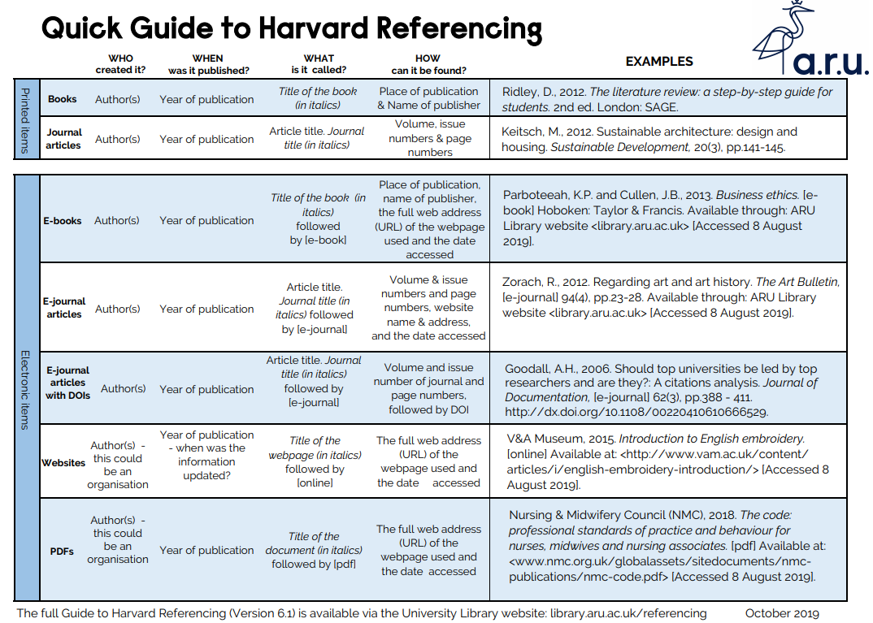
https://library.aru.ac.uk/referencing/files/QuickHarvardGuide2019.pdf

Slide 9
https://library.aru.ac.uk/referencing/files/QuickHarvardGuide2019.pdf

Slide 10
In-text Referencing

Slide 11
Harvard System
Intext citation
The Harvard System uses an author-year style for intext citation
The author's surname and year of publication are cited in the text of your work. It does not use footnotes or endnotes
Example:
“An effective structure is important” (Redman, 2006, p.22)
Reference list
The full details of the source are included in a reference list at the end of your work.
Example:
Redman, P., 2006. Good essay writing: a social sciences guide. 3rd ed. London: Open University in assoc. with Sage.

Slide 12
Harvard Style: References in the Text
Intext citations list the author(s), the year and, if referring to a specific part of the work, the relevant page/page numbers.
If you cite from more than one work by the same author(s), allocate alphabetical lettering to each of these separate works.
Here are examples for publications with one, two and more authors:
(Smith 2002)
(Smith and Wesson 2002a)
(Smith et al 2002, p. 23)
If the authors are mentioned in the text the parenthesis only contain the year and optionally the page number. Example:
“As explained by Smith (2002) …”

Slide 13
Examples of In-text Citations (1)
A paraphrased quotation is where a source is not produced word for word but rendered or summarized in own words
If you make reference to a work, the author’s name and publication year are placed at the relevant point in the sentence or at the end of the sentence in brackets:
Making reference to published work appears to be characteristic of writing for a professional audience (Cormack, 1994).
When making reference to an author in your text, their name is followed by the year of publication of their work:
In general, when writing for a professional publication, it is good practice to make reference to other relevant published work. This view has been supported in the work of Cormack (1994).
The citations are part of a sentence, i.e. before the full stop.
(Anglia Ruskin University 2013)

Slide 14
Examples of Intext Citations (2)
When there are several authors for a work, they should be noted in the text using “and” and in the brackets using “&”:
White and Brown (2004) in their recent research paper found …
Recent research (White & Brown, 2004) suggests that…..
Further research (Green, Harris & Dunne, 1969) showed.
Where there are six or more authors, only the first author should be used, followed by “et al.” meaning “and others”: :
Green et al. (1995) found that the majority …
Recent research (Green et al., 1995) has found that the majority of ….
References to several publications from a number of authors should be cited in chronological order:
Recent research (Collins, 1998; Brown, 2001; Davies, 2008) shows that ....
Smith (1946) and Jones (1948) have both shown …
Several works by one author in different years:
as suggested by Patel (1992; 1994) who found that …
Several works by one author in the same year should be differentiated by adding a lower case letter after the year
Earlier research by Dunn (1993a) found that…but later research suggested again by Dunn (1993b) that ……
(Anglia Ruskin University 2013)

Slide 15
Examples of Intext Citations (1)
When making reference to an author in your text, their name is followed by the year of publication of their work:
In general, when writing for a professional publication, it is good practice to make reference to other relevant published work. This view has been supported in the work of Cormack (1994).
Where you are mentioning a particular part of the work, and making direct reference to this, a page reference should be included:
Cormack (1994, pp.32-33) states that 'when writing for a professional readership, writers invariably make reference to already published works'.
If you make reference to a work without mentioning the author in the text then the author’s name and publication year are placed at the relevant point in the sentence or at the end of the sentence in brackets:
Making reference to published work appears to be characteristic of writing for a professional audience (Cormack, 1994).
Where reference is made to more than one author in a sentence, and they are referred to directly, they are both cited:
Smith (1946) and Jones (1948) have both shown …
(Anglia Ruskin University 2013)

Slide 16
Sources over one or several paragraphs
Where a source serves as a reference across one or a number of paragraphs, the in-text citation may be placed at the beginning of the paraphrasing to ensure that the authorship is clear.
Examples:
The following paragraph is based on suggestions by Friedrich (1997) .
According to Friedrich (1997, p. 28), the following criteria should be observed: …
It is not ok, to write a whole paragraph and place the citation at the end only, because then it is not clear, when the referenced work starts.

Slide 17
Direct Quotation
A direct quotation is where words or sentences are reproduced word-for-word
Short direct quotations are incorporated directly in the text
Friedrich (1997, p. 17) asserts the modern “wealth of technical literature” is overwhelming
Longer direct quotations appear as separate indented paragraphs
“These days it is hard to find a sphere of activity in which the wealth of technical literature (manuals, monographs, journal articles, documentation, etc.) does not far exceed the capacity of the individual to absorb it all.” (Friedrich, 1997, p. 17)
Avoid too many and in particular long direct quotations
Thefull stop ends the quotation and the citation is after the full stop
For direct quotations provide the page numbers

Slide 18
Reference list - Bibliography

Slide 19
Reference List
The reference list should include details for everything that you cite in your assignment.
The term bibliography is a synonym for reference list.
It occurs at the end of your work and should be in alphabetical order according to the surname of the (first) author
All the different types of material in one sequence.
The bibliography entries depend on the type of publications (journal article, book, book chapter, URL, …). Harvard Style defines what has to be listed for each type of publication.

Slide 20
Reference managers make correct quotations and reference lists if
The bibliographic data is correct
The citations are placed correctly

Slide 21
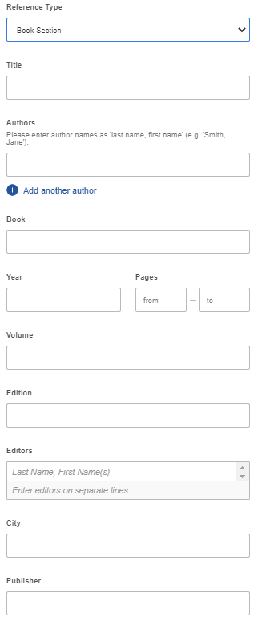
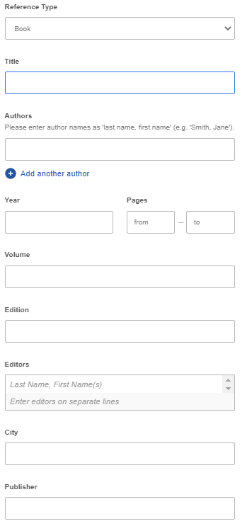
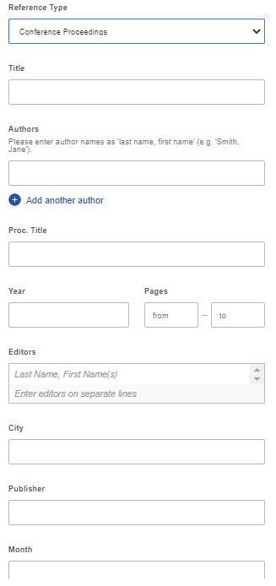
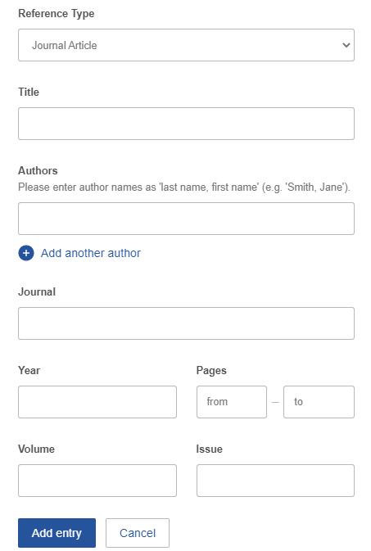
Reference Managers guide in adding the necessary Bibliographic data
Fields change depending on reference type

Slide 22
URLs
For electronic sources you should add a URL
BUT: Only official links
DOI (Digital Object Identifier)
URL from publisher
No inofficial sources like researchgate, author’s website, search strings
For websites also add the date of access
This is only for website, because they can change over time and it is important which content you refer to
It is not necessary for scientific literature like e-books, journal articles etc. because they do not change

Slide 23
Compiling a Reference List (1)
Required items for some often used entries:
Books:
Authors, Initials., Year. Title of book. Edition. (only include this if not the first edition) Place of publication* (this must be a town or city, not a country): Publisher.
Adams, R.J., Weiss, T.D. and Coatie, J.J., 2010. The World Health Organisation, its history and impact. London: Perseus.
Barker, R., Kirk, J. and Munday, R.J., 1988. Narrative analysis. 3rd ed. Bloomington: Indiana University Press
Books which are edited:
Author, Initials. ed., Year. Title of book. Edition. Place: Publisher .
Keene, E. ed., 1988. Natural language. Cambridge: University of Cambridge Press..
Barker, R., Kirk, J. and Munday, R.J., 1988. Narrative analysis. 3rd ed. Bloomington: Indiana University Press
(Anglia Ruskin University 2013)

Slide 24
Compiling a Reference List (2)
Chapters of edited Books:
Chapter author(s) surname(s) and initials., Year of chapter. Title of chapter followed by In: Book editor(s) initials first followed by surnames with ed. or eds. after the last name. Year of book. Title of book. Place of publication: Publisher. Chapter number or first and last page numbers followed by full-stop.
Samson, C., 1970. Problems of information studies in history. In: S. Stone, ed. 1980. Humanities information research. Sheffield: CRUS. pp.44-68.
E-books:
Author, Initials., Year. Title of book. [e-book] Place of publication: Publisher. Followed by Available through: Anglia Ruskin University Library website <http://libweb.anglia.ac.uk> [Accessed date].
Fishman, R., 2005. The rise and fall of suburbia. [e-book] Chester: Castle Press. Available through: Anglia Ruskin University Library website <http://libweb.anglia.ac.uk> [Accessed 12 May 2010].
(Anglia Ruskin University 2013)

Slide 25
Compiling a Reference List (3)
Print journal article:
Author, Initials., Year. Title of article. Full Title of Journal, Volume number (Issue/Part number), Page number(s).
Boughton, J.M., 2002. The Bretton Woods proposal: a brief look. Political Science Quarterly, 42(6), p.564.
Cox, C., Brown, J.T. and Turmpington, W.T., 2002. What health care assistants know about clean hands. Nursing Today, Spring Issue, pp.647-85..
Conference paper:
Author, Initials., Year. Full title of conference paper. In: followed by editor or name of organisation, Full title of conference. Location, Date. Place of publication: Publisher.
Brown, J., 2005. Evaluating surveys of transparent governance. In: UNDESA (United Nations Department of Economic and Social Affairs), 6th Global forum on reinventing government: towards participatory and transparent governance. Seoul, Republic of Korea, 24-27 May 2005. New York: United Nations.
(Anglia Ruskin University 2013)

Slide 26
Compiling a Reference List (4)
Reports by organisations:
Authorship/Organisation, Year. Full title of report. Place: Publisher .
Department of Health, 2001. National service framework for older people. London: Department of Health.
Dissertations:
Author, Initials., Year of publication. Title of dissertation. Level. Official name of University.
Richmond, J., 2005. Customer expectations in the world of electronic banking: a case study of the Bank of Britain. PhD. Anglia Ruskin University.
(Anglia Ruskin University 2013)

Slide 27
Exercises

Slide 28
Finding literature – when to stop?
Discussion: The process of literature research is obviously highly recursive: what are criteria for stopping (temporarily)?
Some possible criteria:
when references start to repeat significantly
When content of references does not add significant insights to what you have read so far => the “state-of-the-art” becomes obvious after reading potentially many, but not all publications of a field…
For each single reference: if they start to be less relevant for your topic => stay focused!

Slide 29
Assignment– Mendeley
Task:
find a paper that has something to do with your topic in the ACM digital library (dl.acm.org)
import it into Mendeley
create a reference to it in a Word document
create a bibliography section at the bottom of the same Word document that includes the reference that you inserted

Slide 30
Finding literature - exercise
Consider topic 4 «Bringing data mining to the business» and the following two references that describe related work:
http://citeseerx.ist.psu.edu/viewdoc/summary?doi=10.1.1.94.9984
http://www.stat.fi/isi99/proceedings/arkisto/varasto/gord0025.pdf
Task:
based on your understanding of the topic and these starting points, find further relevant literature
select one reference that you think is a key paper on the subject, paste the link to it into the questionnaire provided on Moodle
write a sentence to explain why you think this paper is so important

Slide 31
Quality Literature
Peer-reviewed papers
Peer review process is a mechanism to control quality
Peer-reviewed published work can be used with confidence,
Peer-rieviewed papers are published in
Journals
Conference proceedings
(Books)
quality of journal or conference where published
impact factor = average number of citations of articles within a journal or conference
Not all journals In Information Systems and Computer Science, conference proceedings contain peer-rievewed and current papers

Slide 32
Finding literature – Introductory Material
Find introductory material on a topic
look for textbooks and monographs, e.g. from library
check encyclopedic and introductory resources
Wikipedia
other encyclopedias
(online) tutorials
lecture notes
Note: these resources are useful for
introduction to a topic
finding references to original work
but frequently do not constitute valuable references to a research article
adapted from Thomas Hanne

Slide 33
Skimming
You will not be able to read everything word for word the first time that you search thru literature, when skimming:
Books: look at the table of contents, bibliography, introduction and first and last paragraphs in chapters,
Articles and dissertations: skim the abstract, the introduction, conclusion and bibliography
Online resources: skim the organization, abstract, read content by looking for key words.
Skim according to keywords. Make a list and first look them up when you read an article / work.
The first sentence in a paragraph should be the most important – read that to get an overview of the paragraph
Thanks to Prof. Alta van der Merwe

Slide 34
Writing the Literature Review
When writing the literature review continuously ask yourself: ‘how is the work presented in the article related to my study?’
An effective and quality literature review is one that is based upon a concept-centric approach rather than chronological or author-centric approach
Principle for summarising literature
cluster references by topic/concept
give the clusters labels (abstraction task!)
when writing: present one cluster per paragraph/subsection
first state the commonalities of papers that make them belong to the cluster
then shortly address individual differences (optional, depends on relevance of cluster to your work)

Slide 35
Summarising literature
Anything wrong with this?

Slide 36
Example: summarising literature
Better would be:

Slide 37
The Credentials
You need to:
Reference the leaders in the field
Remember, your examiners should be also leaders in the field, if they do not recognize the work you are referencing, they will doubt the credentials of the work.
If no references are given:
it is not clear whether you are familiar with the state-of-the-art
possibly, it is not credible that you obtained some results by yourself (especially if a reader knows the relevant literature)
Thanks to Prof. Alta van der Merwe

Slide 38
Three Stages of Effective Literature Review Process
(Levy & Ellis 2006)

