Slide 1
Process Model Quality Assurance Overview
Barbara Re

Slide 2
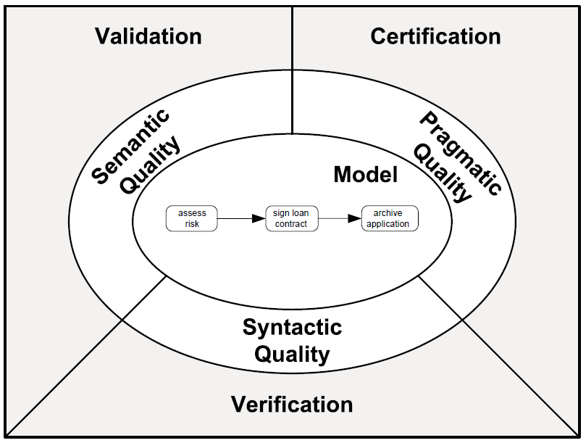
Process model quality assurance
Validity
Completeness
Understandibility
Mantainability
Learning
Structural correctness
Behavioral correctness

Slide 3
Syntactic quality: Verification
Syntactic quality relates to the conformance of a process model to the syntactic rules of the modeling language used.
Two types of syntactic rules: structural rules and behavioural rules.
A model is of high syntactic quality if it is syntactically correct:
Structurally correct +
Behaviorally correct

Slide 4
Structural correctness
A model is structurally correct if it satisfies the following syntactic rules:
Element-level rules:
activities must have at least one incoming and one outgoing sequence flow
start events must not have incoming arcs, end events must not have outgoing arcs
gateways must have exactly one incoming and at least two outgoing arcs (splits) or at least two incoming and exactly one outgoing arcs (joins)
…
Model-level rule: all flow nodes must be on a path from a start to an end event
i.e. no dangling arcs or disconnected nodes
implies that a model should have at least one start and one end event.

Slide 5
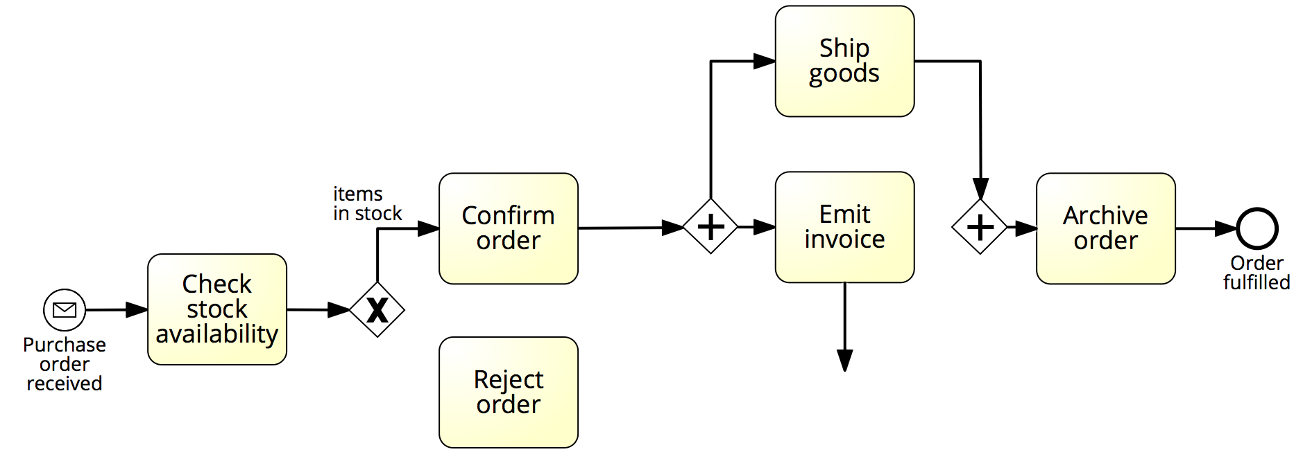
Example: structural correctness

Slide 6
Behavioral correctness (aka “soundness”)
A model is sound if it satisfies the following behavioral rules:
option to complete: any running process instance must eventually complete,
proper completion: at the moment of completion, each token of the process instance should be in a different end event, and
no dead activities: any activity can be executed in at least one process instance.

Slide 7
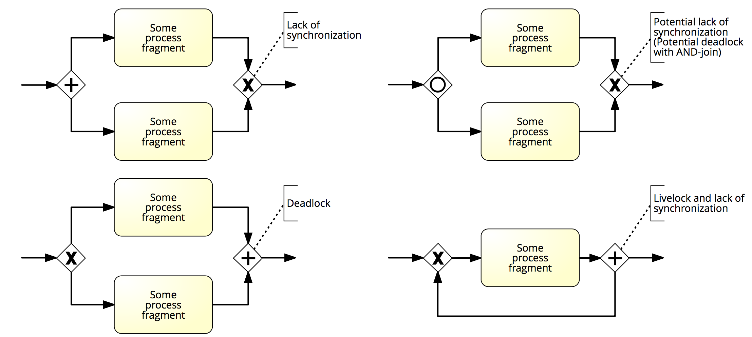
Exercise 5.12
Have a look at Figure 5.11. What is precisely going wrong in each block structure?

Slide 8
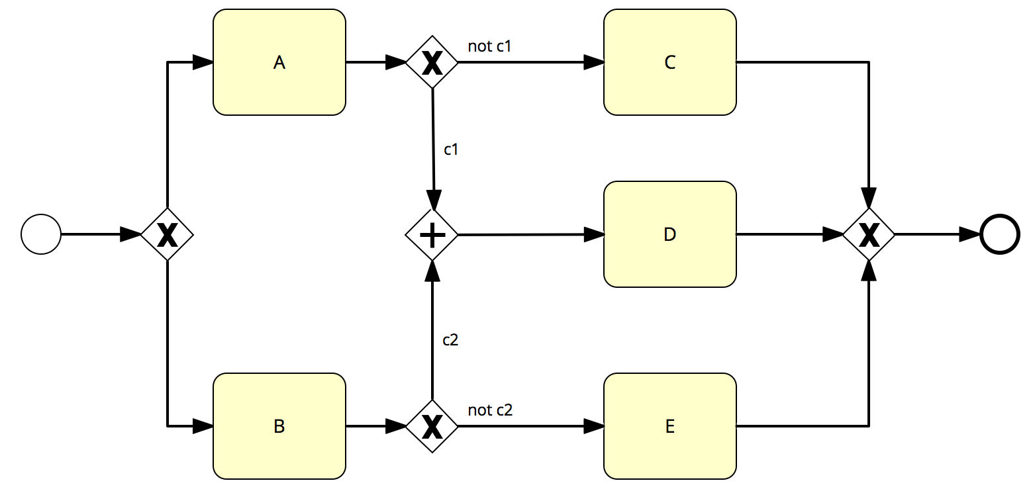
Example: no option to complete
If c1 is true after executing A, or c2 is true after executing B, the instance cannot complete (deadlock)
Note: this model also suffers from a dead activity (D)

Slide 9
Example: livelock (no option to complete)
If condition_1 is true, the instance cannot complete and activity B will be repeated forever (livelock)
Note: this model is structurally incorrect, because B is not on a path to the end event

Slide 10
Example: no proper completion
At the moment of completion, there will be two tokens in the end event (lack of synchronization)

Slide 11
Example: dead activity
Even if this model can always complete, Activity D will never be executed
Note: this model also suffers from a deadlock, as a token will be left behind (stuck before the AND-join). However, there is always an option to complete

Slide 12
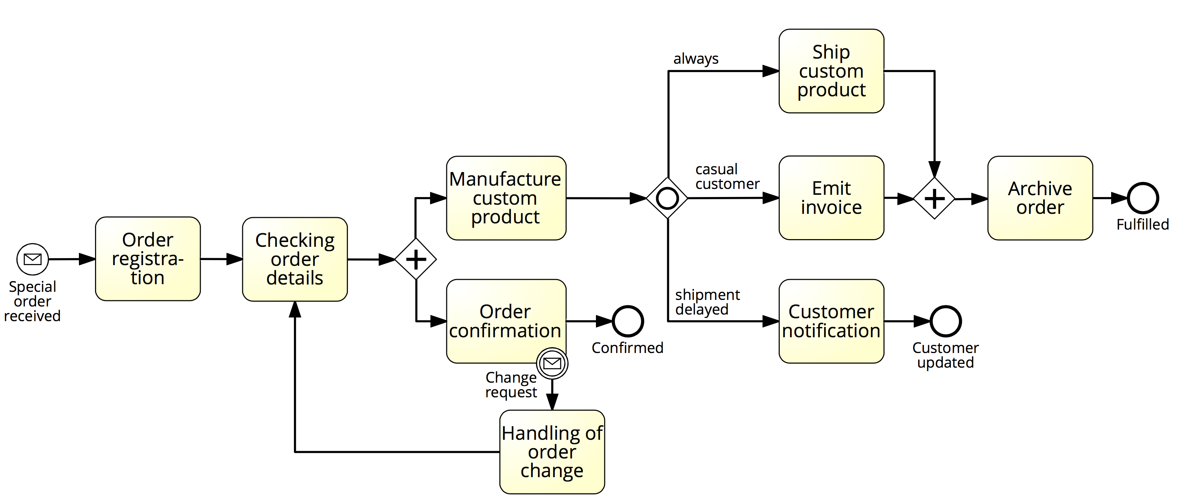
Exercise 5.13
Fulfilment of special orders
Which behavioral rules are violated in the model below?
How can this model be made sound?

Slide 13
Semantic quality: validation
Semantic quality relates to the adherence of a process model to its real-world process.
Validation is the activity of checking the semantic quality of a model by comparing it with its real-world business process.
A model is of high semantic quality if it is semantically correct:
Valid (all model instances are correct and relevant) +
Complete (all possible process instances are covered)
Domain Expert
Process Analyst

Slide 14
Semantics
Meaning of the various elements
Activities model something actively performed during the process
Events model something happening instantaneously during the process
AND gateways model parallelism
XOR gateways model exclusive decisions and simple merging points
OR gateways model inclusive decisions and synchronizing merging points
+
Meaning of the whole business process model
“This model captures an order fulfilment process that takes place at a seller. The model starts with the receipt of an order…”

Slide 15
Exercise 5.14
Consider the following process description.
A company has two warehouses that store different products: Amsterdam and Hamburg. When an order is received, it is distributed across these warehouses: if some of the relevant products are maintained in Amsterdam, a sub-order is sent there; likewise, if some relevant products are maintained in Hamburg, a sub-order is sent there. Afterwards, the order is registered and the process completes.

Slide 16
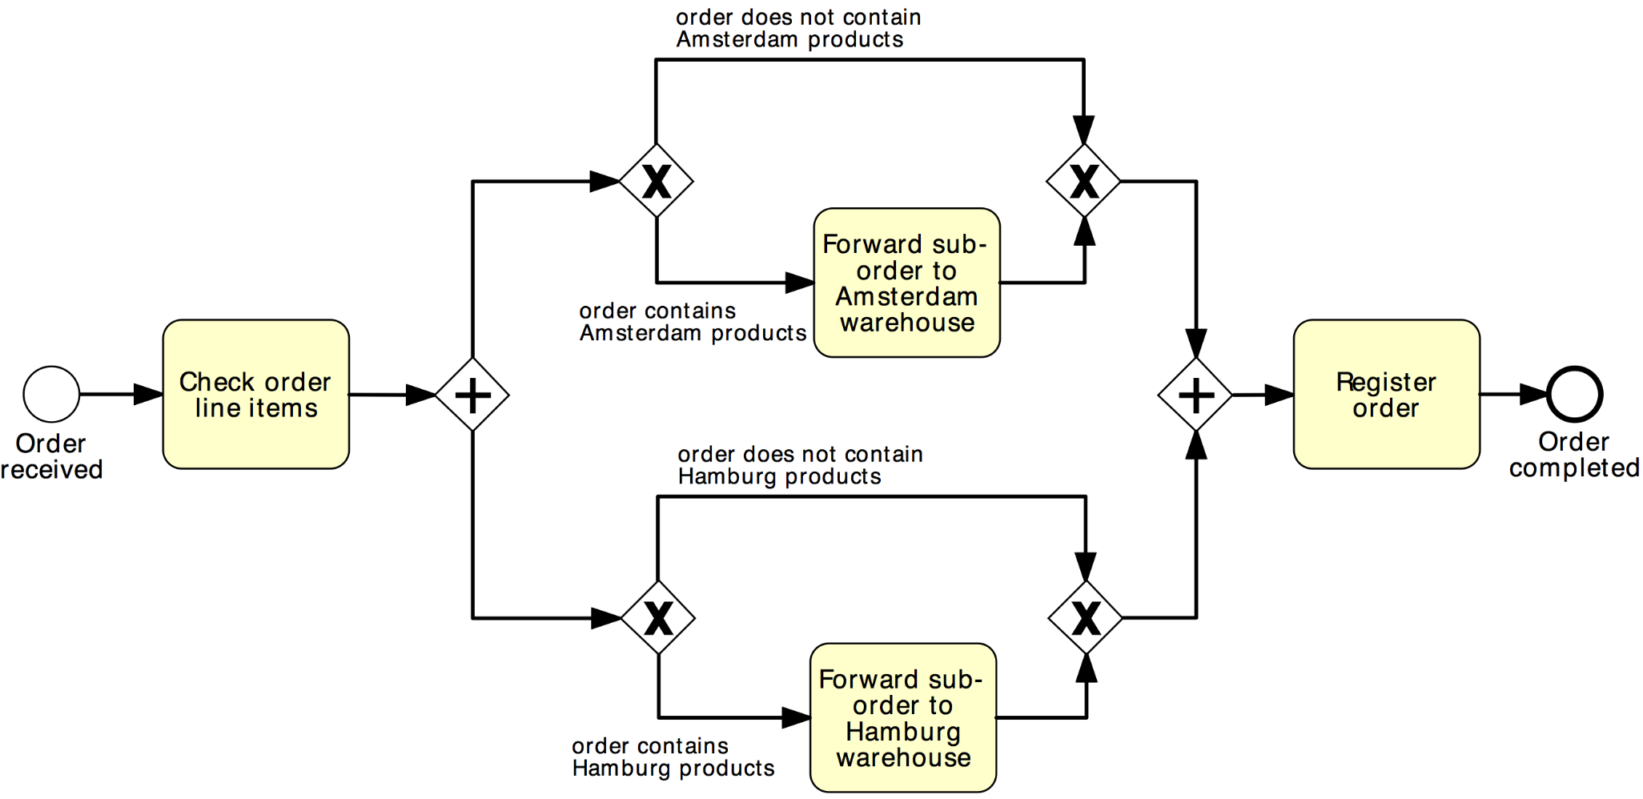
Exercise 5.14 (cont’ed)
What can we say about the semantic quality of this model?
Invalid
It is not possible that products are neither in the Amsterdam nor in the Hamburg warehouse.

Slide 17
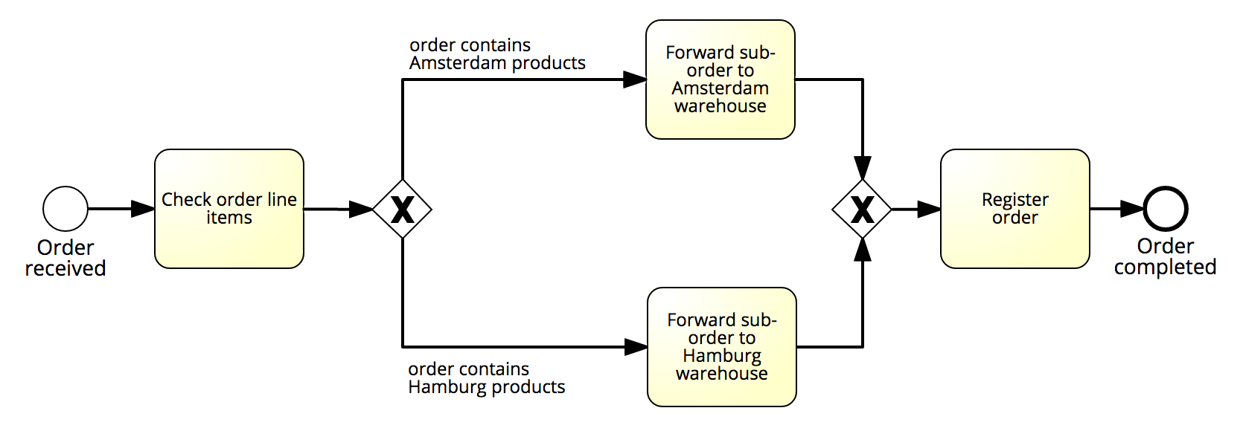
Example: semantic correctness
And about this one? (with reference to the same description)
Incomplete
Orders may contain both products that are in Amsterdam and products that are in Hamburg

Slide 18
Exercise 5.15
Consider the model in the next slide, with reference to the following process description. Is this model valid and complete? If not, what statements are invalid and what is missing?
When a special order is received, it is first registered and then its details are checked. Next, the order is confirmed and meantime the custom product is manufactured. Once the product has been made, the shipment can be planned. Afterwards, the customer type and shipment status are checked. In fact, if a customer is casual an ad hoc invoice must be emitted, which is not required for ordinary customers. In the latter case, the customer account is simply charged with the costs related to the order fulfillment. Moreover, if the shipment has been delayed, the customer must be updated on the expected delay. Concomitantly to these activities, the custom product is shipped. After the latter activity and after the invoice has been emitted, the process completes with the archival of the order. Any time during the confirmation of the order and the manufacturing of the respective product, an order change request may be received, in which case any activity must be interrupted to handle the change re- quest. This includes the registration of the order variation and a notification to the customer, after which the process resumes from the order checking.

Slide 19
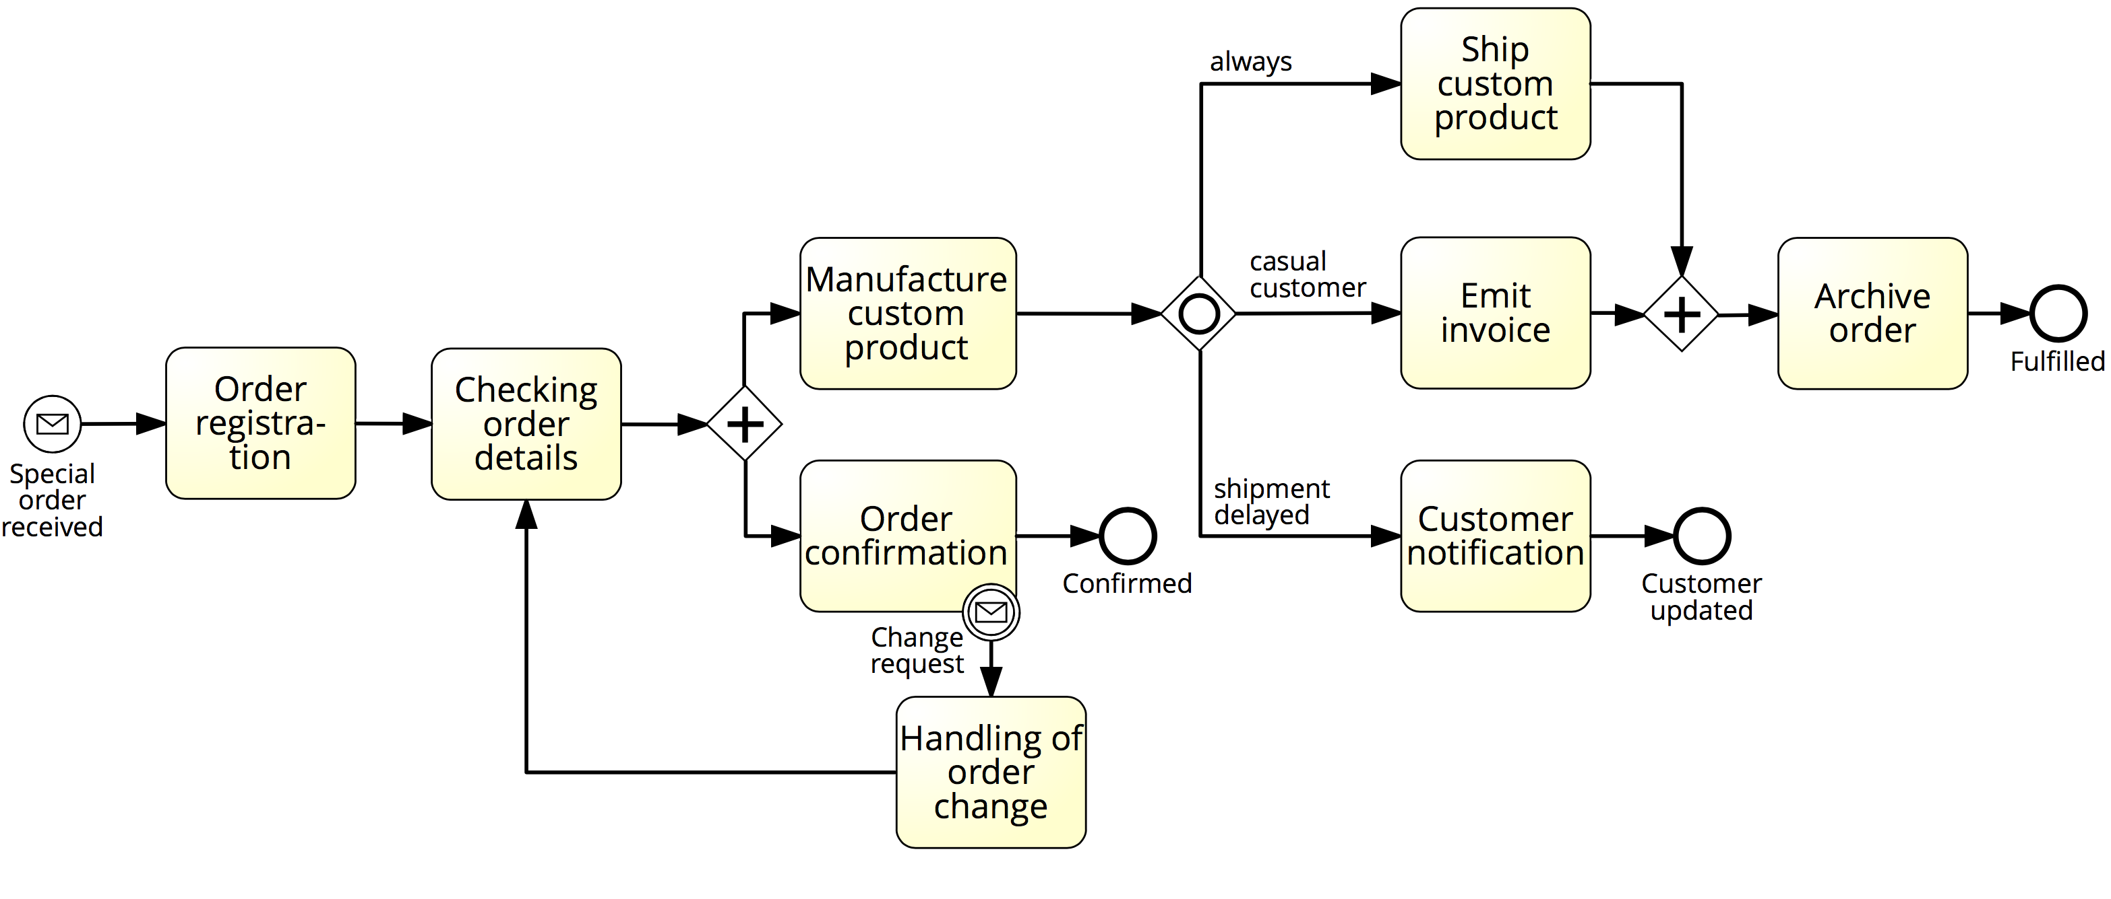
Exercise 5.15 (cont’ed)

Slide 20
Pragmatic Quality: Certification
Pragmatic quality relates to the usability of a process model
Challenge = anticipate the particular usage of the model
Usability:
Understandability: how easy it is to read and comprehend the model
Maintainability: how easy it is to apply changes
Learning: how good a model reveals how its corresponding process works in reality
Model characteristics that influence usability include size, structural complexity and layout

Slide 21
Example: block-structuring a model

Slide 22
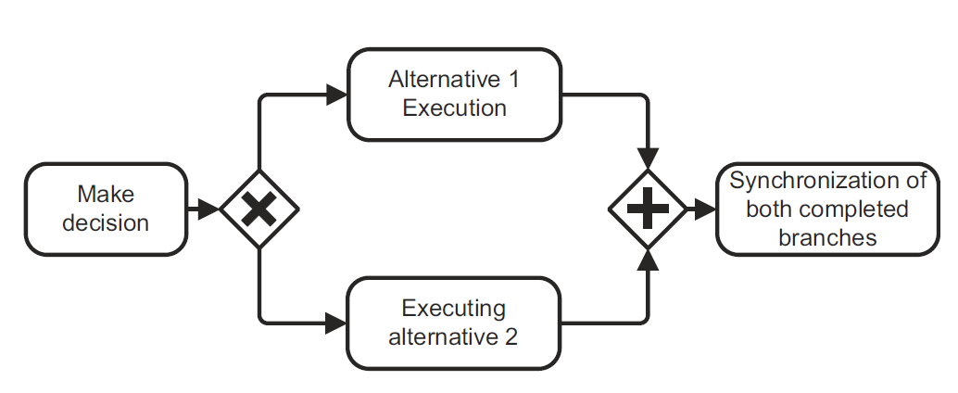
Is this process model of good pragmatic quality?
Different labeling styles
Noun phrase
Verb phrase
(imperative)
Noun phrase
(using “of”)
Verb phrase
(gerund)

Slide 23
Exercise 5.16
Is the process model below of good pragmatic quality?
If not, how can it be improved?

Slide 24
Modeling Guidelines and Conventions
Used to improve pragmatic quality by restricting:
Vocabulary (e.g. banning the use of the OR gateway)
Structure (e.g. limiting the size of a model to max 30 nodes)
Semantics – rare (e.g. using data objects to only capture information flow)
Appearence (e.g. enforcing a particular labeling or layout style)

Slide 25
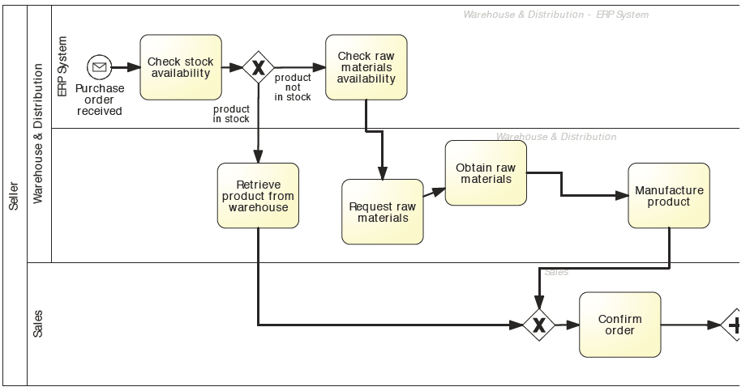
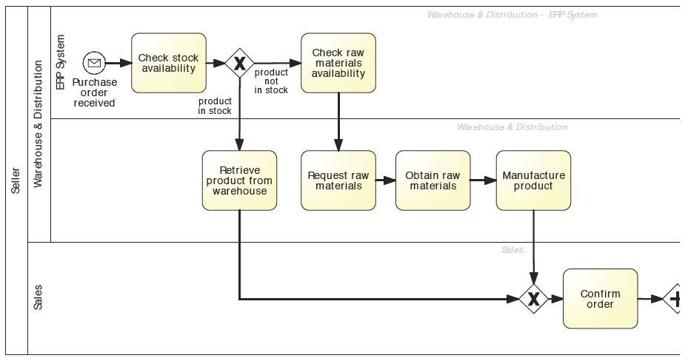
Example: modeling guidelines and conventions
Labeling
Activities as imperative verb + noun
Events as noun + past-participle verb
Conditions on outgoing arcs of (X)OR-splits with reference to object
Layout
From top-left to bottom-right
Use direct arcs with no crossing where possible

Slide 26
Example modelling guidelines: 7PMG
G1 Use as few elements in the model as possible
G2 Minimize the routing paths per element
G3 Use one start event (per trigger) and one end event (per outcome)
G4 Model as structured as possible
G5 Avoid OR gateways where possible
G6 Use verb-object activity labels
G7 Decompose a model with more than 30 elements

Slide 27
Exercise 5.17
Which 7PMG can be applied to this model? Consider the description below.
A complaint is triggered by a phone call by a complaining customer. It is decided whether the complaint can be handled or whether it has to be referred to an internal or external party. An external referral leads to a telephone confirmation to the external party. An internal referral is added to the incident agenda. If no referral is needed, a complaint analysis is conducted and the complainant is contacted. In either case, the complaint is archived and the case is closed.

Slide 28
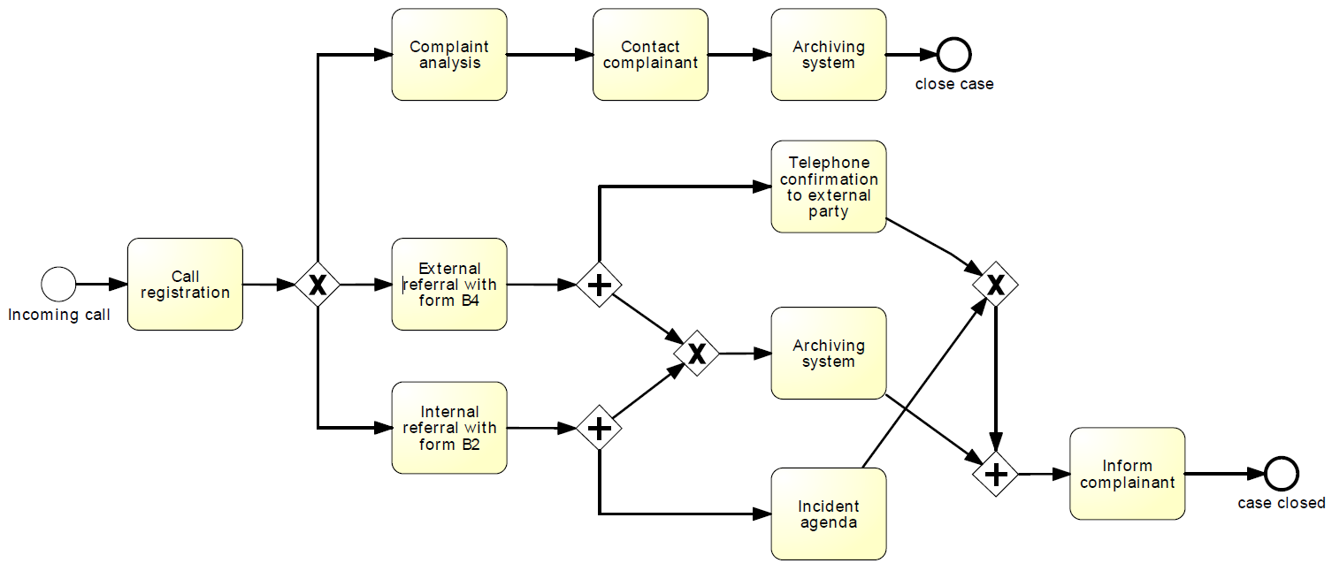
Exercise 5.17

Slide 29
Questions?

