Slide 1
BPMN Choreography
Barbara Re

Slide 2
Choreography Diagram
Focuses on the interactions among two or more participants.

Slide 3
Choreography Diagram (cont’ed)
Interactions can be explicitly captured

Slide 4
Choreography Diagram (cont’ed)

Slide 5
Choreography Task
Atomic activity
Represents an interaction between two business parties
Either one-way (asynchronous) or two-way (synchronous)
Distinction between initiating and receiving party

Slide 6
Choreography Task
Band of initiating party unfilled
Message icons optional
Choreography Task Collaboration View

Slide 7
Basic Choreography Elements

Slide 8
Choreography Sequencing Constraints
The initiator of a Choreography Activity must have been involved in the previous Activity (excluding first activity)
Why?!
Business Process Model and Notation, Page 338
OMG Document Number: formal/2011-01-03
January 2011

Slide 9
Choreography Sequencing Constraints
Business Process Model and Notation, Page 339
OMG Document Number: formal/2011-01-03
January 2011

Slide 10
Example: Choreography of an auction
A Seller sends information about an item he wants to sell to an auction Provider. The Provider publishes the auction by offering the item to the Bidder. Once the auction has started the Bidder places an offer. In case the item is sold the auction Provider finalises the purchase with the Buyer, otherwise he notifies the Seller that his item has not been sold.

Slide 11
Solution: Choreography of an auction
Initiator must be the party that took the decision
Decision needs to be taken by preceding interaction, based on available data
Notes:
Seller sends information about an item he wants to sell to an auction Provider. The Provider publishes the auction by offering the item to the Bidder. Once the auction has started the Bidder places an offer. In case the item is sold the auction Provider finalises the purchase with the Buyer, otherwise he notifies the Seller that his item has not been sold.

Slide 12
Choreography Task – Internal Markers
Only one of the loop or multi-instance applicable
Loop Multi-instance

Slide 13
Choreography Task Multi-instance Party marker
Parties may be multi-instance
E.g. customers or shippers

Slide 14
Example: Choreography of an auction
Where can we use the MI party in the auction example?

Slide 15
Example: Choreography of an auction
Where can we use the MI party in the auction example?

Slide 16
Sub-Choreography
Compound activity of a choreography
Involves at least two business parties
Loop, MI activity and MI party markers are applicable

Slide 17
From Choreography to Collaboration and back

Slide 18
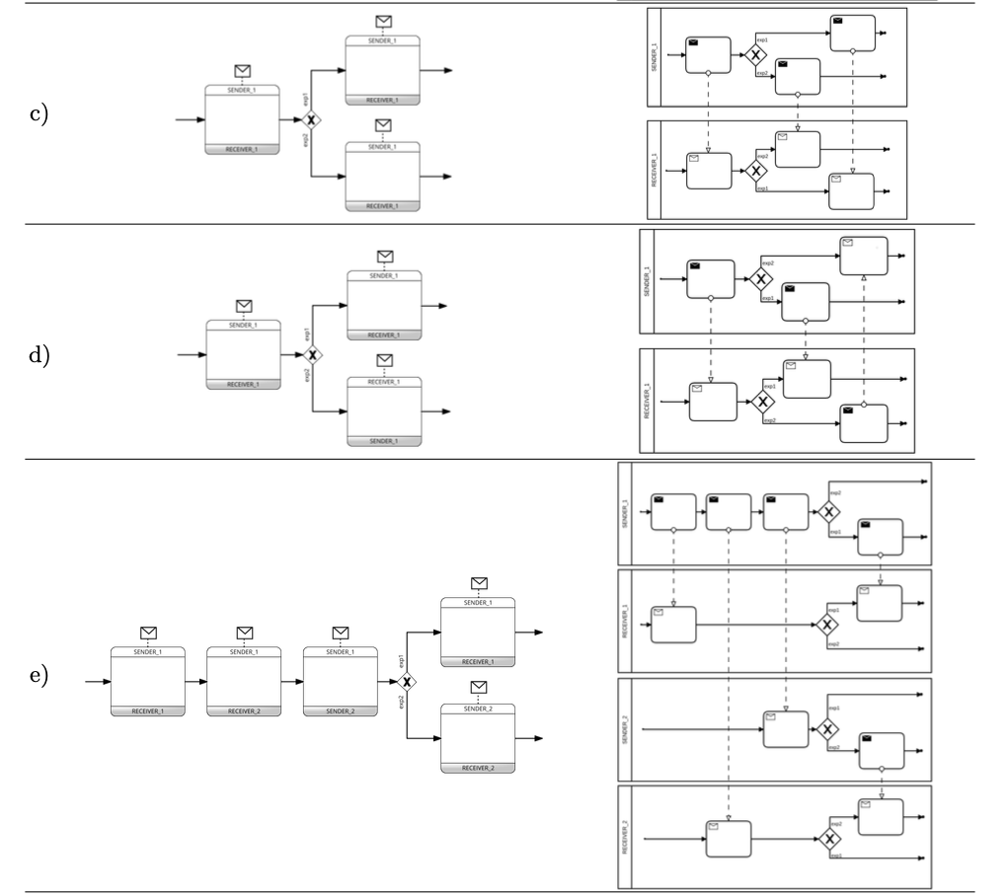
Exclusive Gateway

Slide 19
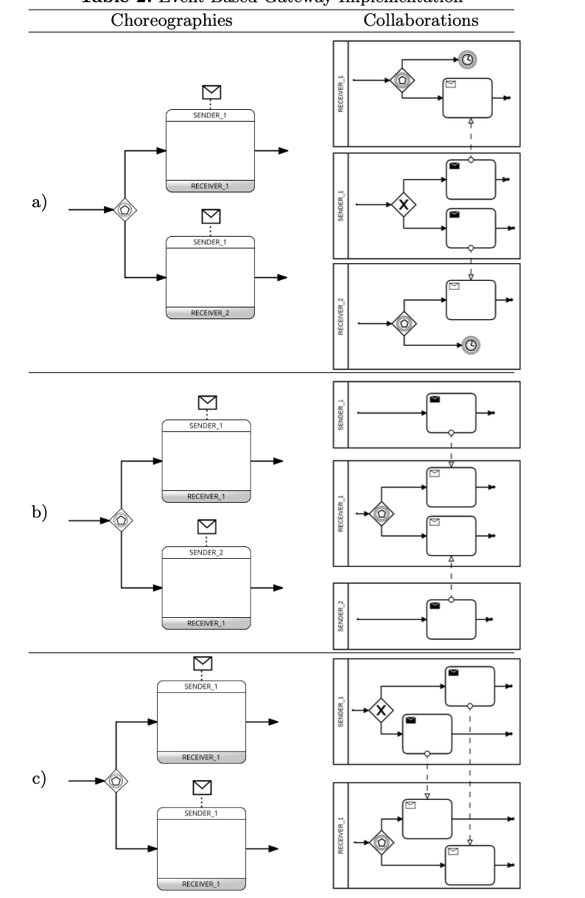
Event Based Gateway

Slide 20
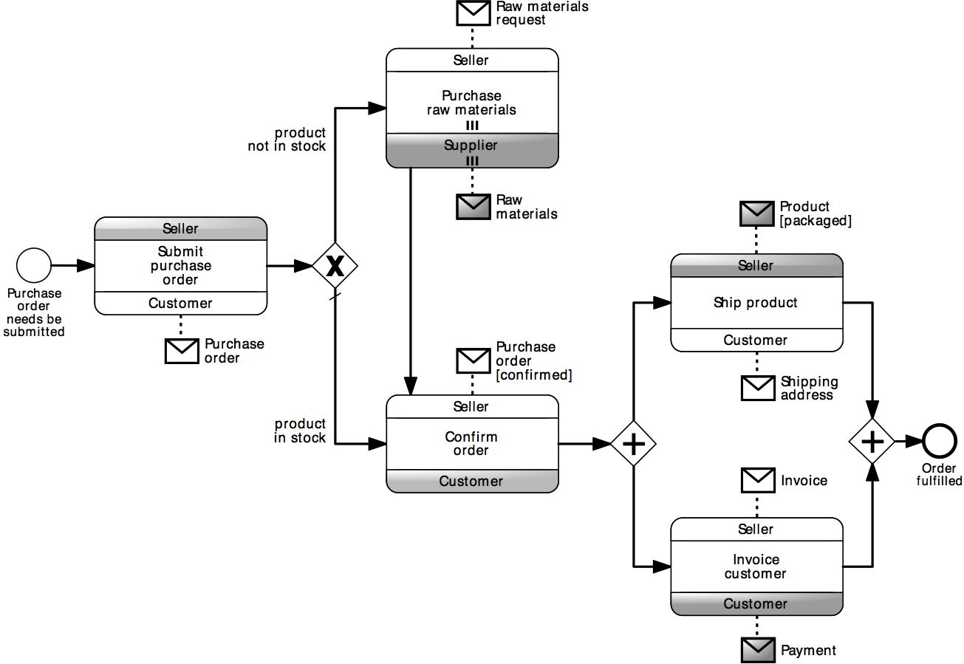
Example: Choreography
Use this diagram as a template to build the corresponding collaboration diagram

Slide 21
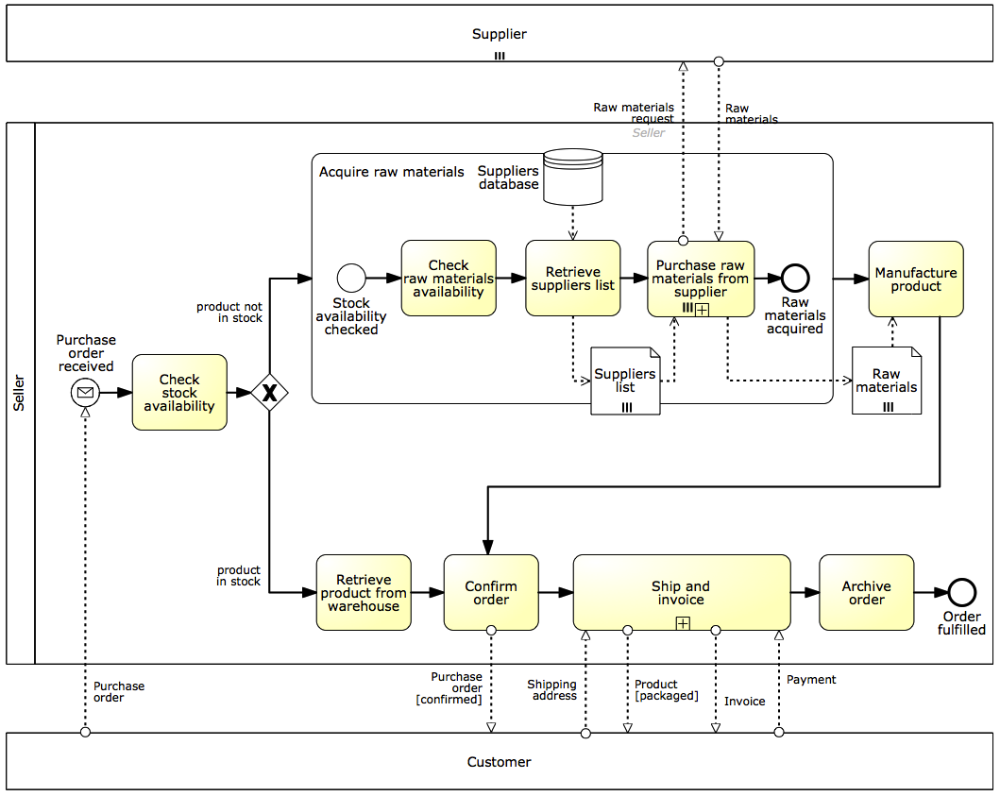
Solution

