Slide 1
Quality Assurance for Information Systems
Barbara Re – Andrea Polini

Slide 2
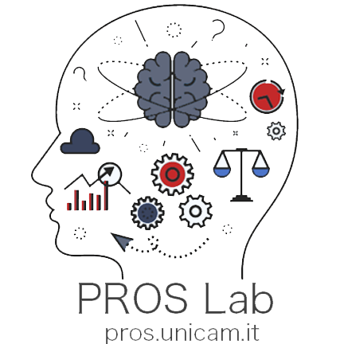
PROcesses and Services Lab
Research carried out within the PROS Lab deals with:
The development of languages and techniques for the modelling and analysis
The development of process aware information systems and services oriented applications
Our goal is to push the use of formal methods as methodological and automatic tools for the development of high-quality software
To make our tools usable by people not acquainted with the underlying mathematical foundations; we aim at effective but disappearing formal methods
Process Design
Process Analysis
Process Implementation
Process Monitoring and Controlling
Notes:
Areas of contamination are formal method and software engineering

Slide 3
Course Objectives and Learning Outcome
The course intends to illustrate to the students the relevance of quality in the production of Information Systems with a particular focus on those information systems based on models. The course, then, faces the quality assurance of such systems from two different perspectives.
The first one is that of the quality of models used to define the behaviour of Information Systems. In particular considered issues are related to behavioural and quantitative aspects.
For what concern behavioural aspect the course will focus on verification techniques; model transformation from semi-formal to formal notation will be presented as well as execution states exploration strategies.
Related quantitative aspects of flow analysis, queueing analysis, the simulation will be discussed. This will make it possible to analyze models and related information systems in terms of process performance measures (i.e. cycle time, waiting time, cost, and other measures).
The second perspective instead refers to software testing. In this case, the student will learn about the main objectives and issues of testing an Information Systems, and how to structure a software testing process for complex Information Systems selecting among the many available strategies.
As a result, the student will acquire competencies that will permit him/her to select the right strategy to adopt in real-world scenarios. The course will also illustrate the usage of concrete tools to perform the different activities introduced for bot quality assurance approaches.

Slide 4
Syllabus
Introduction to information systems
From model to code a framework for quality management
Model transformation and design time verification
Qualitative process analysis: value add analysis, waste analysis
Quantitative process analysis: flow analysis, queueing analysis, simulation
Information systems auditing: anomaly detection and mining
Testing methodologies

Slide 5
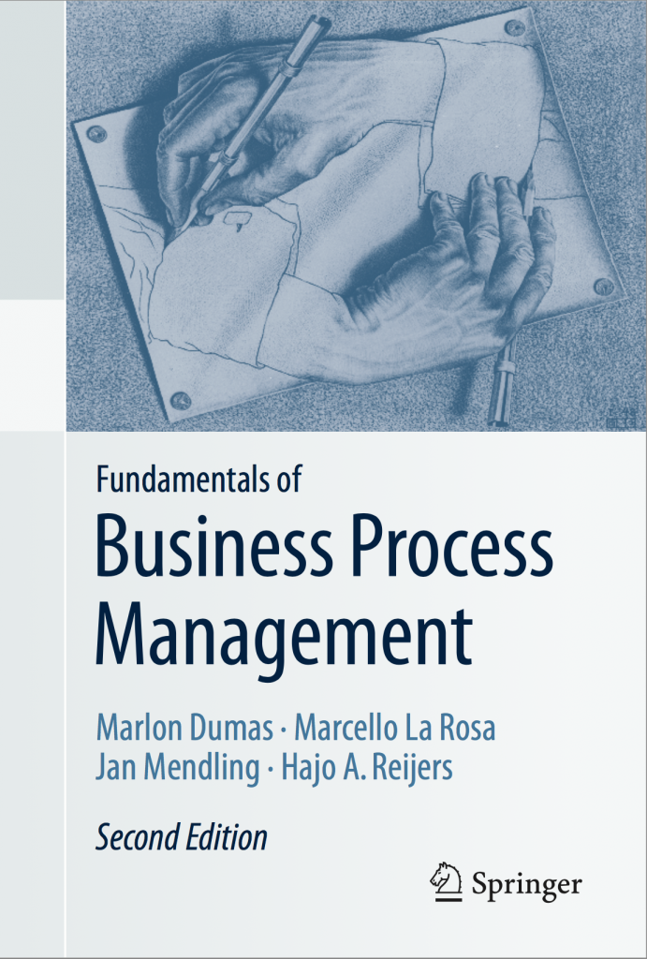
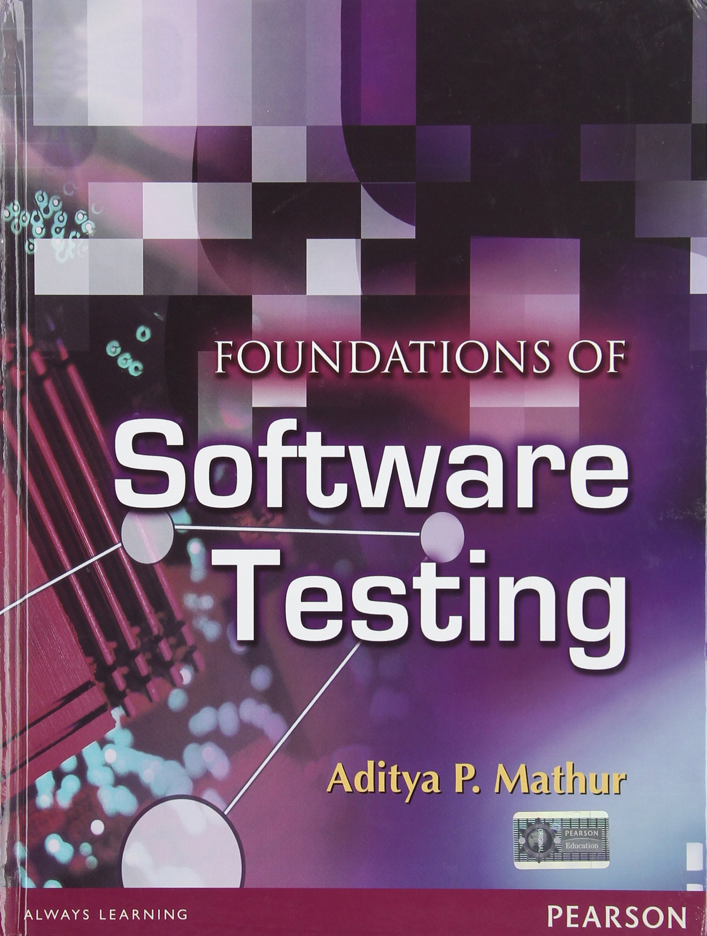
Reference books
Dumas M, La Rosa M, Mendling J., Reijers H: Fundamentals of Business Process Management, Springer 2018.
Aditya P. Mathur, Foundations of Software Testing, 2nd Edition, Pearson 2014
William E. Perry. Quality Assurance for Information Systems: Methods, Tools, and Techniques. A Wiley-QED Publication, 1991.
http://fundamentals-of-bpm.org/

Slide 6
Further materials and Tools
Business Process Model And Notation (BPMN) Version 2.0 - http://www.omg.org/spec/BPMN/2.0/
Research papers selected during the course (all of them are already/will be available on the web-site)
Pros Tools → http://pros.unicam.it/

Slide 7
Teaching and Learning Methods
42 h - Lectures and class exercises
Wednesday : 11:00 am– 13:00 am
Thursday: 16:00 am – 18:00 am
Private study: reading and exploring

Slide 8
WIKI CS
All Relevant Information Available on the Wiki CS
http://didattica.cs.unicam.it

Slide 9
Exams
Writing Examination on the topics of the syllabus
Open or multiple-choice questions + Exercise
2 h
Dates (https://didattica.unicam.it/Home.do)

Slide 10
Students Communications
ISE - Unicam Computer Science
https://t.me/iseunicam

Slide 11
Questions?

