Slide 1
Exercise Ontology Dev. 101
Create the ontology for the MSc Business Information Systems as suggested in the Ontology Engineering lecture.
Use Protégé to create the ontology
Test your ontology
the latest version of the tool has a bug in the SPARQL tab. See the below two options to overcome this issue.
Notes:
PREFIX : <http://www.semanticweb.org/admin/ontologies/2024/3/MScBIS#>
SELECT ?course ?coordinator
WHERE {
?course :MScBISCourseIsCoordinatedByDidacticStaff ?coordinator .
}
All the queries:
SELECT ?module ?coordinator
WHERE {
?module teaching:isCoordinatedBy ?coordinator .
}
SELECT ?lecture ?teacher
WHERE {
?lecture teaching:isTaughtBy ?teacher .
}
SELECT ?course ?researcher
WHERE {
?course teaching:involves ?researcher .
}
SELECT ?project
WHERE {
?project rdf:type teaching:Project .
}

Slide 2
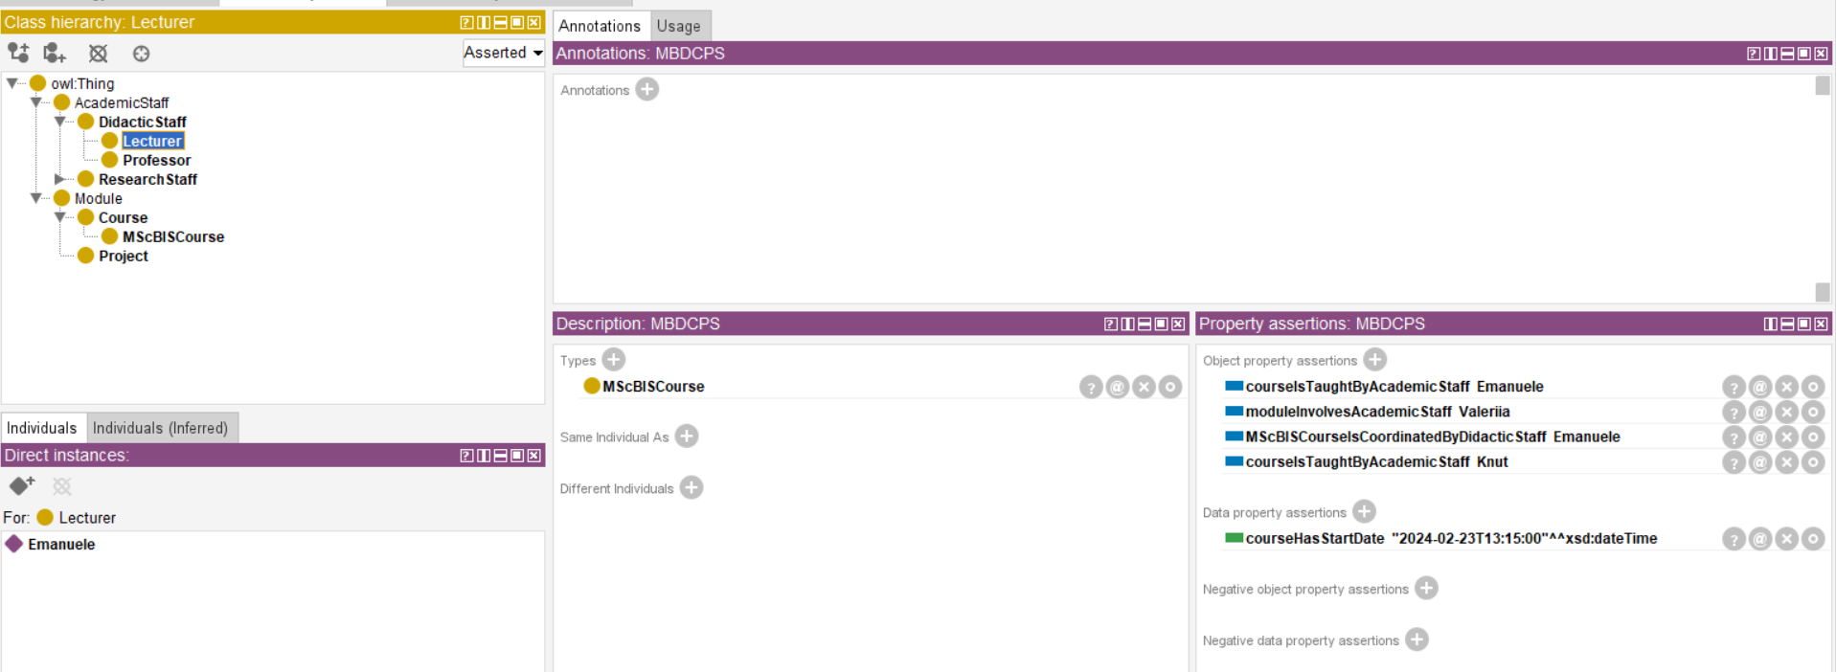
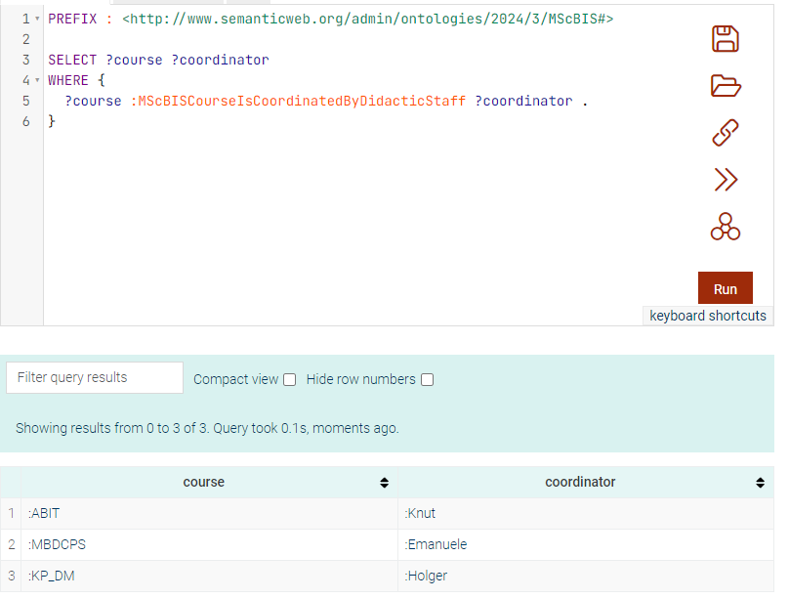
Option 1: Use GraphDB for Testing your ontology
Test your ontology – the latest version of the tool has a bug in the SPARQL tab. Use GraphDB to test your ontology.
Load the ontology create in Protégé in GraphDB and query it.
Notes:
PREFIX : <http://www.semanticweb.org/admin/ontologies/2024/3/MScBIS#>
SELECT ?course ?coordinator
WHERE {
?course :MScBISCourseIsCoordinatedByDidacticStaff ?coordinator .
}
All the queries:
SELECT ?module ?coordinator
WHERE {
?module teaching:isCoordinatedBy ?coordinator .
}
SELECT ?lecture ?teacher
WHERE {
?lecture teaching:isTaughtBy ?teacher .
}
SELECT ?course ?researcher
WHERE {
?course teaching:involves ?researcher .
}
SELECT ?project
WHERE {
?project rdf:type teaching:Project .
}

Slide 3
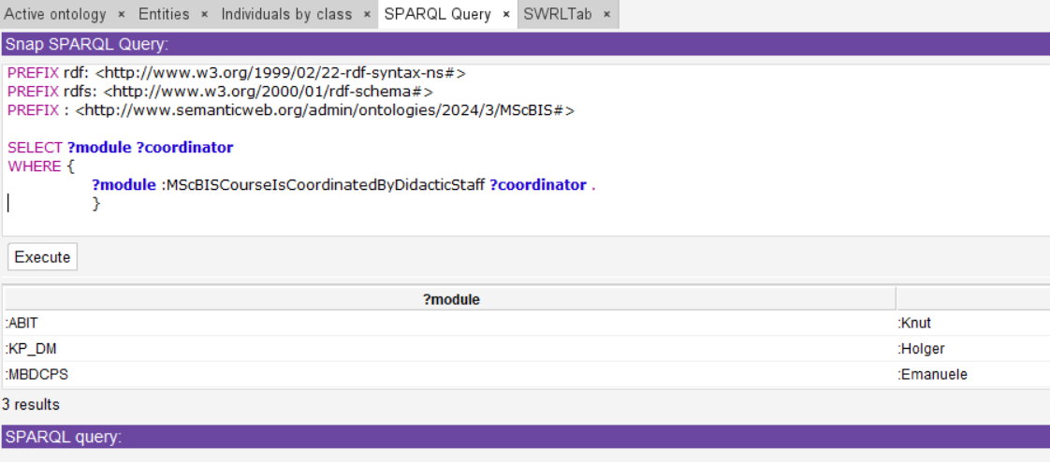
Option 2: Use Snap SPARQL Query in Protégé
Visualize the SPARQL tab (Window>Tabs>SPARQL Query)
View the Snap SPARQL in the SPARQL Tab (Window>Views>Query Views>Snap SPARQL Query)
To see the query results you should first start the reasoner and then execute the query.

