Slide 1
Introduction to Enterprise Architecture and Enterprise Modelling
Barbara Re
Notes:
Enterprise Architecture Frameworks: Alter, Zachman. Modelling an Enterprise Architecture with ArchiMate.

Slide 2
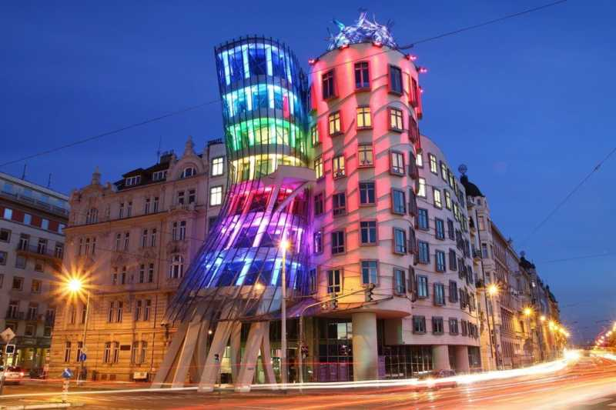
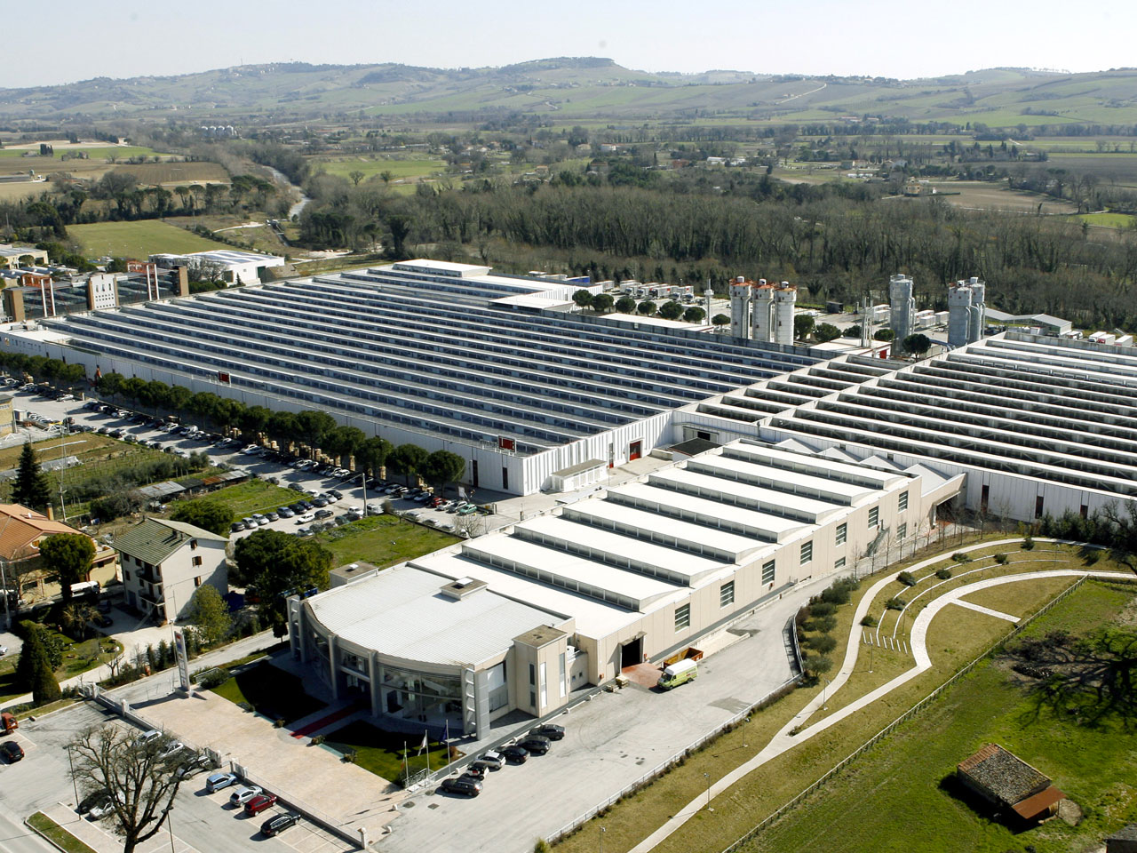
Are we speaking about buildings?
In the literature and community of practices, there are various perspectives in regards to the meaning of the term enterprise architecture
Notes:
The Dancing House (Czech: Tančící dům), or Fred and Ginger, is the nickname given to the Nationale-Nederlanden building on the Rašínovo nábřeží (Rašín Embankment) in Prague, Czech Republic. It was designed by the Croatian-Czech architect Vlado Milunić in cooperation with Canadian-American architect Frank Gehry on a vacant riverfront plot. The building was designed in 1992 and completed in 1996.^{[1]}
Il progetto è stato elaborato dagli architetti Vlado Milunić e Frank O. Gehry. La concezione dell’edificio è ispirata allo stile di danza della famosa coppia Fred Astaire (rappresentato dalla torre di pietra) e Ginger Rogers (rappresentata dalla torre di vetro). Fu costruita nel 1996 e rappresenta la punta di diamante dell’architettura moderna praghese.
IL secondo edificio è lo stabilimento della LUBE

Slide 3
From a terminological point of view
The term enterprise can be defined as describing an organizational unit, organization, or collection of organizations that share a set of common goals and collaborate to provide specific products or services to customers
The term enterprise covers various types of organizations, regardless of their size, ownership model, operational model, or geographical distribution
It includes those organizations' complete socio-technical systems, including people, information, processes, and technologies
The term architecture refers to fundamental concepts or properties of a system in its environment, embodied in its elements, relationships, and in the principles of its design and evolution

Slide 4
Enterprise Architecture Definitions
The MIT Center for Information Systems Research defined enterprise architecture as the specific aspects of a business that are under examination:
Enterprise architecture is the organizing logic for business processes and IT infrastructure reflecting the integration and standardization requirements of the company's operating model for delivering goods and services to customers
The Enterprise Architecture Body of Knowledge defines enterprise architecture as a practice, which analyzes areas of common activity within or between organizations, where information and other resources are exchanged to guide future states from an integrated viewpoint of strategy, business, and technology
IT analysis firm Gartner defines the term as a discipline where an enterprise is led through change
Enterprise architecture (EA) is a discipline for proactively and holistically leading enterprise responses to disruptive forces by identifying and analyzing the execution of change toward desired business vision and outcomes
Enterprise architecture is used to steer decision making toward the evolution of the future state architecture
Notes:
Each of the definitions above underplays the historical reality that enterprise architecture emerged from methods for documenting and planning information systems architectures, and the current reality that most enterprise architecture practitioners report to a CIO or other IT department manager. In a business organization structure today, the enterprise architecture team performs an ongoing business function that helps business and IT managers to figure out the best strategies to support and enable business development and business change – in relation to the business information systems that the business depends on.

Slide 5
ISO Definition
"Architecture" names that which is fundamental about a system; the set of essential properties of a system which determine its form, function, value, cost, and risk
That which is fundamental to a system takes several forms
its elements: the constituents that make up the system
the relationships: both internal and external to the system
the principles of its design and evolution
ISO/IEC/IEEE 42010 - http://www.iso-architecture.org/ieee-1471/cm

Slide 6
Enterprise Architecture: Overall View
Enterprise Strategies & Direction
Project & initiatives
Business Process and Services
Organization
& People
Applications
Data
IT infrastructure and services
Notes:
Outdated Strategies and Organization Structures?
Archaic Business Processes?
Antique Applications and Data?
Obsolete Technologies?
Does Strategy Drive What we do?
Do IT Investments Align with Strategic Business Direction?
Do we have clear visibility of the Scope of our Projects?

Slide 7
Notes:
https://www.youtube.com/watch?v=qDI2oF1bASk

Slide 8
Architecture and Architecture Description
An architecture is a conception of a system – i.e., it is in the human mind. An architecture may exist without ever being written down
An Architecture Description is an artifact that expresses an Architecture to share with others
An Architecture Description consists of one or several Architecture Models
A Model is a reproduction of a relevant part of reality which contains the essential aspects to be investigated

Slide 9
Enterprise Architecture (Description)
An "Architecture" (for anything) would be the total set of descriptive representations (models) relevant for describing a complex object such that it can be created and that constitute a baseline for changing the object after it has been instantiated
Therefore "Enterprise Architecture" would be the total set of models relevant for describing an Enterprise, that is, the descriptive representations required
to create a (coherent, optimal) enterprise
to serve as a baseline for changing the Enterprise once it is created

Slide 10
Architecture Framework
An Architecture Framework establishes a common practice for creating, interpreting, analyzing and using architecture descriptions
It is a logical structure for classifying and organizing the descriptive representations of a system

Slide 11
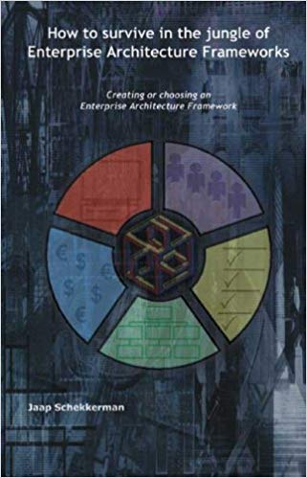
The Jungle of Enterprise Architecture Framework

Slide 12
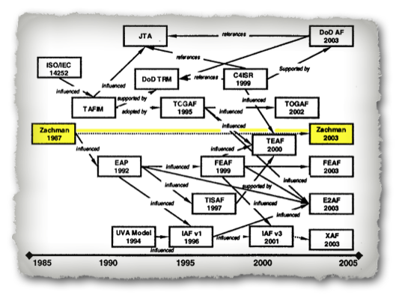
A wide list of frameworks
Consortia-developed frameworks
Generalised Enterprise Reference Architecture and Methodology
IDEAS Group – a four-nation effort to develop a common ontology for architecture interoperability
ISO 19439 Framework for enterprise modelling
TOGAF – The Open Group Architecture Framework – a widely used framework including an architectural Development Method and standards for describing various types of architecture
Defense industry frameworks
AGATE – the France DGA Architecture Framework
DoDAF – the US Department of Defense Architecture Framework
MODAF – the UK Ministry of Defence Architecture Framework
NAF – the NATO Architecture Framework
Government frameworks
European Space Agency Architectural Framework (ESAAF) - a framework for European space-based Systems of Systems
Government Enterprise Architecture (GEA) – a common framework legislated for use by departments of the Queensland Government
Treasury Enterprise Architecture Framework (TEAF) – a framework for treasury, published by the US Department of the Treasury in July 2000
Open-source framework
MEGAF is an infrastructure for realizing architecture frameworks that conform to the definition of architecture framework provided in ISO/IEC/IEEE 42010
Praxeme, an open enterprise methodology, contains an enterprise architecture framework called the Enterprise System Topology
TRAK – a general systems-oriented framework based on MODAF 1.2 and released under GPL/GFDL
SABSA is an open framework and methodology for Enterprise Security Architecture and Service Management, that is risk based and focuses on integrating security into business and IT management

Slide 13
Enterprise Architecture Frameworks
We can distinguish two main types of structures for Enterprise Architecture Frameworks
Matrix of aspects and perspectives
e.g. -- Zachmann Enterprise Architecture Framework
Layer architecture with business, applications and technology
e.g. -- ArchiMate – A modeling language for EA

Slide 14
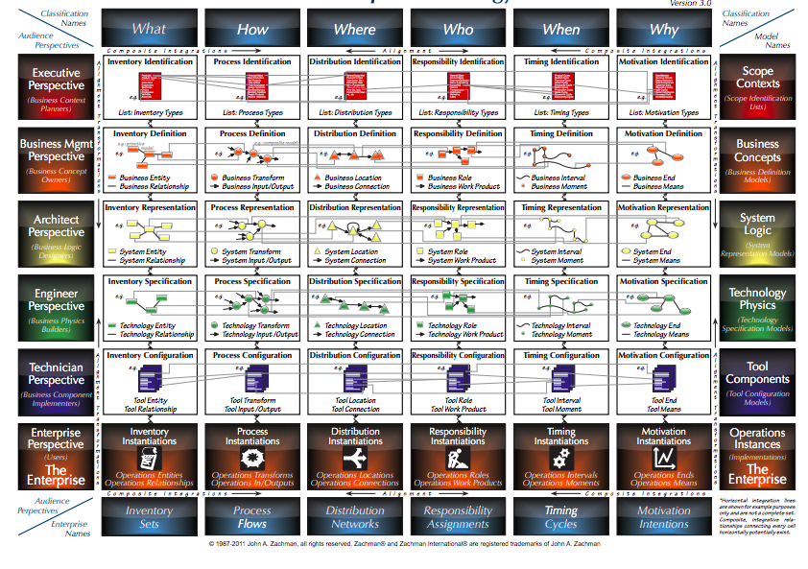
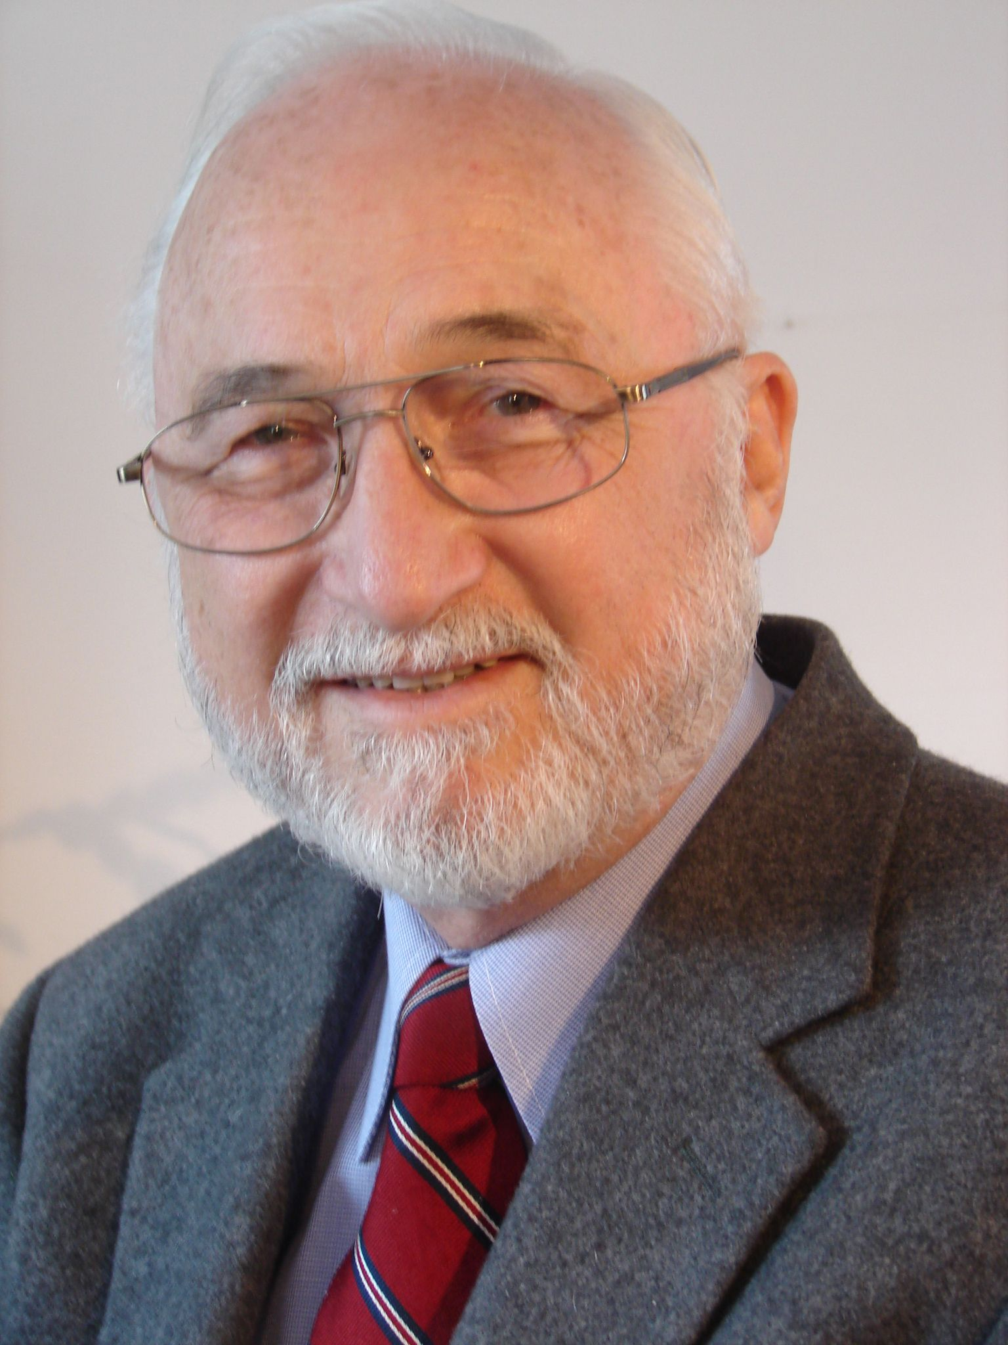
The Zachman Framework
John Zachman

Slide 15
Zachman Framework
Regarded the origin of enterprise architecture frameworks (originally called "Framework for Information Systems Architecture")
First version published in 1987 by John Zachman
It is still further developed by Zachman International (http://www.zachman.com)
Often referenced as a standard approach for expressing the basic elements of enterprise architecture
Zachman, J.A., 1987. A framework for information systems architecture. IBM Systems Journal, 26(3).

Slide 16
Abstractions
Perspectives
Notes:
There is not a single descriptive representation for a complex object ... there is a SET of descriptive representations.
Descriptive representations (of anything) typically include:
Perspectives
Abstractions

Slide 17
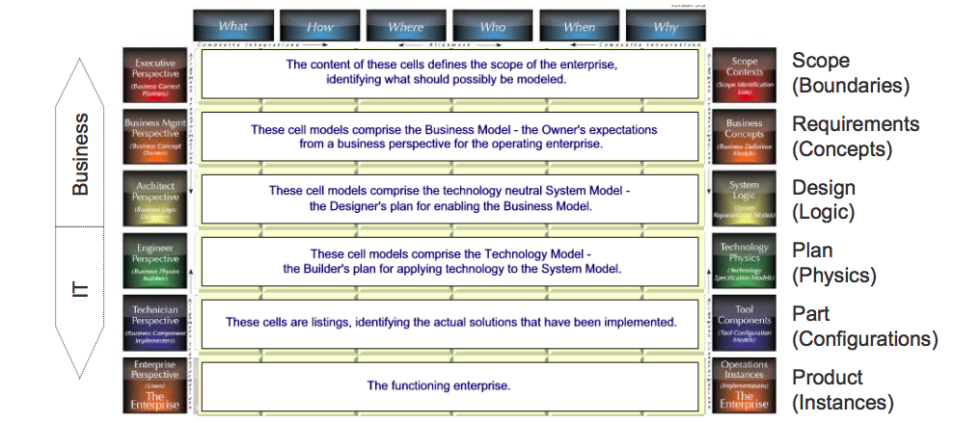
Perspectives
Each row is different in nature, in content, in semantics from the others – representing different perspectives
Representations do not correspond to different levels of details – level of detail is an independent variable, varying within one representation

Slide 18
Abstractions
There exist different types of descriptions oriented to different aspects
Zachman associates each aspect with a question word
WHAT inventory models
HOW functional/process models
WHERE location/distribution models
WHO organisation models
WHEN timing models
WHY motivation models

Slide 19
Framework Rules
Rule 1: The columns have no order
Order implies priorities and creates a bias toward one aspect at the expense of others. All columns are equally important because all are abstractions of the same enterprise.
Rule 2: Each column has a simple, basic model
Each column represents an abstraction from the real world for convenience of description. These models include: Data (what), Function (how), Network (where), People (who), Time (when), and Motivation (why)
Rule 3: The basic model of each column must be unique
The individual models may be related to one another because they are all abstractions of the same real-world enterprise, but each model represents a separate and unique concept.
Rule 4: Each row represents a distinct perspective
This rule is most easily demonstrated by the Business Model, System Model, and Technology Model rows, which represent the owner’s, architect’s, and builder’s perspectives. Each perspective is different because it deals with a different set of constraints. For example, the owner deals with usability constraints, both aesthetic and functional, and the architect deals with design constraints, the laws of physics or nature, and the builder deals with construction constraints, the state of the art in methods and technologies.
Rule 5: Each cell is unique
Since each column has a unique basic model that makes each column unique and each row has a different perspective, each cell in the framework is unique.
Rule 6: Combining the cells in one row forms a complete model.
The sum of all cells in a given row is the most complete depiction of reality from the perspective of that row. As new cells in a given row are defined each new cell description must be consistent with the perspective of that row. Each cell in a given row can be defined and is independent of any other cells in the row, yet each cell is but one abstraction of the same perspective of reality. Therefore, each cell is related to every other cell in the same row

Slide 20
Row 1
Motivation/Why
Business goals, objectives and performance
measures related to each function
Perspective: scope
Role: planner
Function/How
High-level business functions
Data/What
High-level data classes related to each
function
What
How
Where
Who
When
Why
1
Contextual
Contextual
People/Who
Stakeholders related to each function
Conceptual
Conceptual
Logical
Logical
Network/Where
VA locations related to each function
Physical
Physical
As Built
As Built
Time/When
Cycles and events related to each
function
Functioning
Functioning
What
How
Where
Who
When
Why
Enterprise and Business Process Modelling
20
Notes:
Sommario essenziale per chi voglia pianificare un investimento in un sistema informativo aziendale delineando lo scopo e stimandono I costi e le performance

Slide 21
Row 2
Motivation/Why
Policies, procedures and standards for each
process
Perspective: business model
Role: owner
Function/How
Business processes
Data/What
Business data
What
How
Where
Who
When
Why
Contextual
Contextual
People/Who
VA roles and responsibilities in each
process
2
Conceptual
Conceptual
Logical
Logical
Network/Where
VA locations related to each process
Physical
Physical
As Built
As Built
Time/When
Events for each process and sequencing
of integration and process improvements
Functioning
Functioning
What
How
Where
Who
When
Why
Notes:
Obiettivi strategie e processi che sono usati per supportare la mission del progetto in atto

Slide 22
Row 3
Motivation/Why
VA policies, standards and procedures
associated with a business rule model
Perspective: system model
Role: designer
Function/How
Logical representation of information
systems and their relationships
Data/What
Logical data models of data and data
relationships underlying VA information
What
How
Where
Who
When
Why
Contextual
Contextual
People/Who
Logical representation of access privileges
constrained by roles and responsibilities
Conceptual
Conceptual
3
Logical
Logical
Network/Where
Logical representation of the distributed
system architecture for VA locations
Physical
Physical
As Built
As Built
Time/When
Logical events and their triggered responses
constrained by business events and their responses
Functioning
Functioning
What
How
Where
Who
When
Why
Notes:
E’ la prospettiva dell’ingegnere del software intermiatior tra quello è che desiderato nella riga 2 e quello che è possibiletenchicamente e fisicamente nella linea 4. E’ colui che si occupa del disegno logico del nuovo sistema. I modelli includono I requisiti del sistema gli oggetti, le attività e le funzioni che implementano il modello di business

Slide 23
Row 4
Motivation/Why
VA business rules constrained by information
systems standards
Perspective: Technology
Role: builder
Function/How
Specifications of applications that operate
on particular technology platforms
Data/What
Database management system (DBMS) type
requirements constrained by logical data models
What
How
Where
Who
When
Why
Contextual
Contextual
Conceptual
Conceptual
People/Who
Specification of access privileges to
specific platforms and technologies
Logical
Logical
4
Physical
Physical
Network/Where
Specification of network devices and their
relationships within physical boundaries
As Built
As Built
Functioning
Functioning
Time/When
Specification of triggers to respond to system
events on specific platforms and technologies
What
How
Where
Who
When
Why
Notes:
Il modello che adatta il progetto di sistema ai vincoli posti dal linguaggio di programmazione, dai dispositivi hardware e in generale dalle tecnologie esistenti.

Slide 24
Row 5
Motivation/Why
VA business rules constrained by specific
technology standards
Perspective: Detailed Representation
Role: sub-contractor
Function/How
Programs coded to operate on specific
technology platforms
Data/What
Data definitions constrained by physical
data models
What
How
Where
Who
When
Why
Contextual
Contextual
Conceptual
Conceptual
People/Who
Access privileges coded to control access
to specific platforms and technologies
Logical
Logical
Physical
Physical
Network/Where
Network devices configured to conform to
node specifications
5
As Built
As Built
Functioning
Functioning
Time/When
Timing definitions coded to sequence
activities on specific platforms and technologies
What
How
Where
Who
When
Why
Notes:
Significa dettagliata fornitura ai programmatori che hanno il compito di sviluppare moduli individuali senza la necessità di procurarsi del contesto cioè della struttura generale del sistema.

Slide 25
Row 6
Motivation/Why
Operating characteristics of specific
technologies constrained by standards
Perspective: Functioning Enterprise
Role: user view
Function/How
Functioning computer instructions
Data/What
Data values stored in actual databases
What
How
Where
Who
When
Why
Contextual
Contextual
People/Who
VA personnel and key stakeholders
working within their roles and responsibilities
Conceptual
Conceptual
Logical
Logical
Network/Where
Sending and receiving messages
Physical
Physical
Integrated
Integrated
Time/When
Timing definitions operating to sequence
activities
6
Functioning
Functioning
What
How
Where
Who
When
Why

Slide 26
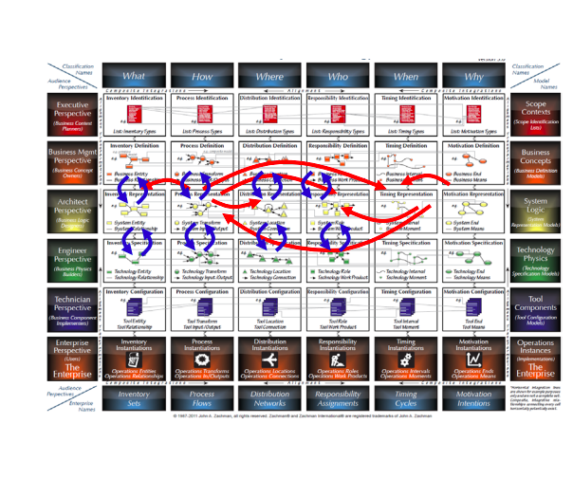
Relations between Models
There are relations between (elements of) the models
Horizontal Relations: In same perspective, e.g.
Data used in a process
Application implementing a process activitiy
Vertical relations: Between different perspectives
Implementation of an application
Database model for an entity relationship model

Slide 27
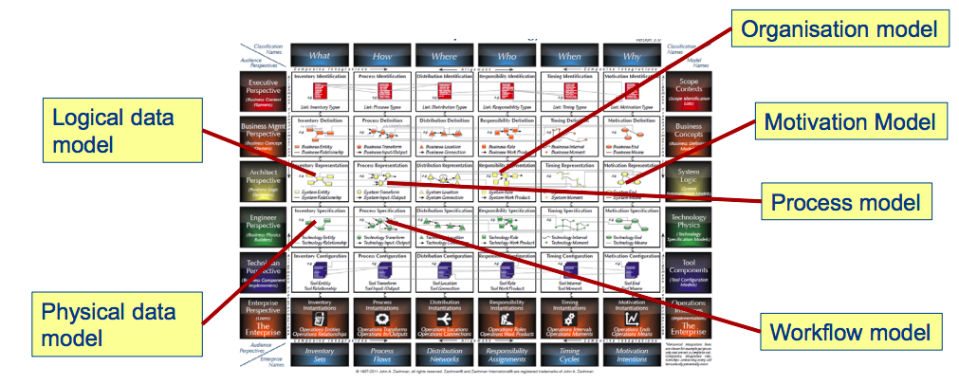
Models and the Zachman Framework
Notes:
Concepts for modelling are related to cells.
Models are composites, they can roughly be assigned to cells, if they are composed of elements (concepts) of this cell.
The elements of models can (roughly) be assigned to cells, but often cover.

Slide 28
Examples of Models Kinds
Notes:
La colonna what descrive in linea generale I materiali e gli oggetti di cui il prodotto finale sarà composto in un sistema informativo questa colonna contine il modello dei dati
BASIC Model: entity relationship entity
La colonna how descrive le caratteristiche funzionali del prodotto finale per un sistema informativo una simile descrizione può essere chimata modello di processo
BASIC Model: Process diagram
La colonna where descrive il prodotto dal punto di vista fisico dello spazio evidenzianone la dislocazione e connessione dei componenti.
BASIC Model: Site liink site (node link node)
LA colonna who riguarda l’allocazione del lavoro e la strutturazione delle responsabilità e dell’autorità.
Basic Model: people work people
La colonna when descrive eventi e le relazioni tra essi che determinano I criteri per misurare le performance e l’utilizzo di srisorse
Basic model event duration event
La colonna why descrive quali sono le motivazioni che guidano le scelte relative al prodotto sistema
Basic Model: ends – means - ends

Slide 29
Exercise - Executive Perspective of Alitalia Enterprise Architecture
For the Alitalia Airlines, what information can you find to describe the enterprise architecture according to the Zachman Framework from the executive perspective (scope contexts).
Notes:
What

Slide 30
List of flies Hour of flyies List of destination Budget constrains Prize of tickets Hot destinations List of flyers Lists of hotels List of airplanes Types of airplanes List of companies (suppliers) List of staff number | Booking Pilot Selection/Control Partnership management with hotels Booking Airplane Maintenance Rearrange seats Booking seats Booking | - Airport Fiumicino Website Agencies The financial department offices Garage Fiumicino Malpensa | Director Pilots Crew Disability Assistance Staff Director The financial department Head of Plain Maintainence Division Airport Staff Maintainace Crew | 6 years 4 months 10 months | To serve the customer Optimize the services Safe time/money Optimize the ticket prize to sell more Rearrange the plain space

Slide 31
Visual Paradigm
https://ap.visual-paradigm.com/universita-di-camerino

Slide 32
Questions?

