Slide 1
Marcello La Rosa & Marlon Dumas
Part II: the “last mile”
Queensland University of Technology, University of Tartu
m.larosa@qut.edu.au, marlon.dumas@ut.ee

Slide 2
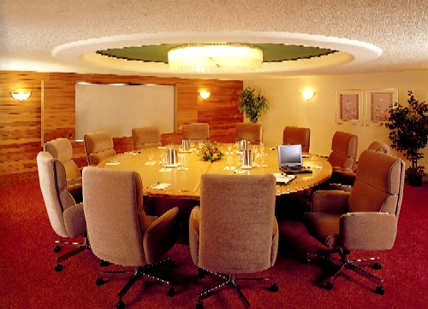
Bridging the gap: one task at a time
Identify the automation boundaries
Review manual tasks
Complete the process model
Adjust task granularity
Specify execution properties
Notes:
Recap

Slide 3
5. Specify execution properties
-> Process variables, messages, signals, errors
-> Task and event variables and their mappings to process variables
-> Service details
-> Code snippets
-> Participant assignment rules and user interface structure
-> Task, event and sequence flow expressions
-> BPMS-specific: work queues, forms, connectors…
Notes:
So far we have obtained a “to-be-executed” process model. Up until this point, business analysts can be involved, so these first four steps are not a prerogative of technical staff. However, the last step is something that requires knowledge of the system and related technologies. In fact, in this step we need to specify:

Slide 4
Let‘s take a step back: BPMSs
Notes:
Thus, in order to specify these properties, we first need to become familiar with the IT solutions that are available to perform this last step, i.e. to concretely automate the “to-be-executed” model that we have obtained so far. So let’s keep calm and take a step back.

Slide 5
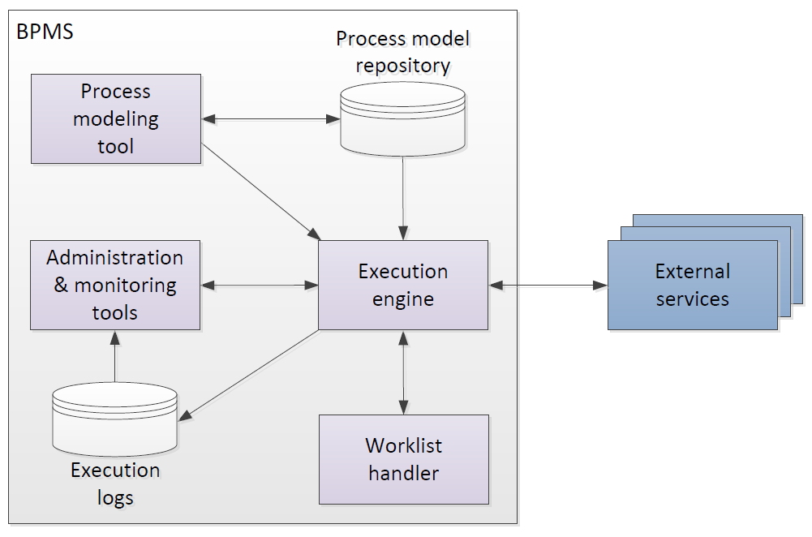
Business Process Management System
Notes:
External services, e.g. a business rules engine (sometimes available as an internal component)
If the previous slide is skipped, this slide can simply be called “Typical architecture of a BPMS”

Slide 6
Process modeling tool
To create and modify executable process models (by specifying execution properties)
To store and retrieve automation solutions from a process model repository
May import from conceptual process modeling tools

Slide 7
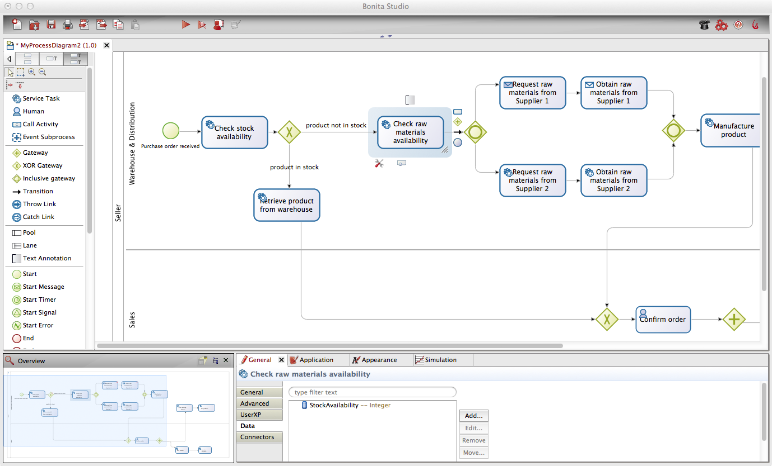
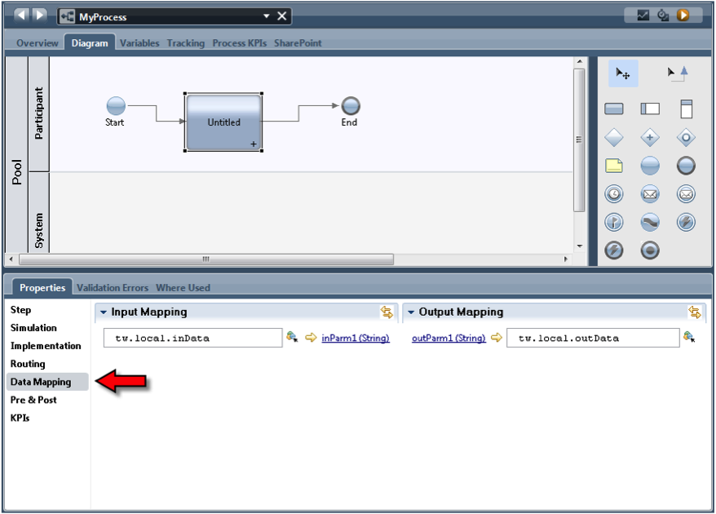
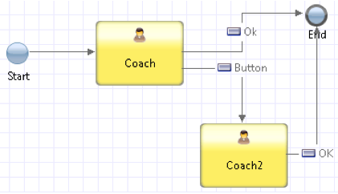
Example process modeling tools
IBM Business Process Manager
Bonita Soft Bonita Open Solution
Notes:
Focus on the interface to specify extra properties

Slide 8
Execution Engine
Instantiates executable process models (also called “cases”)
Orchestrates distribution of work items to process participants and software services in order to execute a business process from start to end
Logs execution data

Slide 9
Worklist Handler
Imagine it as an “inbox”
Offers work items to process participants and allows participants to commit to these work items
Handles participants’ work queues and work item priorities
May provide social network capabilities

Slide 10
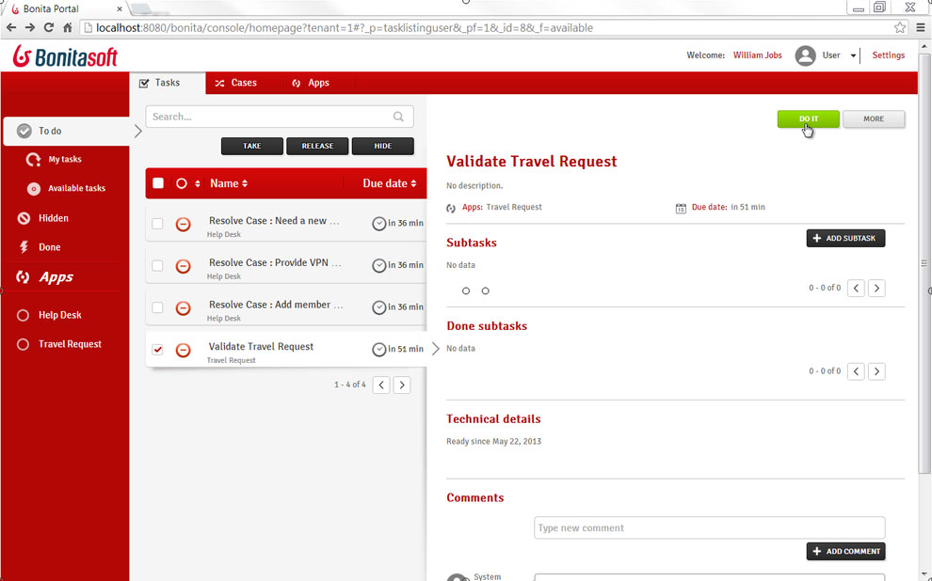
Example worklist handlers
Bonita Soft Bonita Open Solution
Notes:
TODO: add example with social network capabilities from Appian. Comment on social network capabilities of commercial worklist handlers

Slide 11
Administration & Monitoring Tools
To manage automation solutions
To configure access to system components
To monitor participants availability and performance of process cases

Slide 12
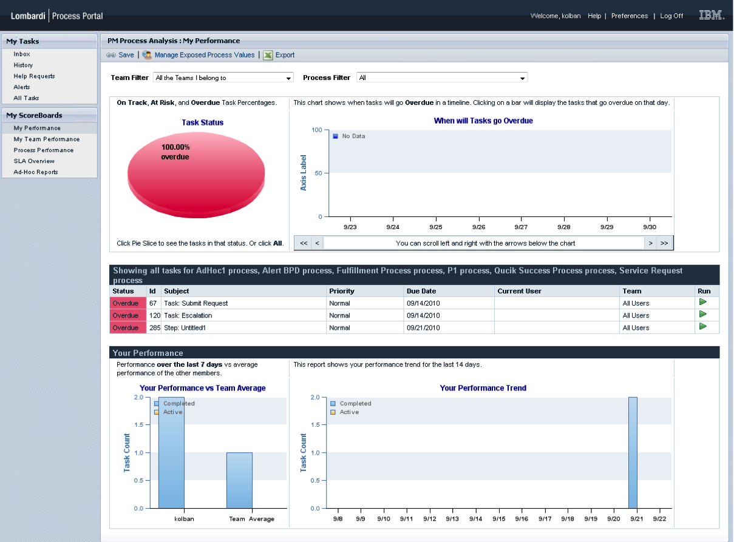
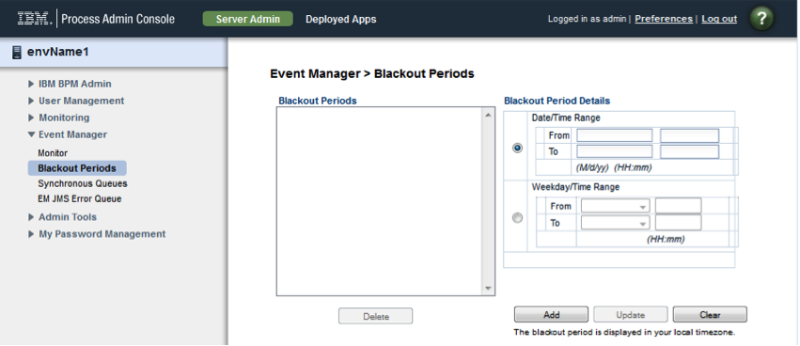
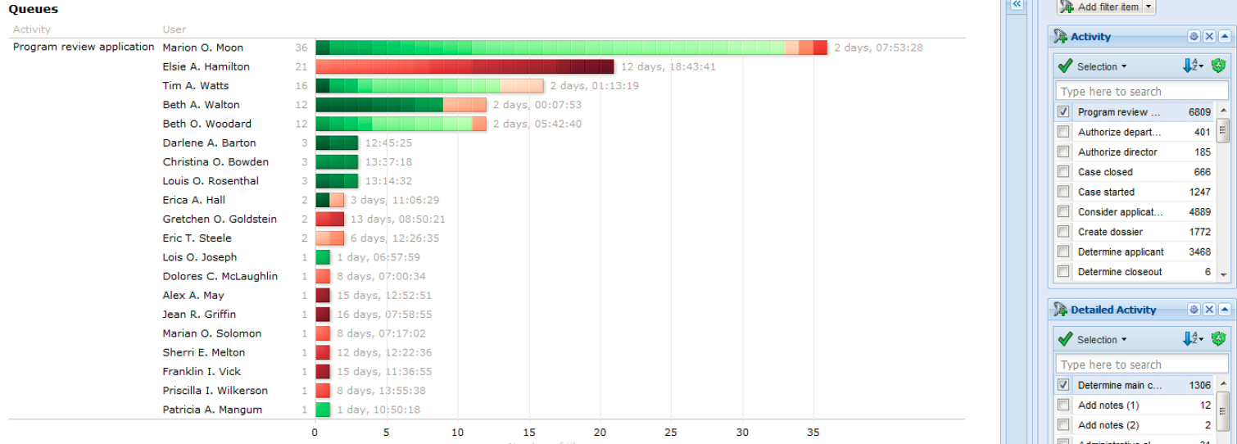
Example monitoring & administration tools
Perspective BPMOne
IBM BPM Process Admin Console
IBM BPM Process Portal

Slide 13
External Services
Expose a service interface with which the engine can interact
The engine provides the invoked service with the necessary data it will need to perform the activity for a specific case
Examples: rules engine, email or Twitter notification, DB connector, CRM connector…

Slide 14
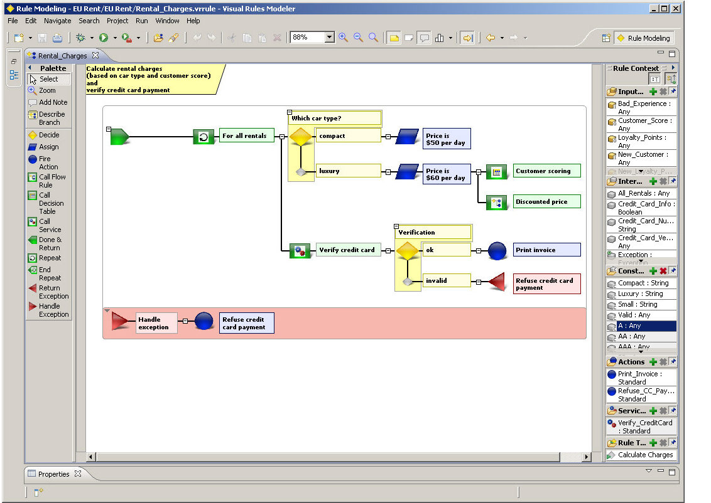
Example external services
Bosch Visual Rules editor

Slide 15
Evolution of the BPMS Landscape
© BPTrends

Slide 16
BPMS Landscape
Big vendors
Oracle BPMS
Microsoft BizTalk, Wf
Other closed-source
Appian BPMS
BizAgi BPM Suite
Community open-source
Shark
YAWL
SAP NetWeaver BPM
Software AG webMethods
Pagaystems PegaRULES
IBM BPM
OpenTex tBPM
Perceptive BPMONe
Progress Savvion
TIBCO ActiveMatrix BPM
Commercial open-source
Bonita Open Solution
Camunda Fox
Intalio|BPM
Bosch inubit Suite
JBoss jBPM
Notes:
A lot of choice. In large commercial projects, the engines on the left column are an option, since upfront licensing costs can be absorbed either by a project, or more frequently, by multiple projects (BPM program). It is worth noting that Microsoft offers two options: BizTalk which has a large number of integration features (all sort of adapters and integration tools), and Windows Workflow Foundation, which is more geared towards smaller projects.
In smaller projects/companies, the other closed-source engines are an option. These compete with open-source solutions, among which we can clearly distinguish between commercial open-source (companies making revenue out of consultancy, training and branding), and community open-source.
In this course we well use YAWL for 3 reasons:
Very easy and relatively lightweight installation (both on Windows and Mac), and small footprint – Cf. YAWL4Study
Quite advanced resource management features, good for illustrating various ways of assigning tasks to actors
Freely available, no restriction

Slide 17
BPMS classification according to BPMN support
Pure BPMN: (re)designed from the ground up to follow the spec to the letter
IBM BPM, Appian BPMS, Camunda Fox
Adapted BPMN: use a BPMN skin but rely on internal representation – predate BPMN
Bonita Open Solution, BizAgi BPM Suite
Non BPMN: proprietary language and semantics
Bosch inubit Suite, BPMOne, YAWL
Notes:
Adapted BPMN: can import from BPMN

Slide 18
Let‘s take a look at a concrete BPMS

Slide 19
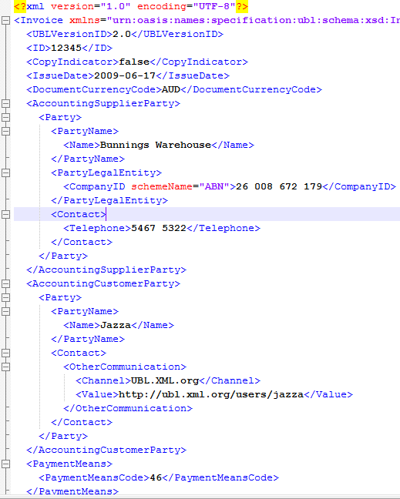
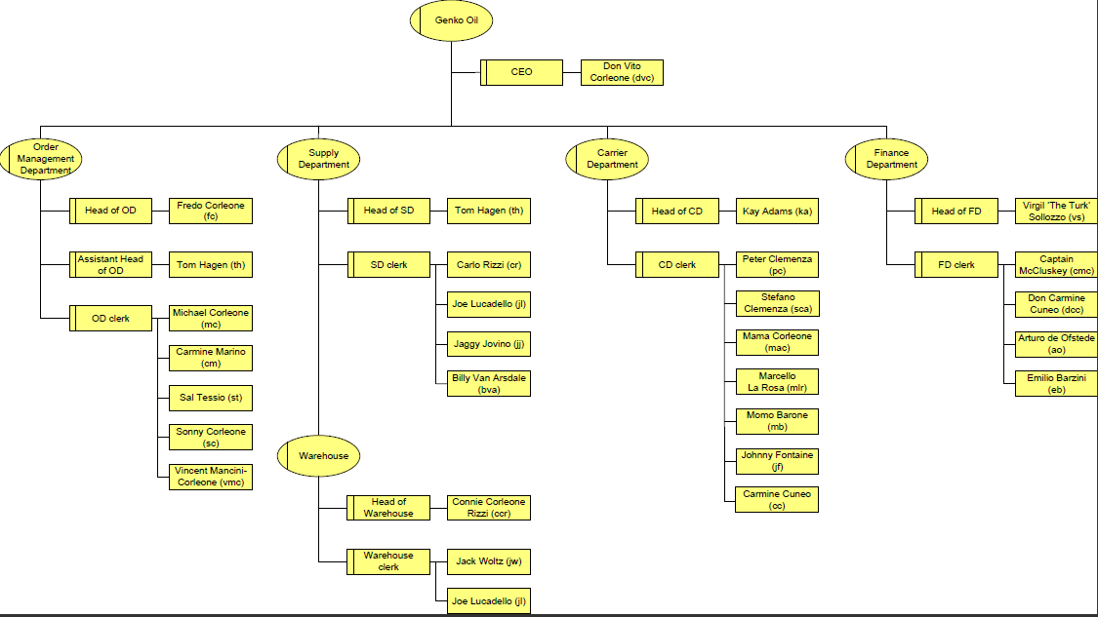
Cheat sheet
> specify sequence flow expressions…
Control flow
Data flow
Resources
> specify data types and data mappings
> specify participants assignment rules, service details...

Slide 20
Want to know more?
Long-awaited BPM textbook
Covers the entire BPM lifecycle
Running examples & questions
100+ exercises with and without solutions
Based on BPMN
Available as Springer eBook, Apple iBook, Amazon…
Chinese translation coming soon
Notes:
The story of the cover picture
3 interpretations of the picture:
Continuous improvement
Hands-on book
Paradox, as BPM…

Slide 21
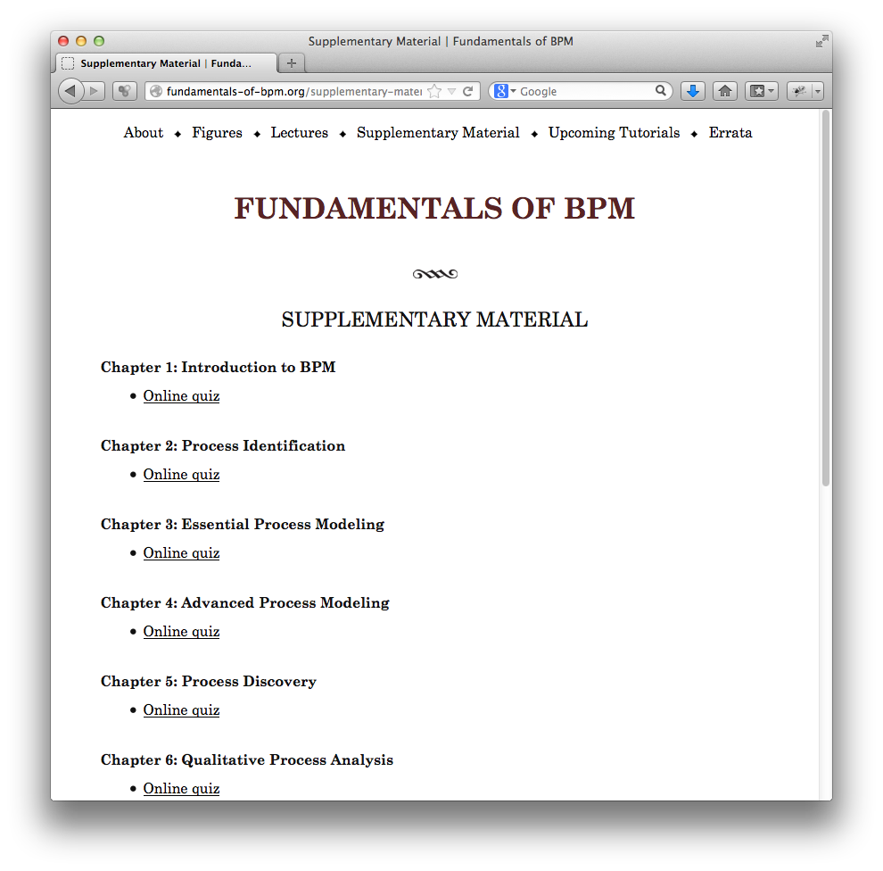
http://fundamentals-of-bpm.org
Lecture notes
A/V recordings
Quizzes
Tutorials
and more…

Slide 22
Marcello La Rosa & Marlon Dumas
That’s it!
Queensland University of Technology, University of Tartu
m.larosa@qut.edu.au, marlon.dumas@ut.ee

